Slide 1
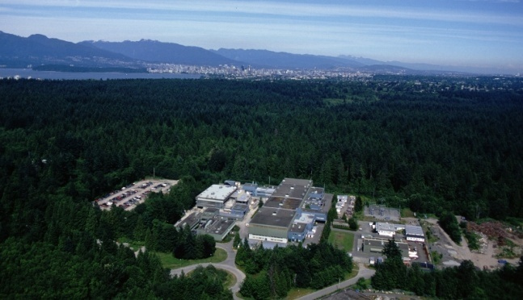



CANADA’S NATIONAL LABORATORY FOR PARTICLE AND NUCLEAR PHYSICS
Owned and operated as a joint venture by a consortium of Canadian universities via a contribution through the National Research Council Canada
In-trap decay spectroscopy for 2νββ decay experiments
T. Brunner, S. Ettenauer, C. Andreoiu, D. Frekers, A. Lapierre, R. Krücken, I. Tanihata and J. Dilling
for the TITAN collaboration
Outline:
Motivation: Neutrinoless double beta decay
EC-BR setup at TITAN
Status and first experimental results
LABORATOIRE NATIONAL CANADIEN POUR LA RECHERCHE EN PHYSIQUE NUCLÉAIRE ET EN PHYSIQUE DES PARTICULES
Propriété d’un consortium d’universités canadiennes, géré en co-entreprise à partir d’une contribution administrée par le Conseil national de recherches Canada

Slide 2
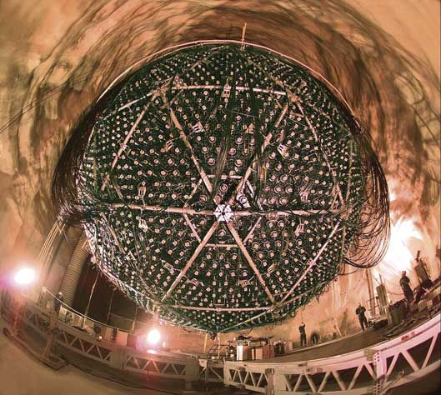
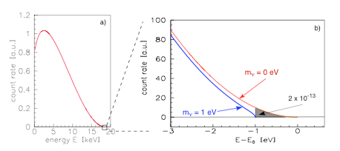
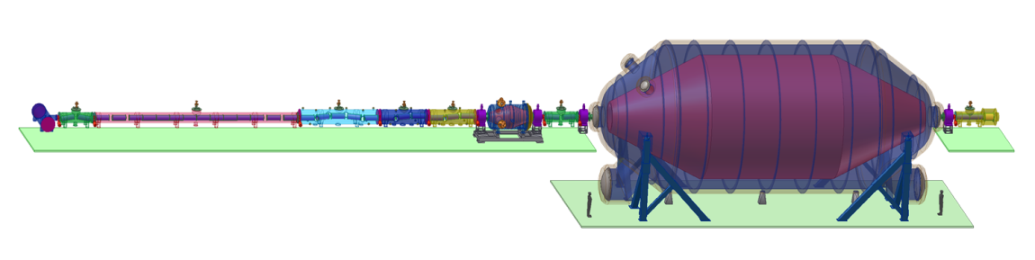
Neutrino experiments
Neutrino oscillation
Tritium decay
KATRIN, picture taken from http://students.washington.edu
SNO, picture taken from http://www.oit.on.ca
Relative mass scale
Absolute mass scale
Indicate a neutrino mass [1]
Determination of mixing angle θ_{ij}
Indicate mass hierarchy
Determination of δm²
Endpoint energy of ³H decay
Effective mass for degenerated neutrinos:
[1] T. Kajita and Y. Totsuka, Rev. Mod. Phys. 73(2001)85

Slide 3
Double β decay and m_{ν}
Some ββ decay experiments
GERDA, CUORE, CUORICINO, COBRA, MOON, EXO
Standard model
New physics
2ν double β - decay
0ν double β - decay
Lepton number violation
Half life> 1.9x10 ²⁵ years [1] (⁷⁶Ge)!!!
If observed:
Half life> 10 ¹⁷ years (⁷⁶Ge)
Dirac - Neutrino
Majorana - Neutrino
0ν and 2ν described in same theoretical framework, but different matrix elements
[1] C.E. Aalseth et al., Phys. Rev. D65(2002)092007
[2] S.R. Elliott and P. Vogel, Annu. Rev. Nucl. Part. Sci. 52(2002)115

Slide 4
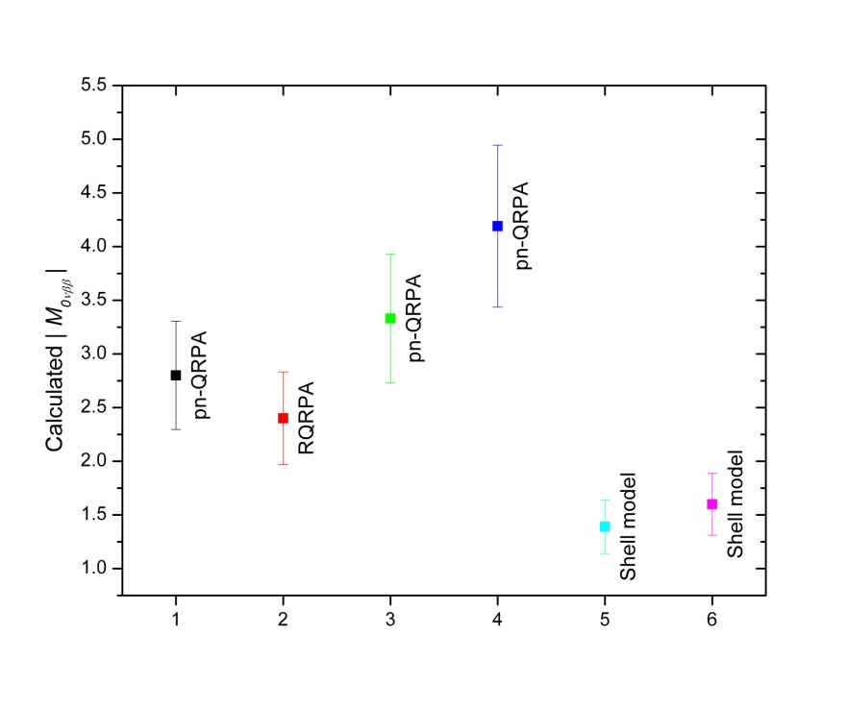
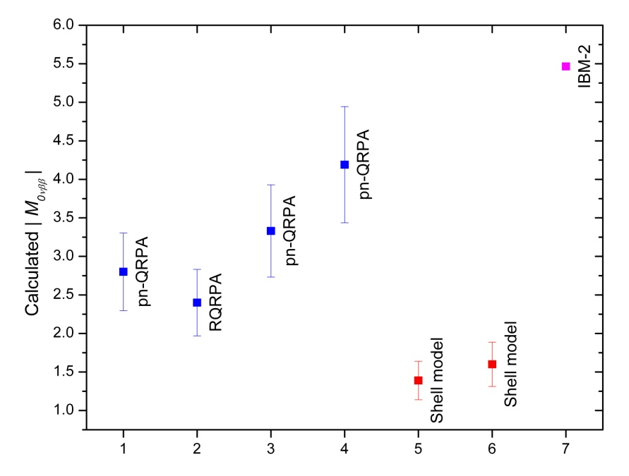
0νββ matrix element
Theoretical models to calculate M_{0ν}
Interacting Boson Model [3]
Nuclear Shell Model [4]
pn Quasiparticle Random Phase Approximation [5]
But…
M_{0ν} needed with an uncertainty of less than 20% [6]
Calculated M_{0ν} vary by a factor 2-5
[3] J. Barea and F. Iachello, Phys. Rev. C 79(2009)044301
[4] E. Caurrier et al., Nucl. Phys. A 654(1999)973c
[5] V. Rodin et al., Phys. Rev. C 68(2003)044302
[6] V.M. Gehman and S.R. Elliott, J. Phys. G 34(2007)667
M_{0ν} ⁷⁶Ge
Measure M_{2νββ} to benchmark theory
[6] and ref. therein

Slide 5
Theoretical benchmark
Single-State Dominance hypothesis
Transition via lowest 1⁺ state in intermediate nucleus accounts for entire M_{2ν}
D. Fang et al., Rhys. Rev. C 81(2010)037303
Knowledge of EC and β⁻ BR can be used to benchmark the theoretical framework of ββ decays
S.K.L. Sjue et al., Phys. Rev. C 78(2008)064317
But:
Difficult measurement due to a small EC branch and difficult X-ray signatures
High background due to dominating beta decay and possible bremsstrahlung
Isobaric contamination

Slide 6
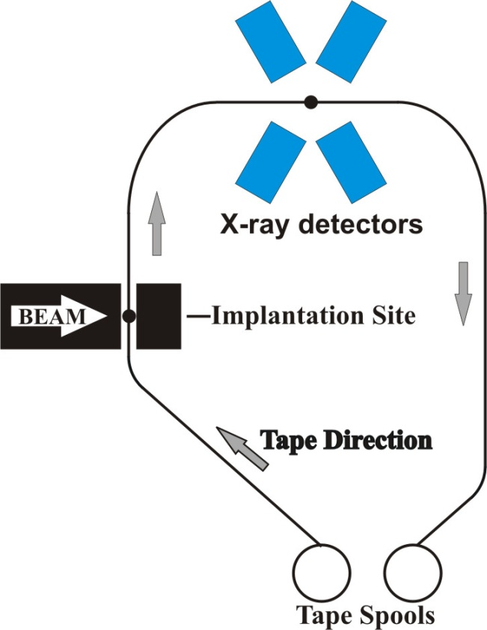
EC-BR measurements
Traditional method: tape station & observe X-rays after EC
Drawbacks:
Contaminations
Intense β background
X-ray absorption in the backing material
Recent development:
Contamination free due to ion trap
Implantation into hole in scintillator (veto 90% of β events)
Novel approach proposed:
EC-BR measurement of ions stored in a Penning trap at TITAN
remedy to all drawbacks in TITAN setup at TRIUMF
S. K. L. Sjue et al., Phys. Rev. C 78, 064317 (2008)
J. Dilling et al., Can. J. Phys. 85, 57 (2007)

Slide 7
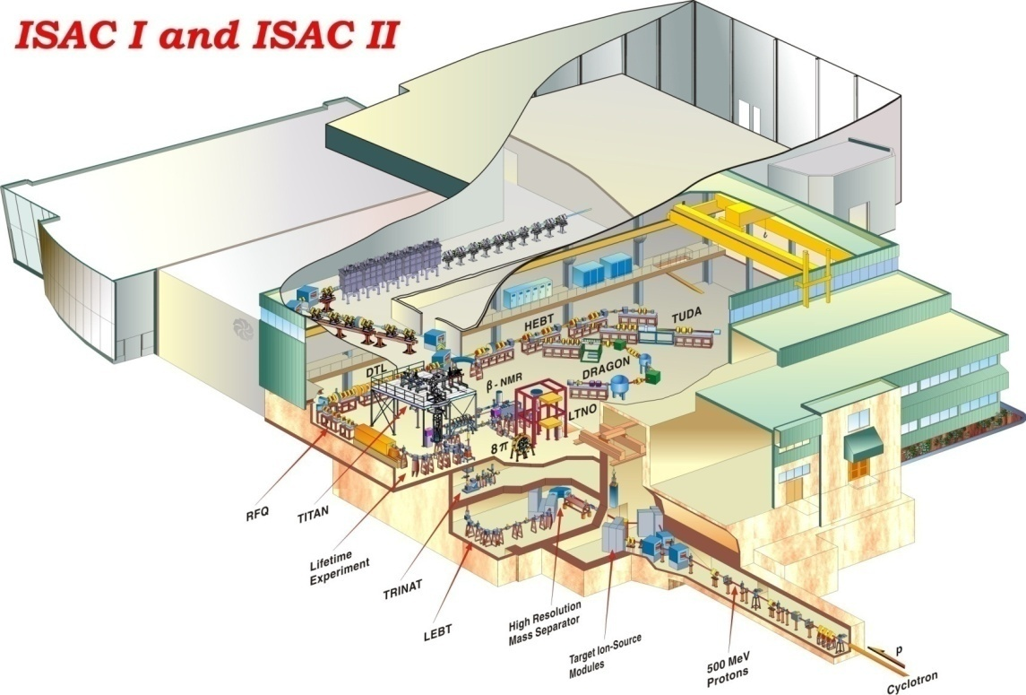
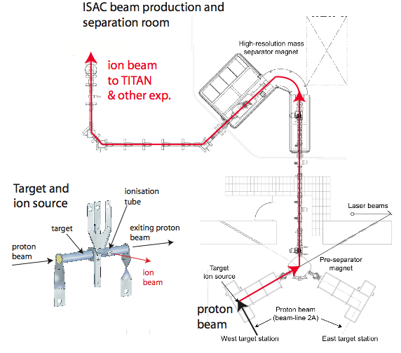
ISAC
TITAN
protons
DC protons with 100 μA @ 500 MeV from cyclotron
Protons hit thick target, unstable nuclei produced, diffuse, get ionized, extracted – ISOL type target
Contamination removed using mass separator (resolution: m/Δm = 3000)
Yields: ¹¹Li 5x10⁴/s, ⁷⁴Rb 2x10⁴/s, ⁶²Ga 2x10³/s

Slide 8
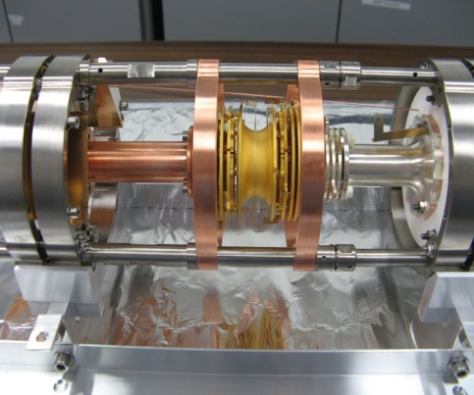
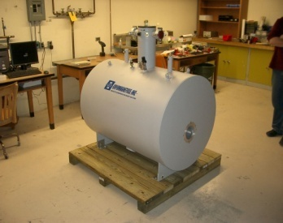
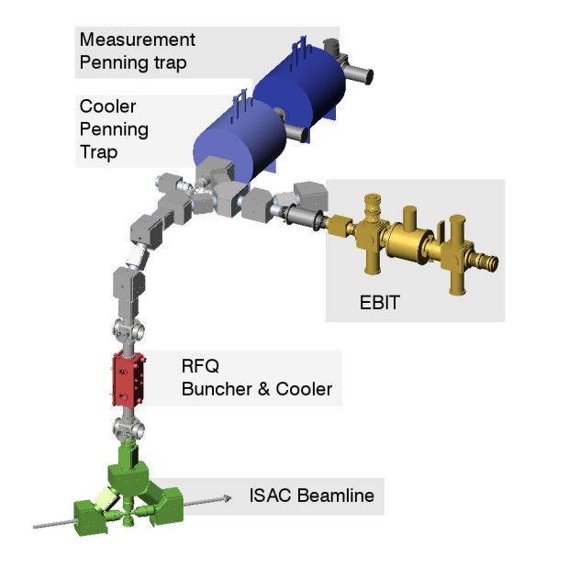
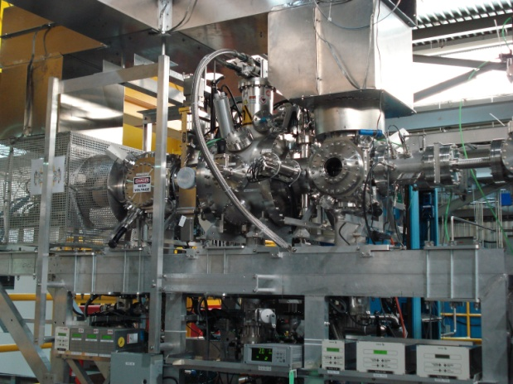
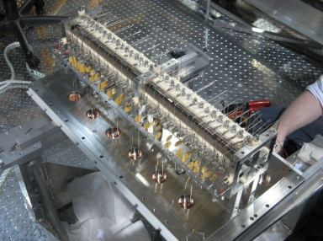
What is TITAN ?
TRIUMF’s Ion Trap for Atomic & Nuclear Science
A^{q+}
~2 kV • q
Under construction: Installation planned
for Dec. 2010
A⁺
~2 ke V
Decelerates beams
  TITAN composed of 3 ion traps (presently)
  Electron Beam Ion Trap (EBIT): Produces Highly Charged Ions and is used for in-trap decay spectroscopy
~20 - ~60 keV
A⁺
Radioactive isotopes from an ISOL facility (TRIUMF ISAC).

Slide 9
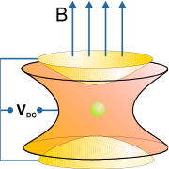
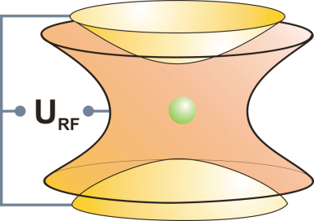
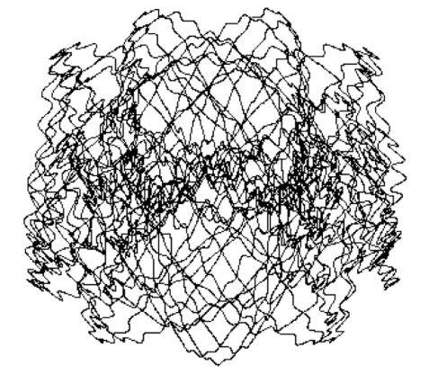
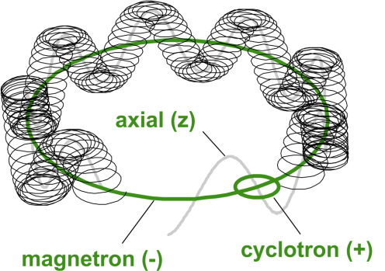
Basic Ion Trap Concepts
Basic ion trap concepts
Penning trap
Static electric quadrupole
and magnetic field
Paul trap
Oscillating electric quadrupole field
3D confinement
3 harmonic oscillations
Suited for precision experiments
micromotion + macromotion
Suited for manipulation techniques

Slide 10
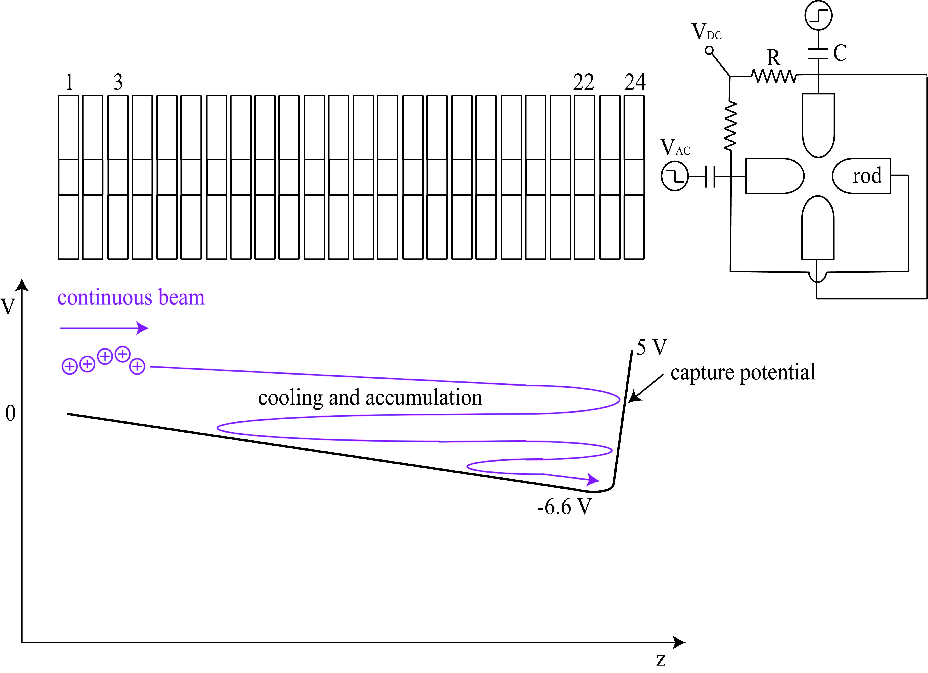
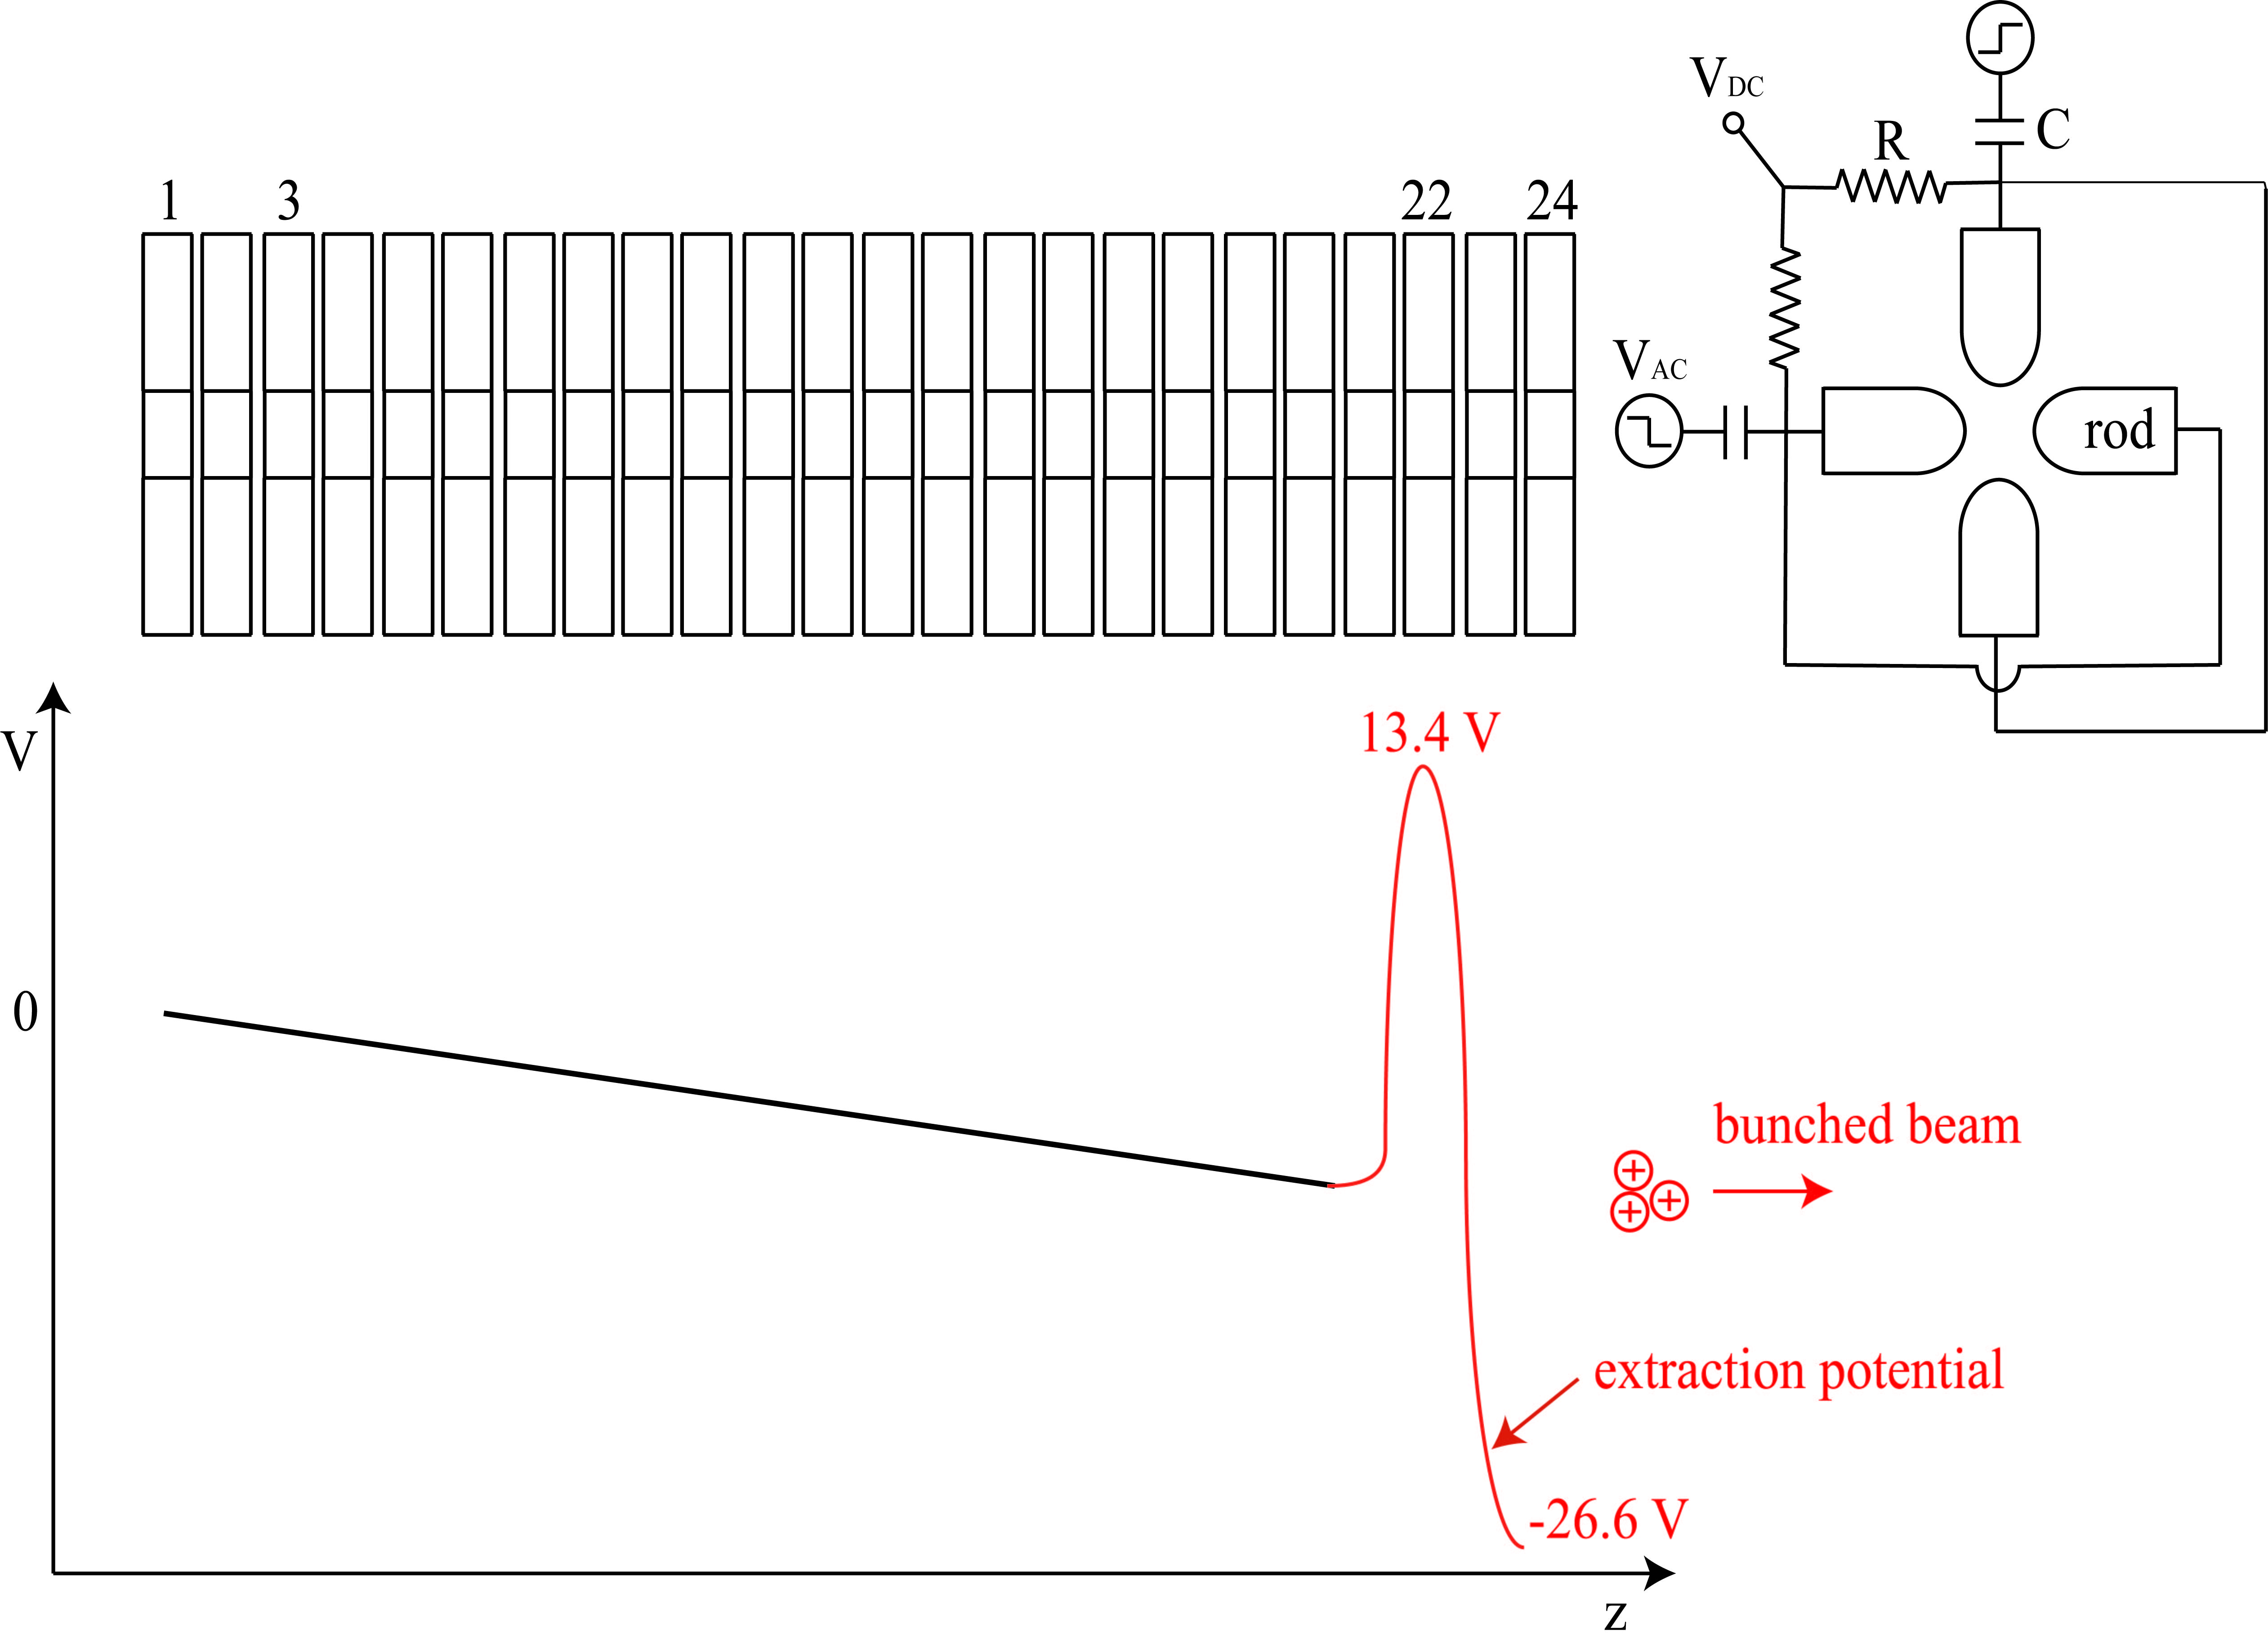
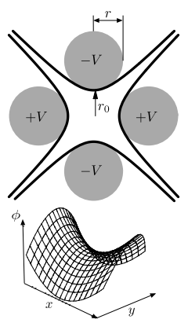
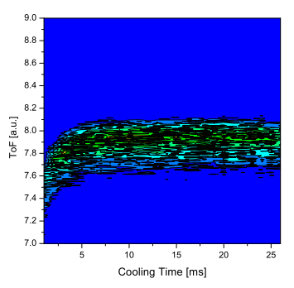
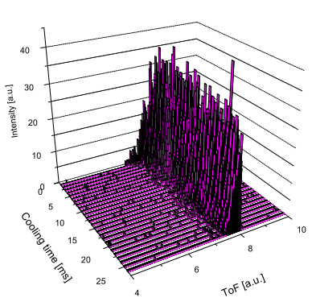

Linear Paul Trap
The TITAN RFQ
ISAC
beam
10 mm
Necessary ingredients
Decelerate and bunch ISAC’s beam
200 kHz to 1 MHz RF along the electrodes
Axial DC gradient
Buffer gas cooling
DC efficiencies:
  80% for ¹³³Cs⁺ in He
  60% for ⁶Li⁺ in H₂
ToF distribution of ¹³³ Cs for different cooling times

Slide 11
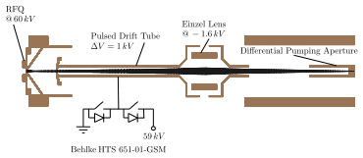
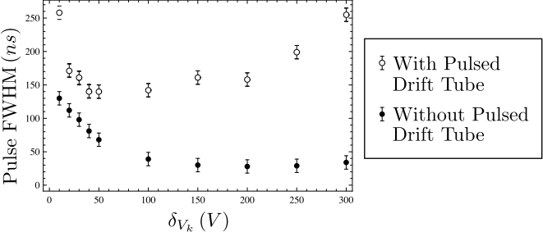
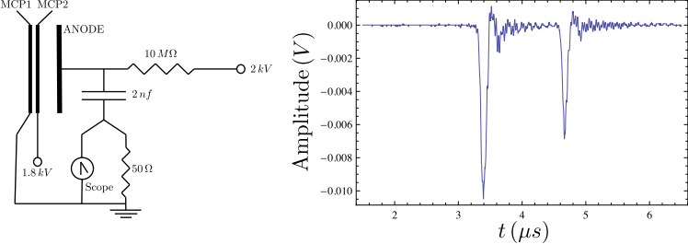
Pulsed Drift Tube
Defines beam energy
Switches ions to GND potential
RFQ 20 kV
PDT
18 kV
Ion elevator
V
GND
Pulse width for different extraction voltages
⁶Li and ⁷Li extracted onto a MCP

Slide 12
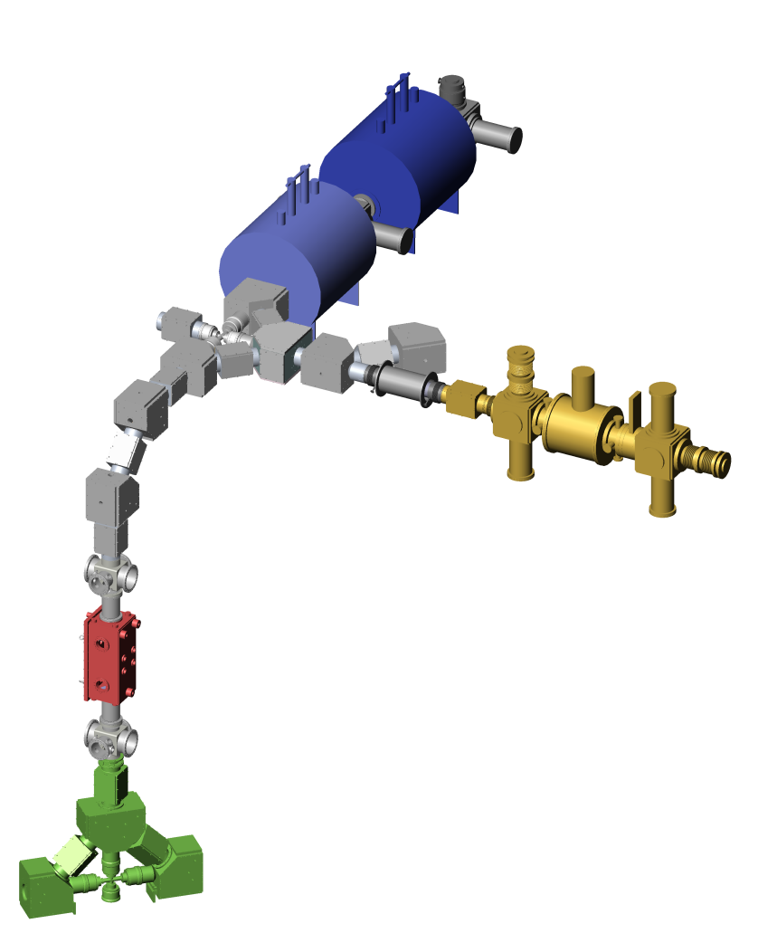
TITAN-EC technique
Use TITAN facility at ISAC
make use of the open access Penning trap EBIT (no e-beam)
Spatially separate X-ray and β detection
Electron Beam Ion Trap (EBIT) in Penning trap mode for EC-BR measurement
→ e-gun retracted and replaced by β detector
Electron Beam Ion Trap (EBIT) in Penning trap mode for EC-BR measurement
Penning trap
A^{q+}
Helmholtz
coils
A⁺
β detector
Short-lived isotopes from an Isotope
Separator and Accelerator (ISAC)
X-ray
detector
A⁺
Notes:
12

Slide 13
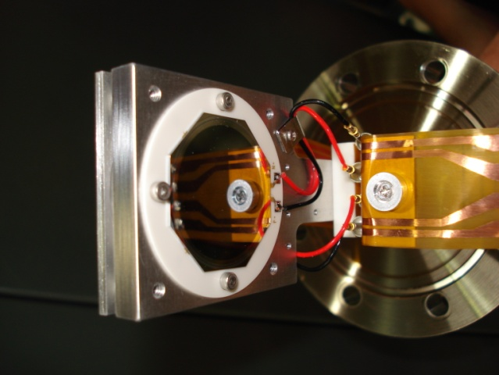

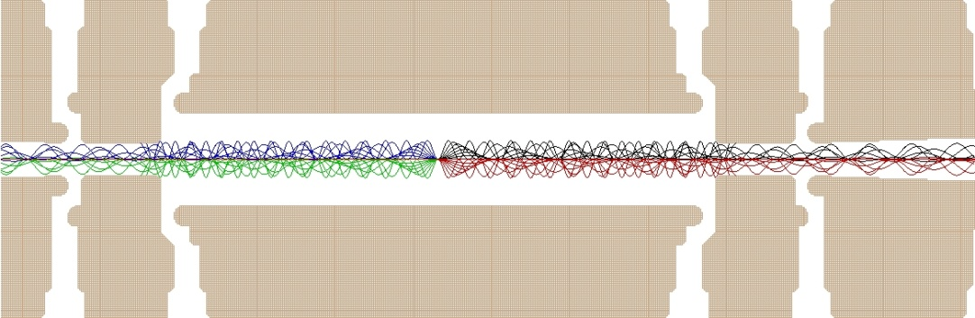
TITAN-EC technique
Silicon detector for β-decay measurements
X-ray detector
X-ray detector
Novel method:
Backing free
Isobaric sample
Spatial separation of β⁻ and X-ray detection
γ
B_{max} ~ 3T
6 T magnet
Ion injection
Beta detector
(PIPS)
Ø5 mm
β
5 kV
4.7 kV
5 kV
A⁺
Trap electrodes
Penning trap
A⁺
Storage and
detection
Penning trap
10⁵ ions injected
High efficient trapping

Slide 14
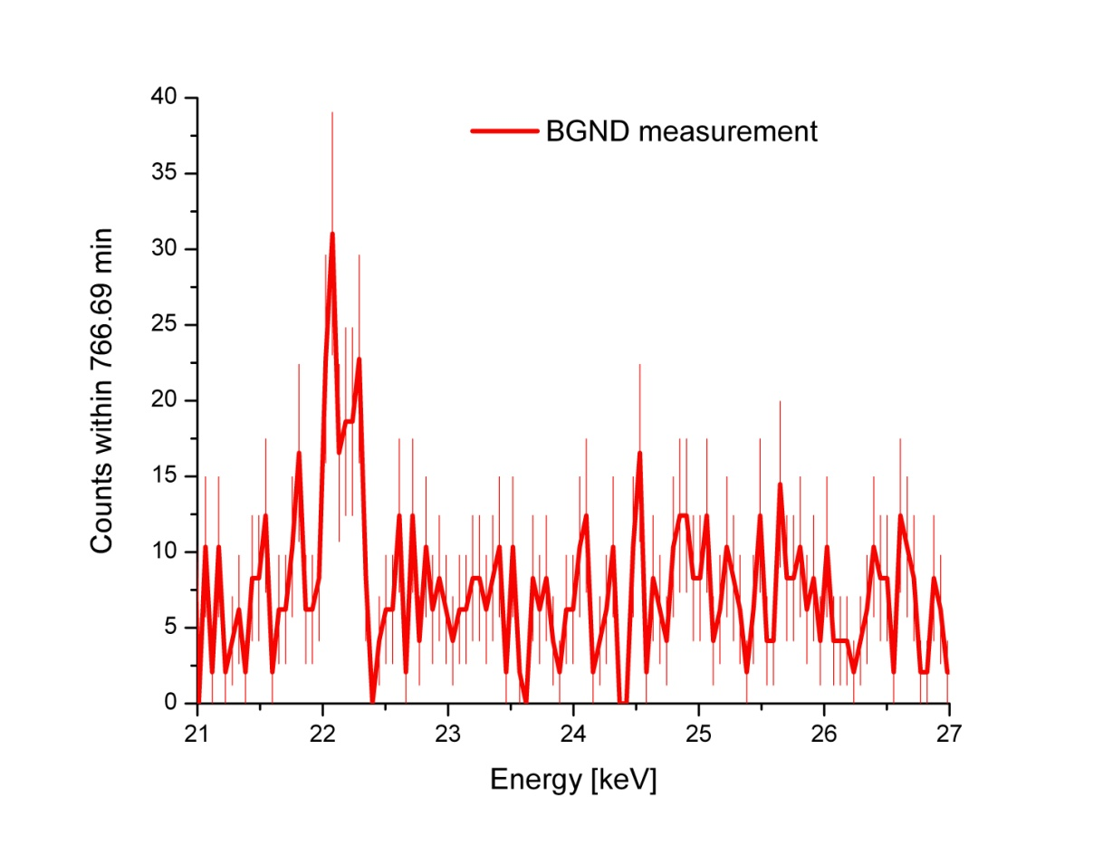
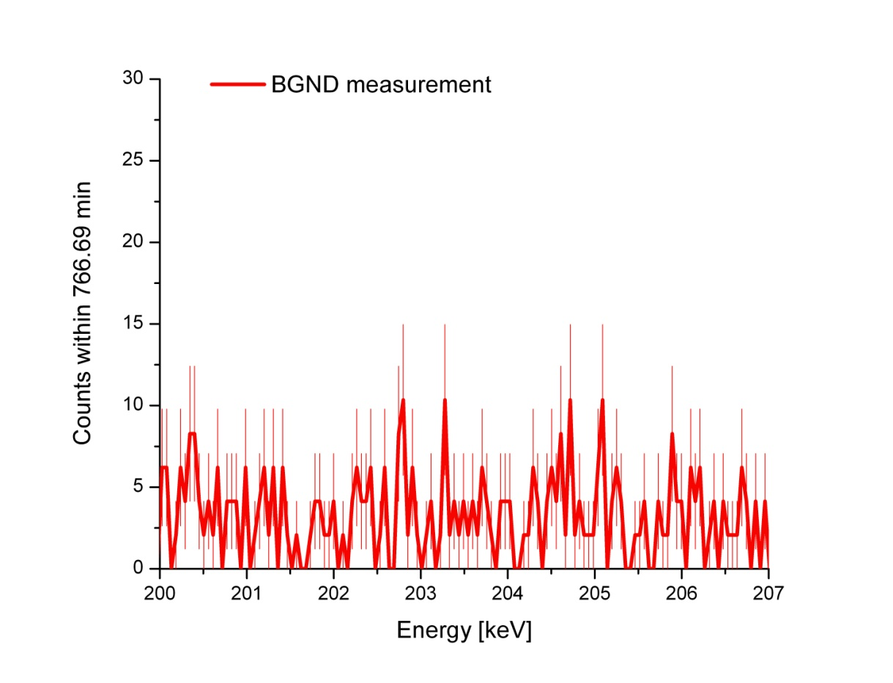
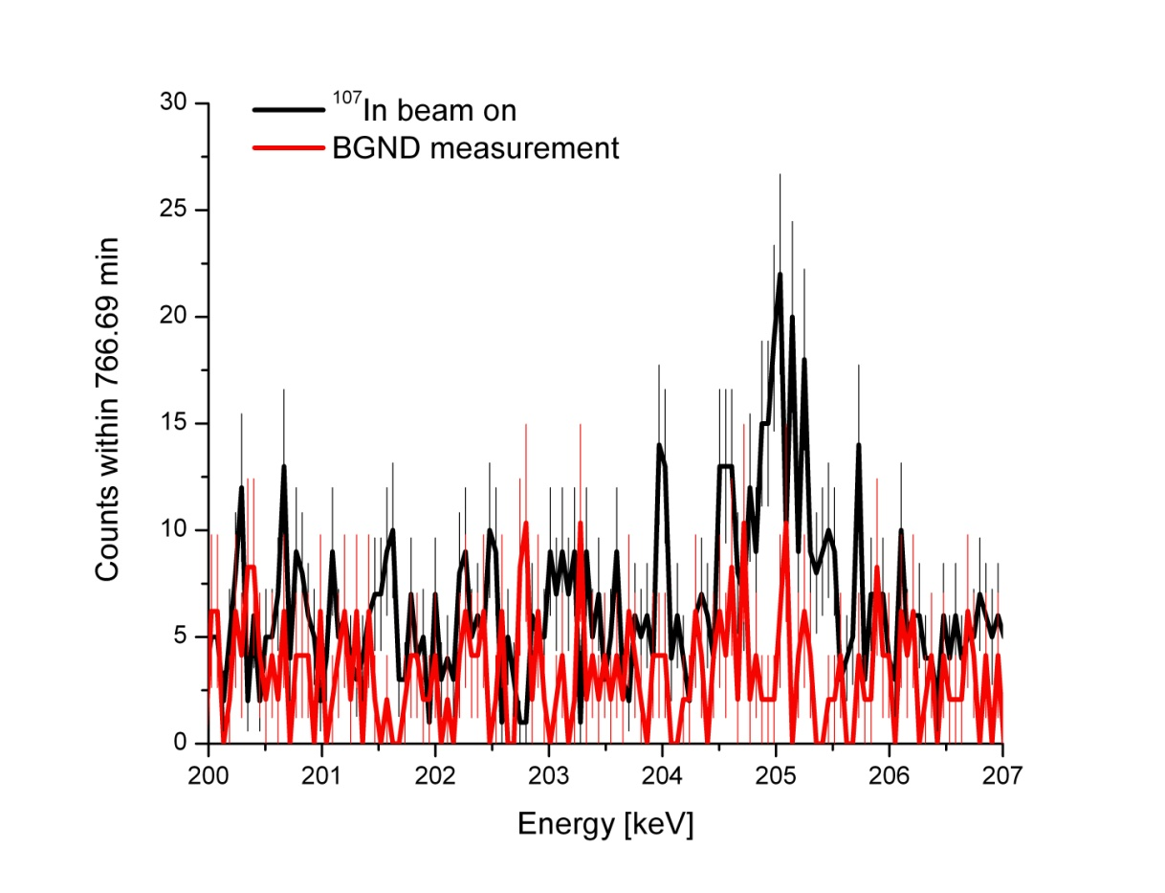
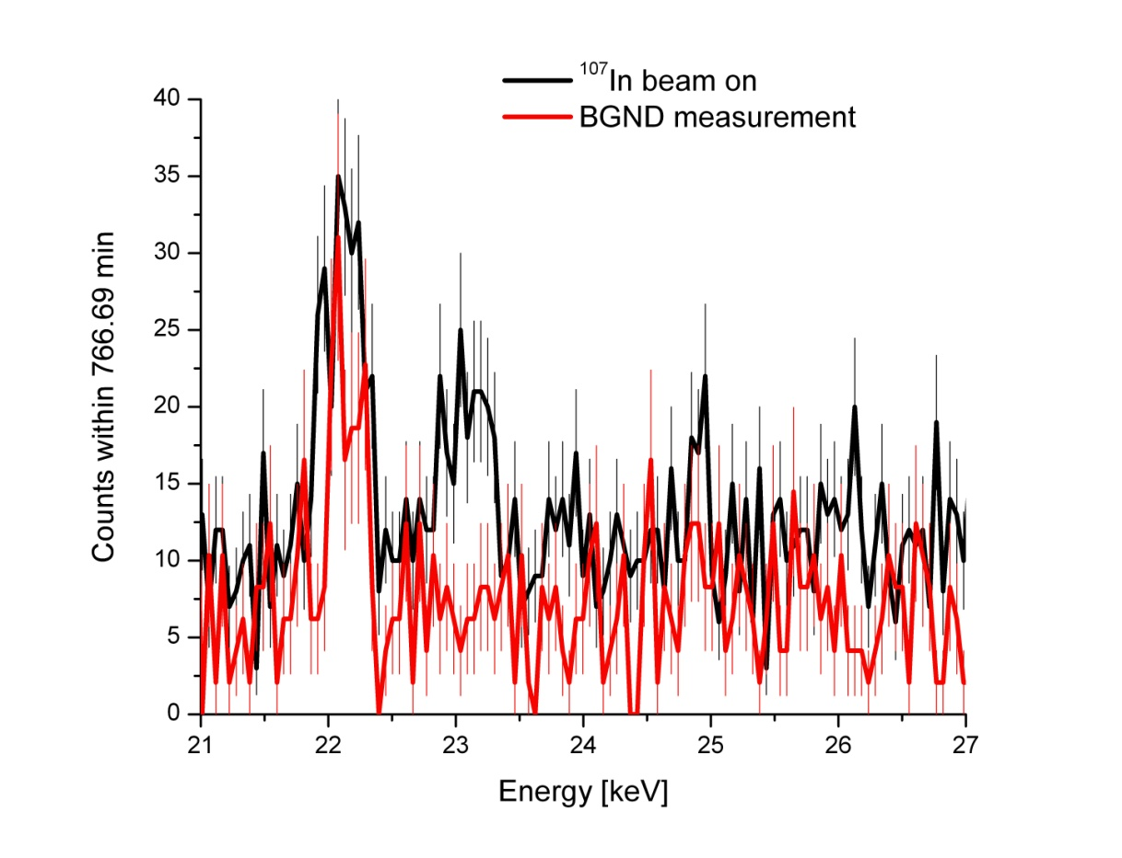
¹⁰⁷In EC signature
¹⁰⁷In
t_{1/2}= 32.4 min
¹⁰⁷In has a strong EC branch and comparable
half live of 32.4 min
EC ~ 63.9%
¹⁰⁷Cd
t_{1/2}= 6.5 h
Signature ¹⁰⁷Cd decay
EC ~ 99.8%
Signature ¹⁰⁷In decay
¹⁰⁷Ag
Goals of the beam time
Shoot through EBIT
Identify ¹⁰⁷In after EBIT
Store radioactive ions in trap
Observe X-rays following an EC
Identify X-rays from EC
Observe electrons from β decays
Signature ¹⁰⁷In decay
√
√
√
√
√
X
First observation of an EC in a Penning trap
BR(EC) = 55 (20) %
S. Ettenauer et al., AIP Conf. Proc. 1182(2009)100
Only one detector
0.02% solid angle!

Slide 15
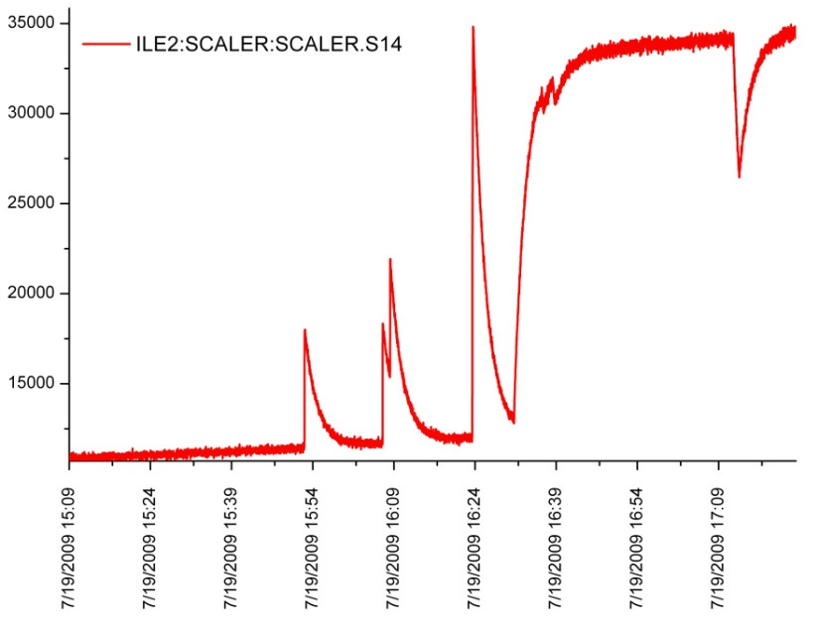
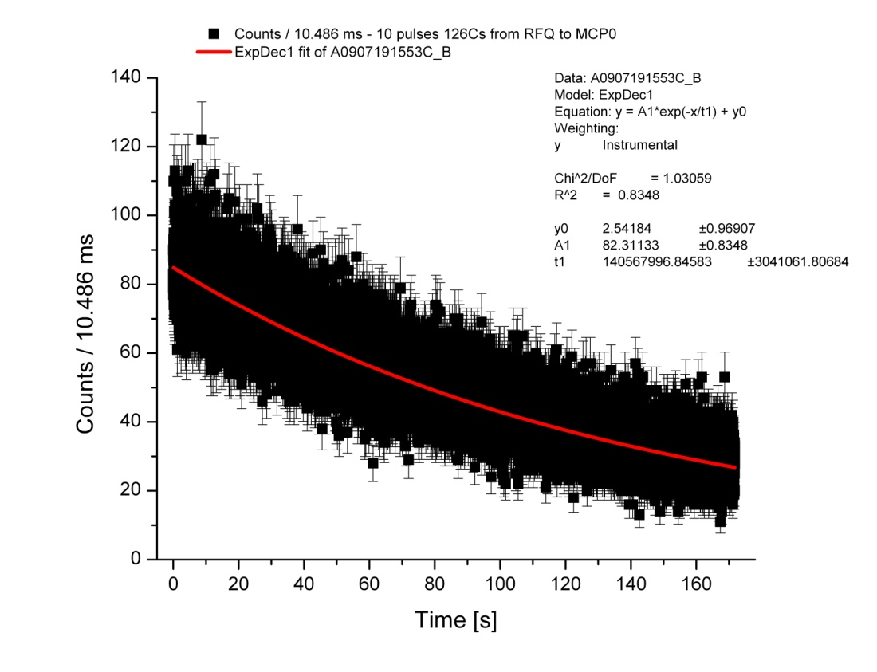
# ions/shot & half life of ¹²⁶Cs
Monitoring PIPS (Passivated Implanted Planar Silicon)
Half life data obtained with a MCS
Al foil
6 hrs beam off before first 10 pulses ¹²⁶Cs
t_{½} = 97.4 ± 2.1 s (fit) (lit: 98.4 ± 1.2s) for first 10 shots (1st spike)
Beam intensity ≈ 3 * 10⁵ ions/RFQ extraction pulse @ 10 Hz
BUT:
Half life increases for the following t_{½} measurements
→ Contamination built up on PIPS detector (~30% ¹²⁶Ba contamination)
EBIT
RFQ

Slide 16
Systematic studies with ^{124, 126}Cs
¹²⁴Cs t_{½} = (30.8 ± 0.5) s
¹²⁶Cs t_{½} = (98.4 ± 1.2) s
Injection of Cs (~1ms)
Monitoring PIPS
V
z
Storage of Cs (25ms)
Observation of decays
LeGe detector
X-ray detection
Ejection of Cs (1ms)
The trap is kept open to empty completely
PIPS
β detection
Empty trap (25ms)
Background measurement
RFQ
Ge detector
X/γ-ray detection

Slide 17
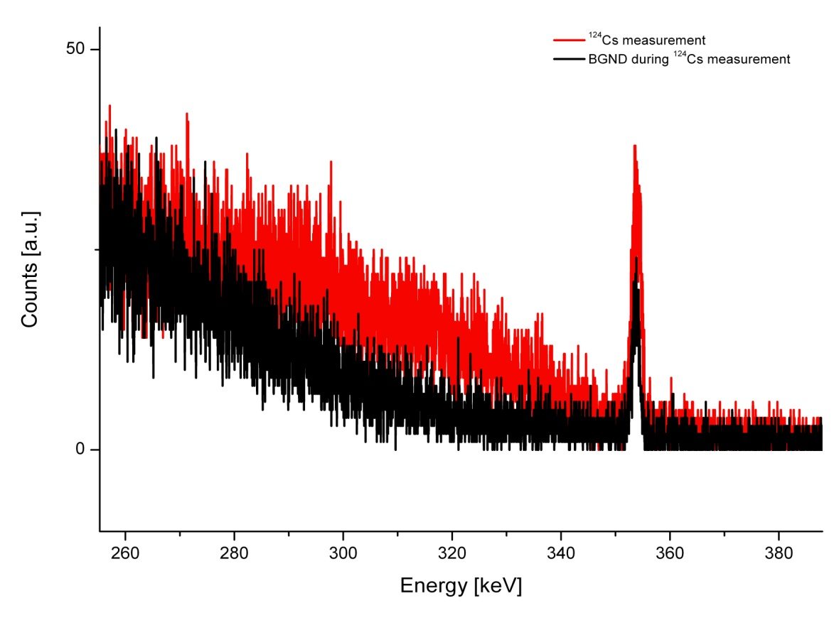
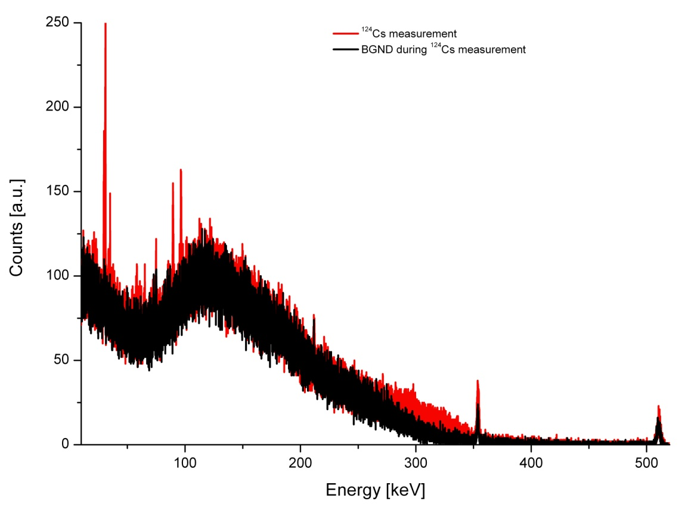
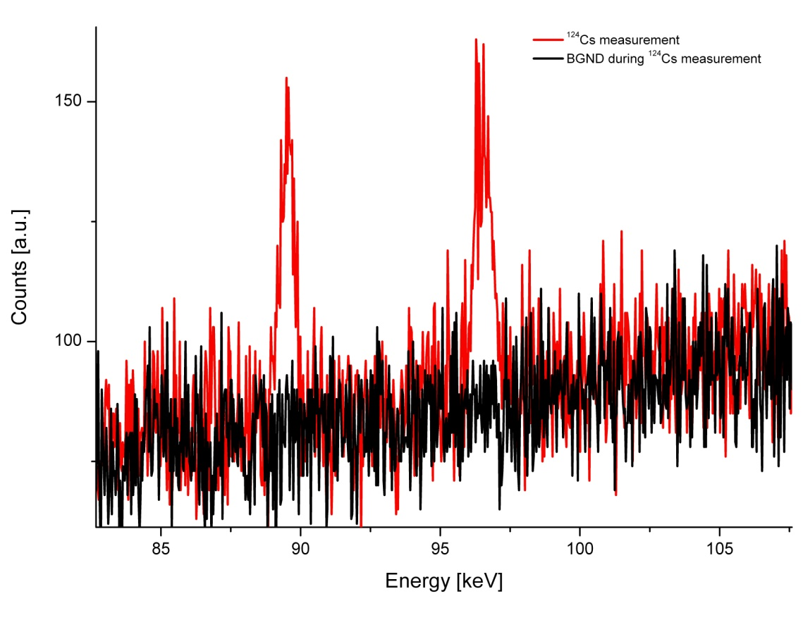
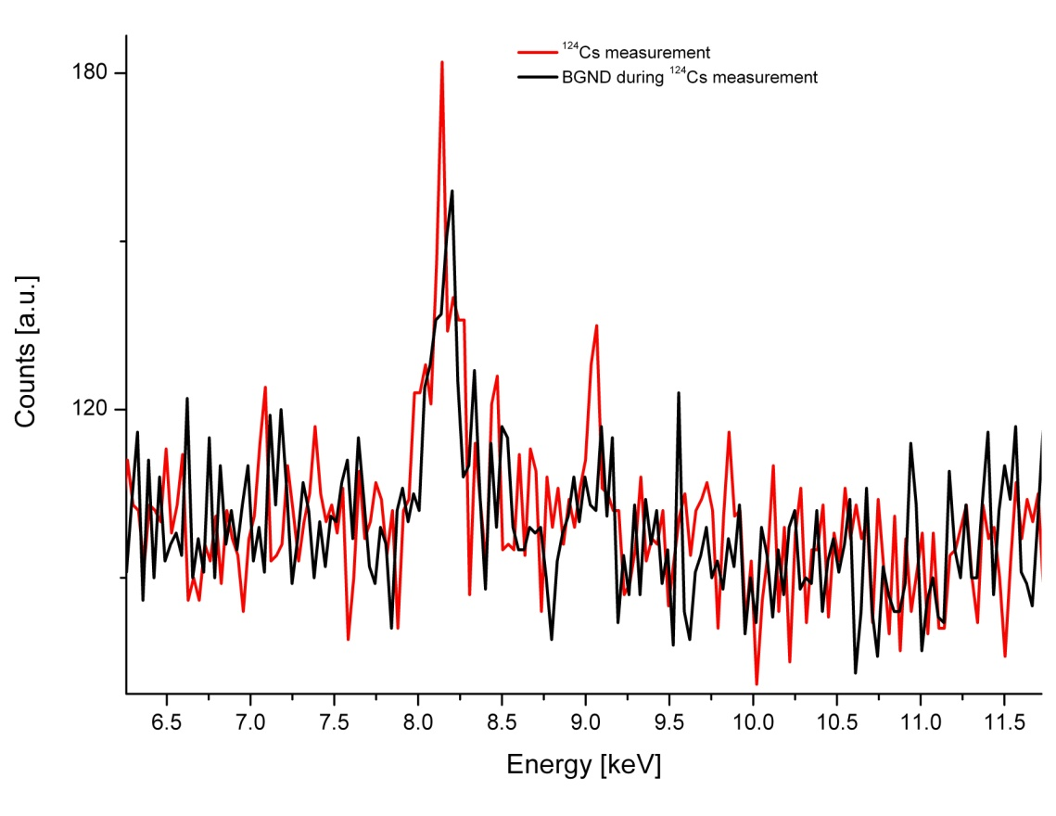
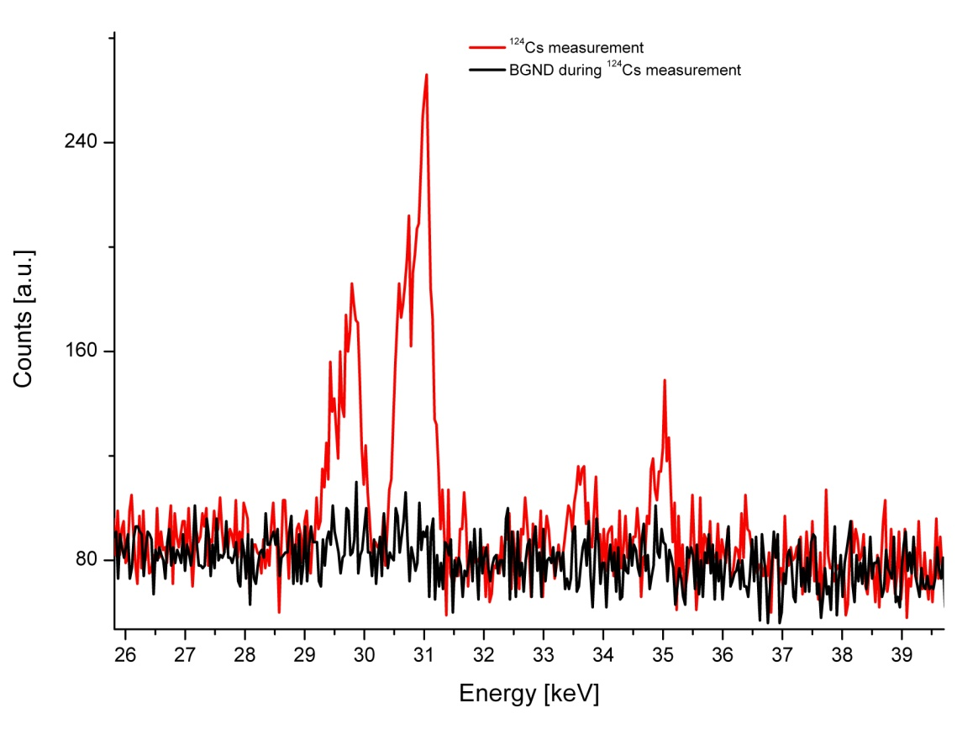
Observation of ¹²⁴Cs EC X-rays
¹²⁴Ba (11.0 min)
Xe X-ray
K lines
354 keV
¹²⁴Cs signature
EC
^{124m}Cs (6.3 s)
Cu K_{α} line
89.5 keV &
96.6keV
¹²⁴Cs isomer
Cs X-ray lines
¹²⁴Cs (30.8 s)
EC
¹²⁴Xe
LeGe detector
X-ray detection
~ 0.1% ε_{geo}
~ 2.5 T B field at detector position
Xe X-ray lines: due to ¹²⁴Cs EC
Cs X-ray lines: probably dominant due to ¹²⁴Ba contamination and decay of ^{124m}Cs
RFQ
Ge detector
X/γ-ray detection
PIPS
Passivated Implanted Planar Silicon
β detection

Slide 18
γ – β⁺ time correlation
Ge detector
~ 0.15% ε_{geo}
Outside vacuum vessel
PIPS detector
Si detector (500μm)
on magentic field axis
at exit of Penning trap
511 keV
491 keV
¹²⁶Cs
Monitoring
PIPS
388 keV
¹²⁶Cs
γ spectrum in coincidence with β⁺ event
LeGe detector
X-ray detection
PIPS spectrum in coincidence with γ event
First time:
β⁺ spectrum from ¹²⁶Cs ions stored inside the trap
PIPS
β detection
RFQ
Ge detector
X/γ-ray detection

Slide 19
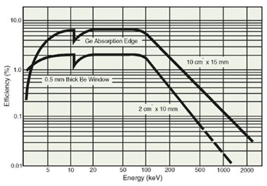
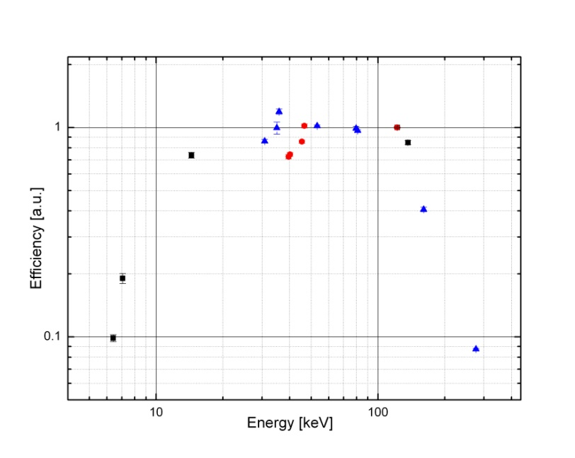
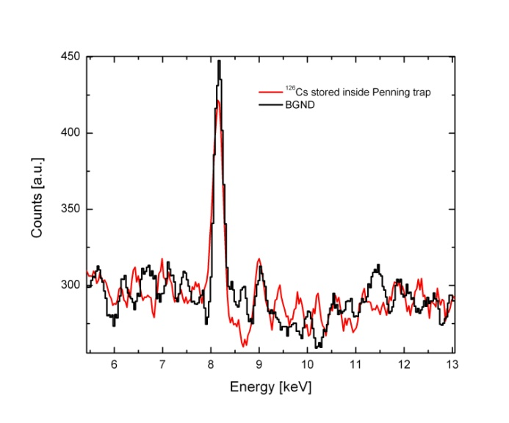
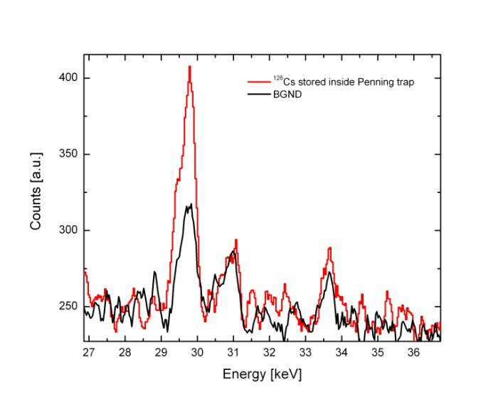
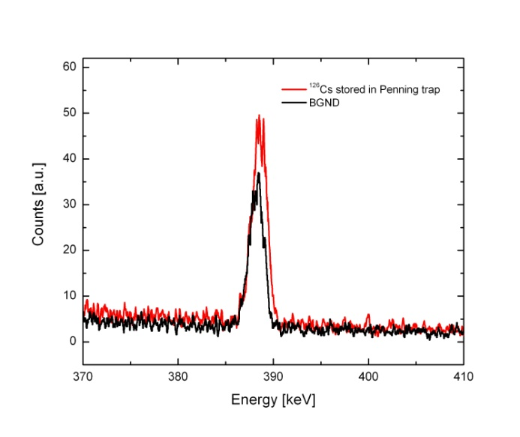
Data analysis
LeGe Calibration spectra
Fit ¹²⁴Cs run: peaks for ions stored and BGND
Fit ¹²⁶Cs run: peaks for ions stored and BGND
Determine BGND contribution to spectra of ions stored
Determine ECBR of ^{124, 126}Cs
EC
¹²⁶Ba
EC
¹²⁶Cs
EC
¹²⁶Cs
Preliminary
388.66 keV

Slide 20
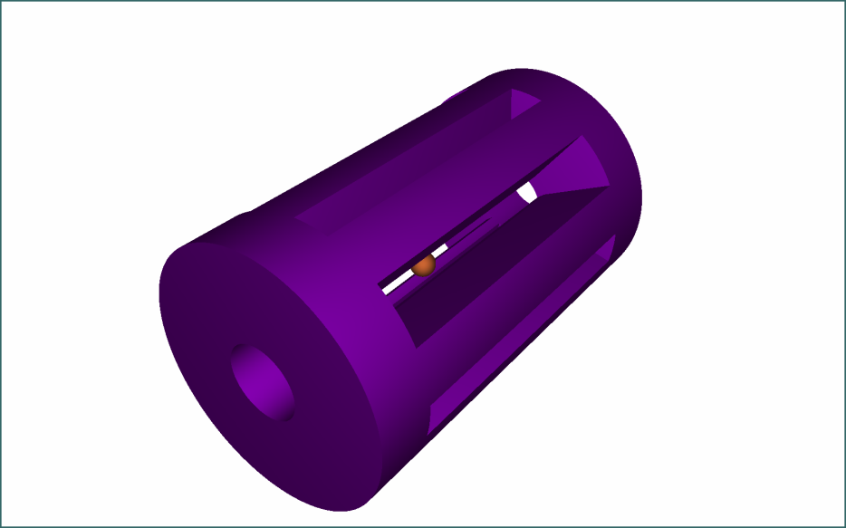
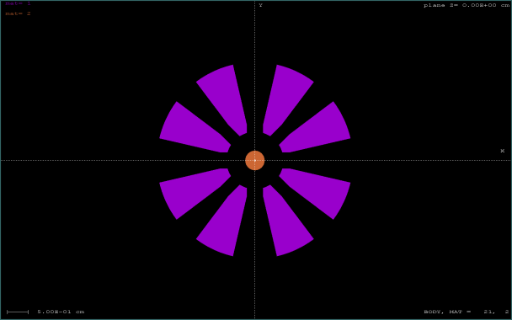
Data analysis
LeGe Calibration spectra
Fit ¹²⁴Cs run: peaks for ions stored and BGND
Fit ¹²⁶Cs run: peaks for ions stored and BGND
Determine BGND contribution to spectra of ions stored
Determine ECBR of ^{124, 126}Cs
Simulate γ spectrum for ion losses inside the trap
Penelope 2008
Trap center

Slide 21

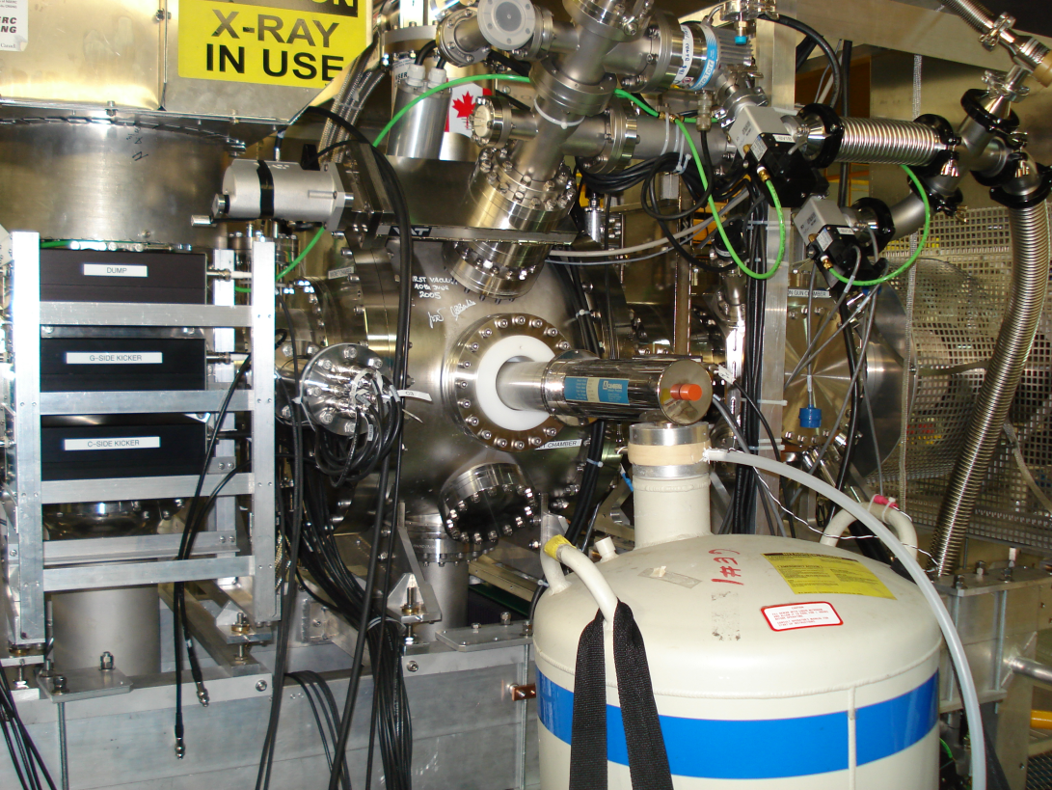
¹⁰⁰Tc - ToDo
Design, machine and install mounting structure for X-ray detectors
Design, order and install Be windows (seven Be windows)
Modify frame of EBIT to allow installation of X-ray detectors
Oder power supplies for X-ray detectors
Optimize cycle and B-field
Setup DAQ
Calibrate detectors

Slide 22

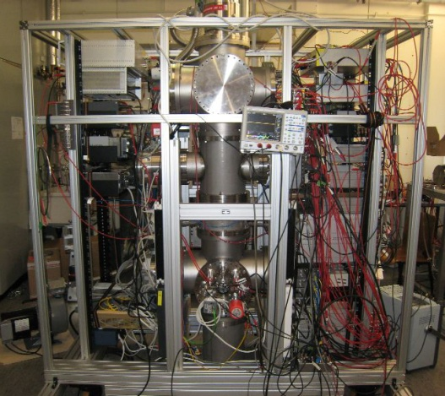
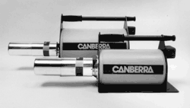
For the future
Install Giessen MR-TOF-MS for sample purification
Get ready for beam time with ¹⁰⁰Tc end of 2010
¹⁰⁰Tc measurement cycle with
25 ms background / 2 ms transfer
50 ms decay spectroscopy
2.1% EC detection efficiency
→ 1.28 detected EC in 1 h
→ 100 EC after 78 h
→ 94 h of beam time with 20% overhead
Seven Si(Li) have been ordered January 2010

Slide 23
Summary
2νββ nuclear matrix elements needed for theoretical framework
EC-BR measurement as benchmark experiment for theoretical description
TITAN EBIT offers a novel approach for EC-BR measurements
  Backing free method
  Low background at X-ray detector – spatial separation of β and X-ray detection
  Isobaric sample
Successful storage of radioactive ions (long storage times: P < 10⁻¹¹ mbar)
First observation of an Electron Capture decay in a Penning trap

Slide 24












People/Collaborations
M. Brodeur, T. Brunner, J. Dilling, P. Delheij, S. Ettenauer, A. Gallant, M. Good, E. Mane, M. Pearson, V. Simon…
… and the TITAN collaboration
as well as A. Lapierre, D. Lunney, R. Ringle, V. Ryjkov, M. Smith and TRIUMF staff.
U. of Manitoba
McGill U.
Muenster U.
MPI-K
GANIL
Colorado School of Mines
U. of Calgary
U. of Windsor
SFU
UBC
TU München
Yale

Slide 25
Backup slides

Slide 26
The Trap
Superconducting
coils (Nb₃Sn) @ ~4 K
Thermal shield @ ~30 K
Electron gun
Trap config. of various lengths
77 mm
TITAN-EBIT special feature
272 mm
8-fold segmented central drift tube:
  Clean ion contaminants with RF field.
  Study the trap content by Ion Cyclotron Resonance.
9 cylindrical
drift tubes
Be windows
7 access viewports for spectroscopy
Notes:
One of the major components of the TITAN facility is the EBIT:

Slide 27

Retractable Electron Gun
The e-gun can be replaced by detectors.
Silicon detector for β or α-decay measurements
Ion beam
image
Ion beam
Ion beam image from a mirror
MCP w/ phosphor screen to have an image injected beams with a CCD camera.
Li-ion beam
Radius: ~1.5mm
MCP w/ phosphor screen placed between the trap & electron gun for alignment of singly charged ion beams (injection).
Back view
Front view

Slide 28


Storage time
< 10 % ion losses after 25 ms storage
³⁹K @ 4T
³⁹K @ 4T

Slide 29


Isotope Production
Targets:
Si, Ta, W, …
Residual
proton beam
500-MeV proton beam
Exotic isotopes
A>170 under development
Some heavy masses may be produced presently from test actinide targets (e.g., UO_{x}).
Proton
target ass’y
Beam extraction at 20 kV – 60 kV
A<170
Notes:
29
ISAC stands for Isotope Sepearot and Accelerator
Short-lived isotopes produced at ISAC are produced by a methode called In-flight separation where…
This method can yield isotopes far from the valley of stability of nuclear mass of less then about 120.

Slide 30


¹³³Cs Transmission
DC transmission
AC transmission
Preliminary
50V RFDC @ 250 kHz → q = 0.29
80V RFDC @ 350 kHz → q = 0.24
200V RFDC @ 850 kHz→ q = 0.10
315 Vpp at 600 kHz
(80 ± 5)% DC transmission
Maximum transmission at ∼35 x 10⁻³ mbar
0.2 nA at Faraday cup
Stable ion motion for different frequency to RF voltage ratios

Slide 31
For the future
Analyze Cs beam time data
Install Giessen MR-TOF-MS for sample purification
Get ready for beam time with ¹⁰⁰Tc end of 2010
¹⁰⁰Tc measurement cycle with
25 ms background / 2 ms transfer
50 ms decay spectroscopy
2.1% EC detection efficiency
→ 1.28 detected EC in 1 h
→ 100 EC after 78 h
→ 94 h of beam time with 20% overhead
CANDIDATES FOR BRANCHING RATIO MEASUREMENTS
¹⁰⁰Mo : | ¹⁰⁰Tc (EC) | [1+→ 0+, T1/2 = 15.8 s] | K_{α} = 17.5 keV
¹¹⁰Pd : | ¹¹⁰Ag (EC) | [1+→ 0+, T1/2 = 24.6 s] | K_{α} = 21.2 keV
¹¹⁴Cd : | ¹¹⁴In (EC) | [1+→ 0+, T1/2 = 71.9 s] | K_{α} = 25.3 keV
¹¹⁶Cd : | ¹¹⁶In (EC) | [1+→ 0+, T1/2 = 14.1 s] | K_{α} = 25.3 keV
⁸²Se : | ^{82m}Br (EC) | [2-→ 0+, T1/2 = 6.1 min] | K_{α} = 11.2 keV
¹²⁸Te : | ¹²⁸I (EC) | [1+→ 0+, T1/2 = 25.0 min] | K_{α} = 27.5 keV
⁷⁶Ge : | ⁷⁶As (EC) | [2-→ 0+, T1/2 = 26.2 h] | K_{α} = 9.9 keV
Seven Si(Li) have been ordered January 2010

Slide 32
¹⁰⁰Tc production rate
LaC₂ target with 50μA p beam
Ta target with 70μA p beam
Thanks to
Marik Dombsky

Slide 33


ECBR Measurements
CANDIDATES FOR BRANCHING RATIO MEASUREMENTS
¹⁰⁰Mo : | ¹⁰⁰Tc (EC) | [1+→ 0+, T1/2 = 15.8 s] | K_{α} = 17.5 keV
¹¹⁰Pd : | ¹¹⁰Ag (EC) | [1+→ 0+, T1/2 = 24.6 s] | K_{α} = 21.2 keV
¹¹⁴Cd : | ¹¹⁴In (EC) | [1+→ 0+, T1/2 = 71.9 s] | K_{α} = 25.3 keV
¹¹⁶Cd : | ¹¹⁶In (EC) | [1+→ 0+, T1/2 = 14.1 s] | K_{α} = 25.3 keV
⁸²Se : | ^{82m}Br (EC) | [2-→ 0+, T1/2 = 6.1 min] | K_{α} = 11.2 keV
¹²⁸Te : | ¹²⁸I (EC) | [1+→ 0+, T1/2 = 25.0 min] | K_{α} = 27.5 keV
⁷⁶Ge : | ⁷⁶As (EC) | [2-→ 0+, T1/2 = 26.2 h] | K_{α} = 9.9 keV
1+
15.8 s
¹⁰⁰Tc
Q_{EC} = 0.168
ε ≈ 0.0018%
Q_{β} = 3.202
¹⁰⁰Mo
β⁻β⁻
¹⁰⁰Ru
10⁵ ions in trap with one half-life measurement cycle:
solid angle: 2.1%
detection efficiency: 30%
5.7 x 10⁻³ EC counts/cycle
100 EC counts → 17636 EBIT fills → 74h
88h proposed for ¹⁰⁰Tc

Slide 34





Simulations
Ø5 mm
5 kV
4.7 kV
5 kV
Loss through magnetic bottle for θ > 79deg:
3 MeV electrons
B_{max} = 6T
25 mm
284 mm to center
3 MeV electrons hitting a 500μm Si waver
Loss through wall collisions
→ Rotating wall cooling or side-band cooling

