Slide 1
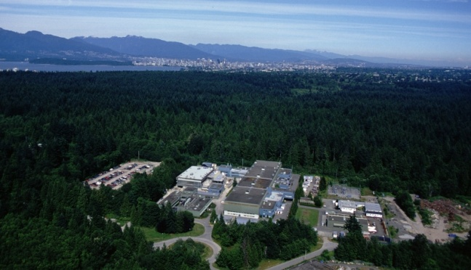


Fundamental physics with stored ions at TITAN
T. Brunner for the TITAN collaboration
Canada’s National Laboratory for Nuclear and Particle Physics,
Vancouver, British Columbia, Canada

Slide 2
Outline
Isotope production at TRIUMF
The TITAN facility
Ion trap techniques
Scientific program
  Mass measurements of halo nuclei
  Laser spectroscopy
  Electron capture branching ratio measurement
Outlook

Slide 3
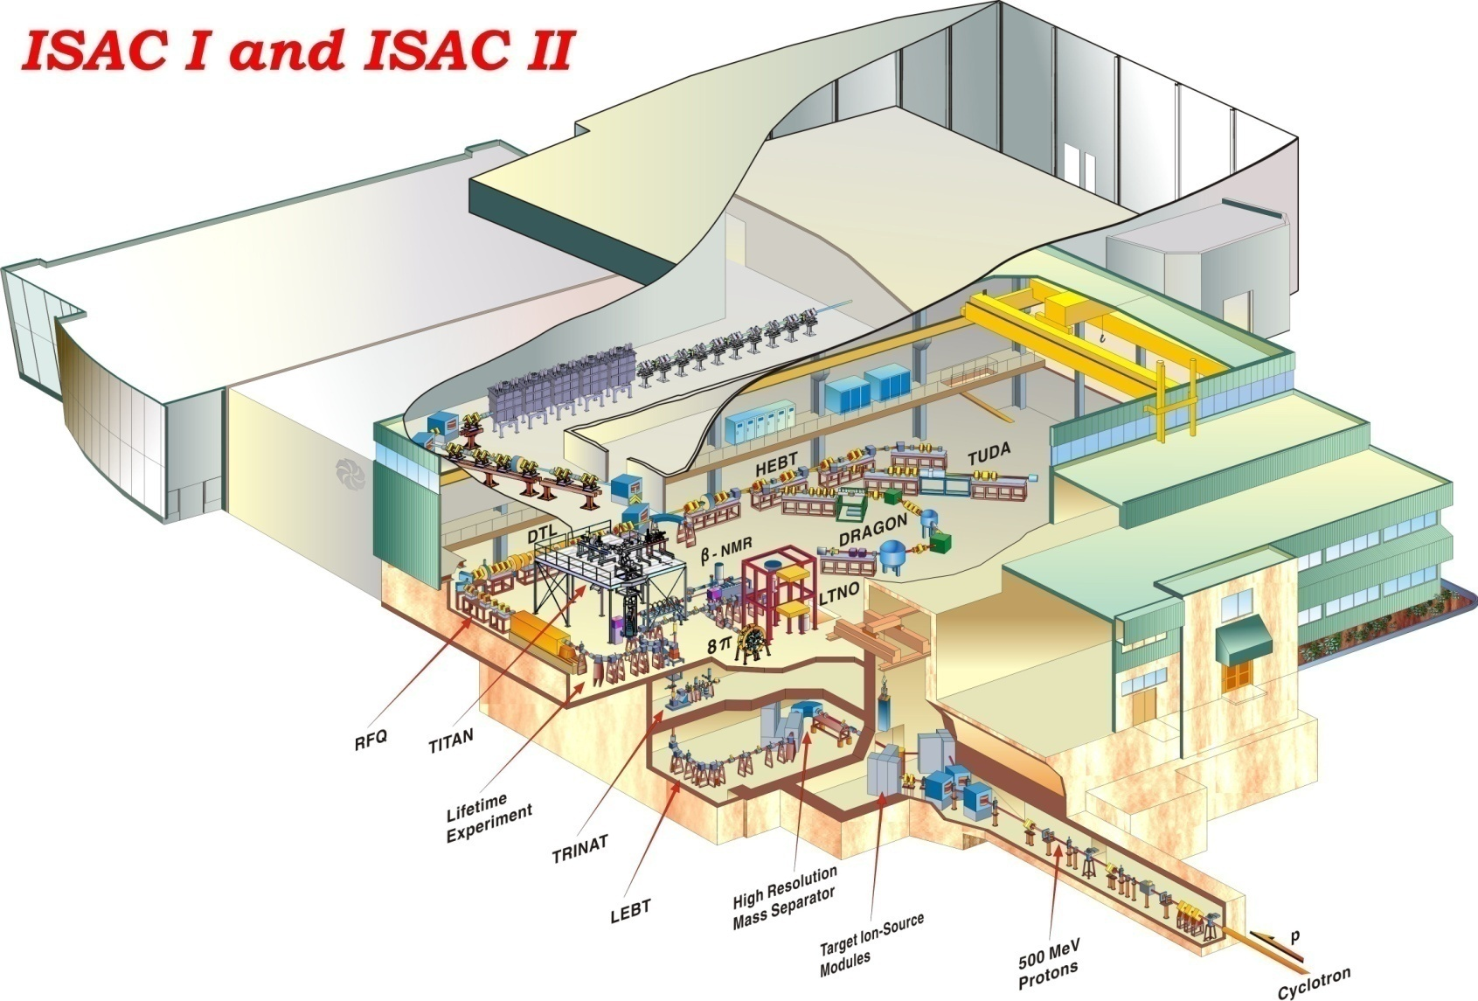
ISAC
ISAC:
Highest yields for on-line
facilities, we go up to 100μA@500MeV DC proton (50kW)
ISAC has 3 experimental areas:
Low energy (60keV)
ISAC I (cont. up 1.8 MeV/u)
ISAC II (up to 18 MeV/u)
Many experimental stations:
TRINAT, Beta-NMR, 8pi, tape-station, TITAN, Collinear laser spec, polarised beam line, etc
DRAGON, TUDA, TACTIC, GPS (Leuven)
TIGRESS, EMMA (2011), GPS (Maya)
TITAN
Yields: ¹¹Li 5x10⁴/s, ⁷⁴Rb 2x10⁴/s, ⁶²Ga 2x10³/s

Slide 4
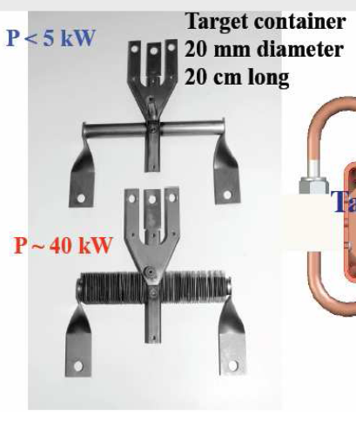
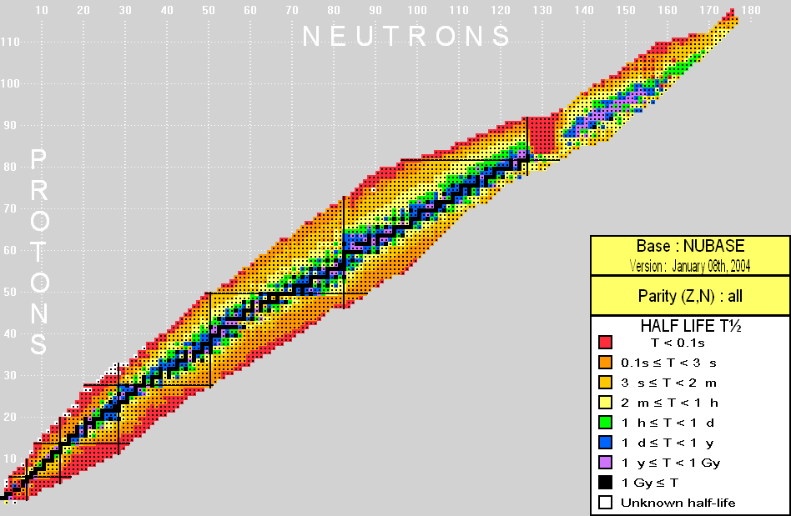
Radioactive Isotope Production
Targets:
Si, Ta, W, …
Residual
proton beam
500-MeV proton beam
Exotic isotopes
A>170 under development
Some heavy masses may be produced presently from test actinide targets (e.g., UO_{x}).
Proton
target ass’y
Beam extraction at 20 kV – 60 kV
A<170
Notes:
4
ISAC stands for Isotope Sepearot and Accelerator
Short-lived isotopes produced at ISAC are produced by a methode called In-flight separation where…
This method can yield isotopes far from the valley of stability of nuclear mass of less then about 120.

Slide 5
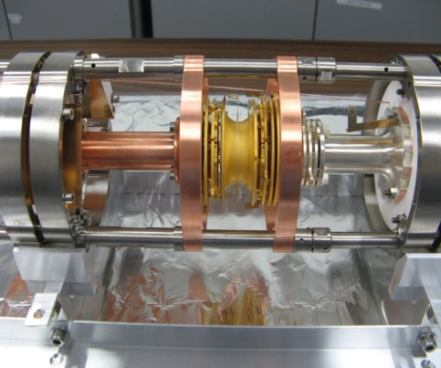
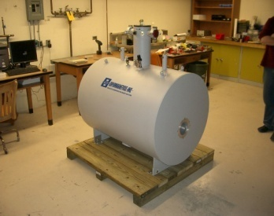
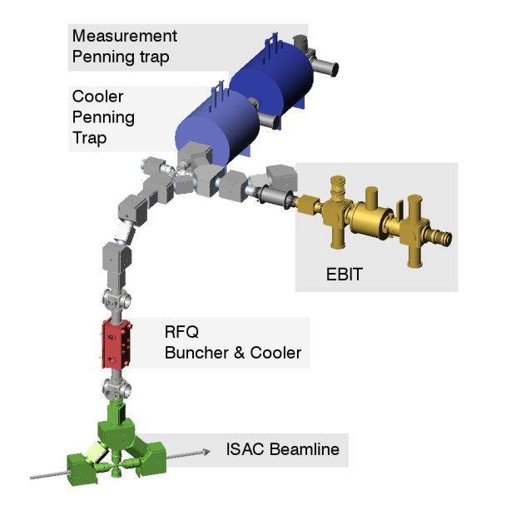
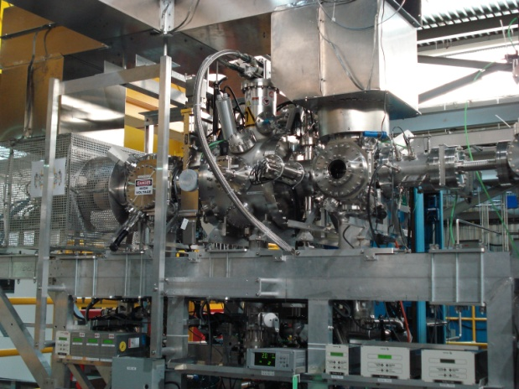
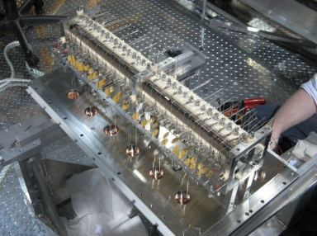
What is TITAN ?
TRIUMF’s Ion Trap for Atomic & Nuclear Physics
A^{q+}
~2 kV • q
Under construction: Installation planned
for Dec. 2010
A⁺
~2 ke V
Decelerates beams
  TITAN composed of 3 ion traps (presently)
  Electron Beam Ion Trap (EBIT): Produces Highly Charge Ions and is used for in-trap decay spectroscopy
~20 - ~60 keV
A⁺
Radioactive isotopes from an ISOL facility (TRIUMF ISAC).

Slide 6
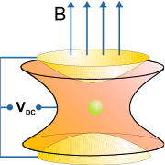
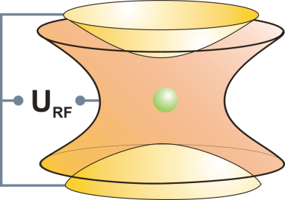
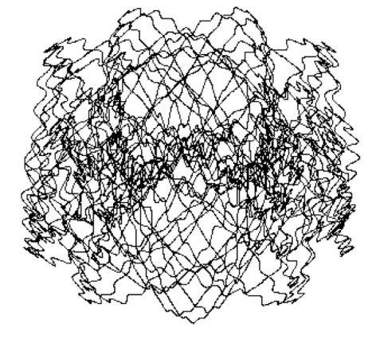
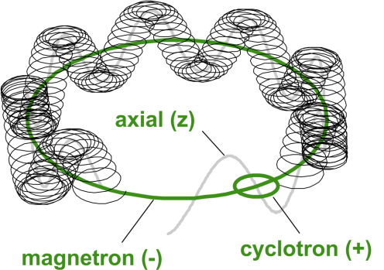
Basic Ion Trap Concepts
Basic ion trap concepts
Penning trap
Static electric quadrupole
and magnetic field
Paul trap
Oscillating electric quadrupole field
3D confinement
3 harmonic oscillations
Suited for precision experiments
micromotion + macromotion
Suited for manipulation techniques

Slide 7
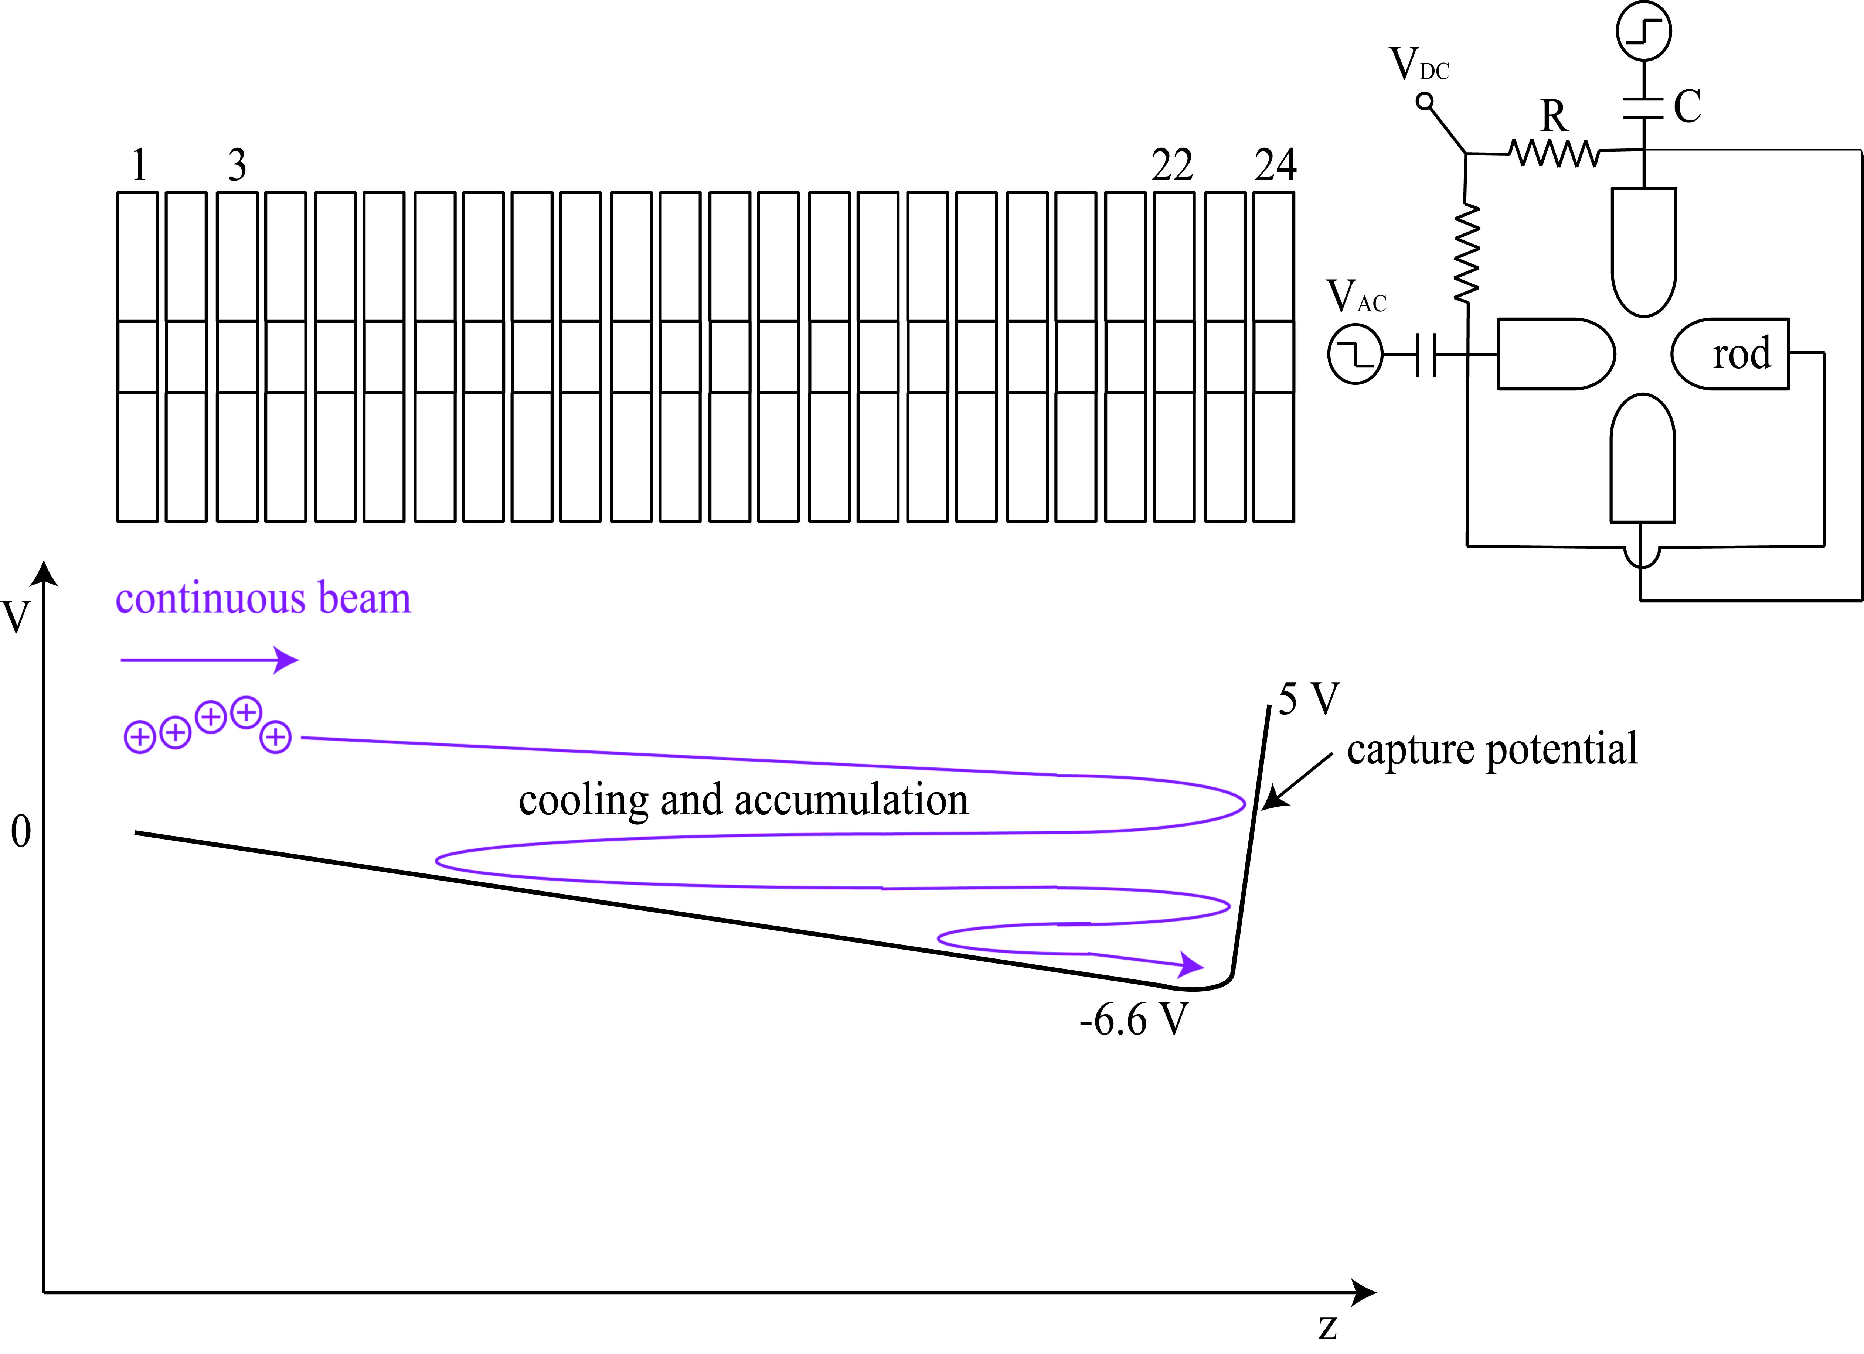
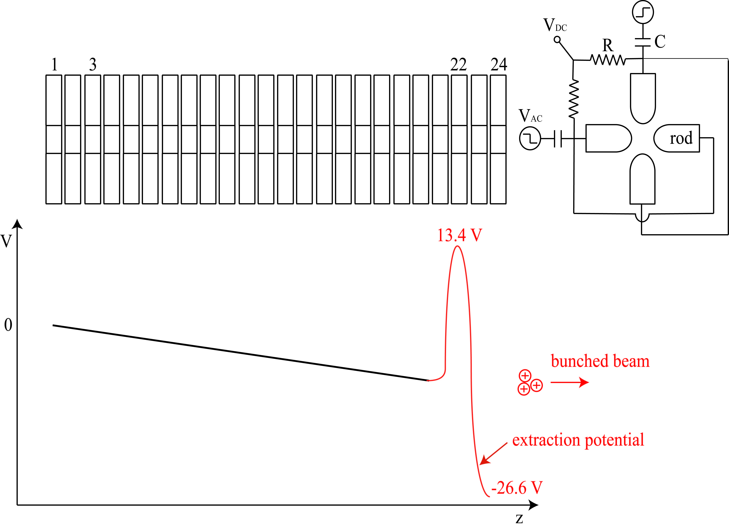
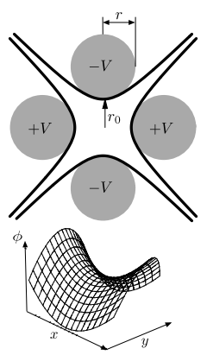
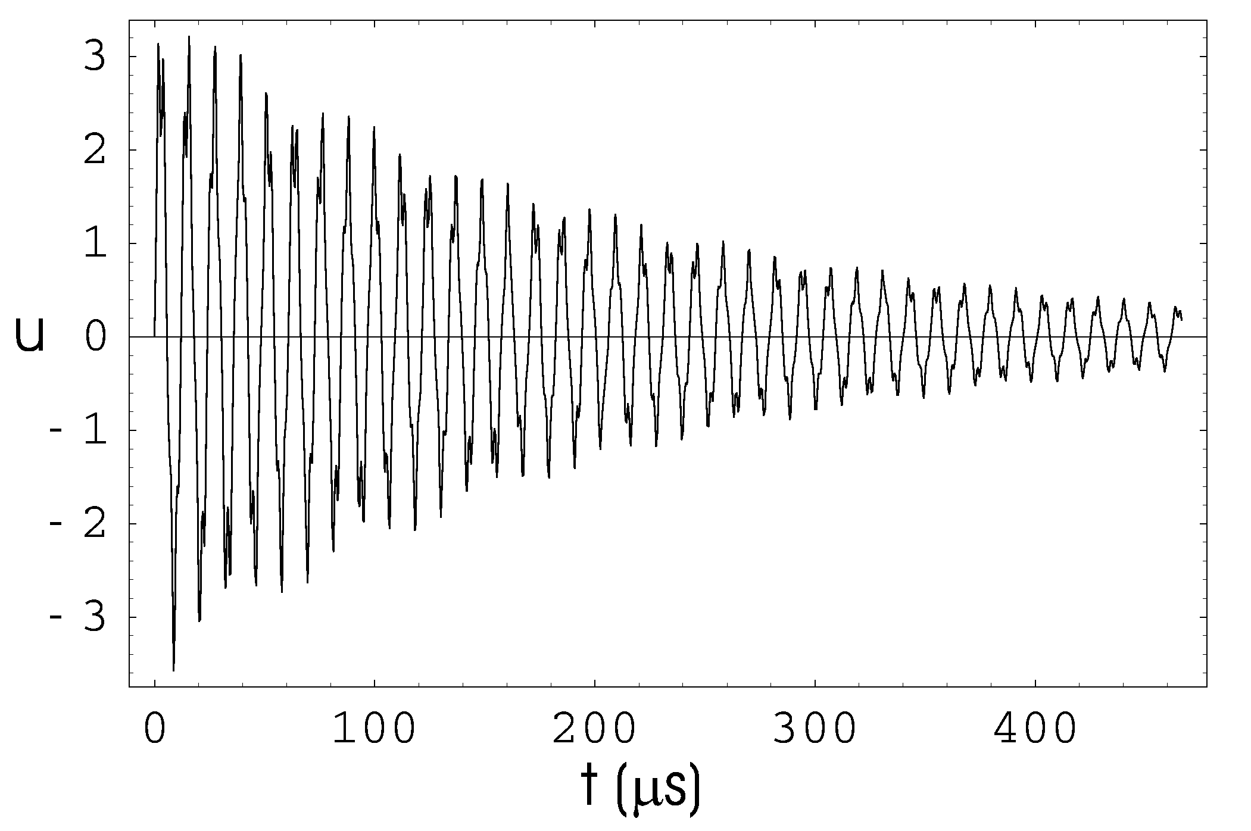
Linear Paul Trap
The TITAN RFQ
ISAC
beam
10 mm
Necessary ingredients
Decelerate and bunch ISAC’s beam
200 kHz to 1 MHz RF along the electrodes
Axial DC gradient
Buffer gas cooling
DC efficiencies:
  80% for ¹³³Cs⁺ in He
  60% for ⁶Li⁺ in H₂
(mm)
Radial trajectory of ¹³³Cs in 2.5 x 10⁻² mbar
Viscous drag model calculation

Slide 8
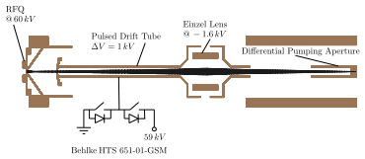
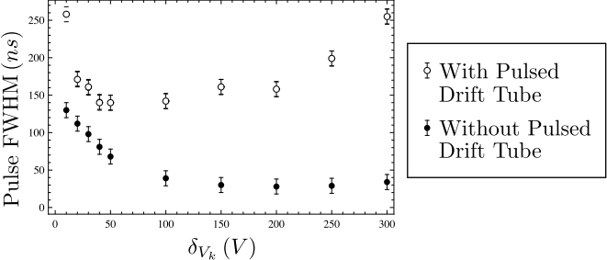
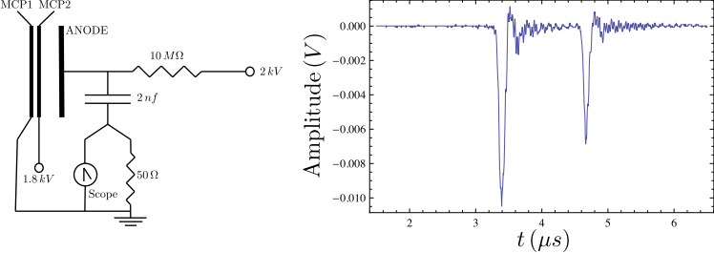
Pulsed Drift Tube
Defines beam energy
Switches ions to GND potential
RFQ 20 kV
PDT
18 kV
Ion elevator
V
GND
Pulse width for different extraction voltages
⁶Li and ⁷Li extracted onto a MCP

Slide 9
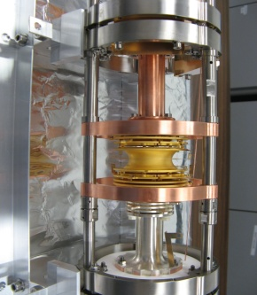

Mass measurement – Time of Flight method
t₁=TOF
1 m
t₀=0
inhomogeneous mag. Field, inverse mag. bottle
Cyclotron frequency:
Determine atom mass from frequency ratio with a well known reference
Time-of-flight cyclotron resonance detection → suited for radioactive isotopes
EXPERIMENT is carried out with ONE ion in the trap!

Slide 10
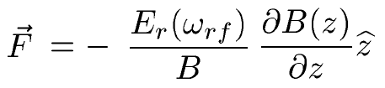
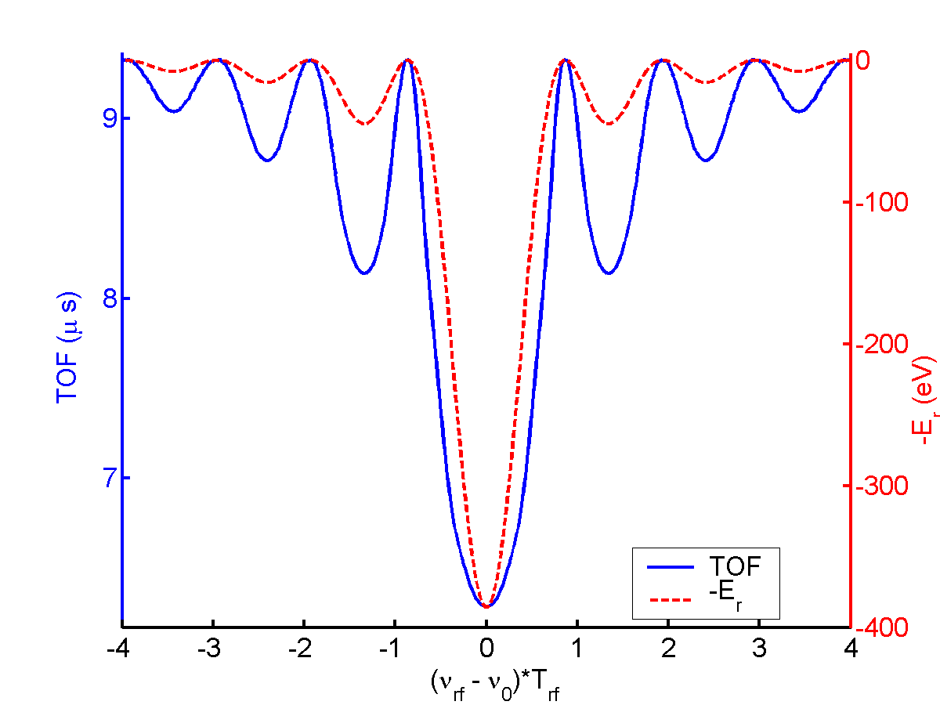
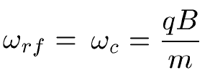
Mass measurement – Time of Flight method
Ions in the trap are
submitted to an rf-excitation ω_{rf} of duration T_{rf}
accelerated by the magnetic field gradient:
stopped by an MCP detector, TOF is recorded
Comparison to well known isotope
Resolution
Large E_{r} = shorter TOF
longer excitation time
larger B
more ions
highly charged ions
CHARGE BREEDING
The mass is found by a scan of
ω_{rf} around the resonance:

Slide 11
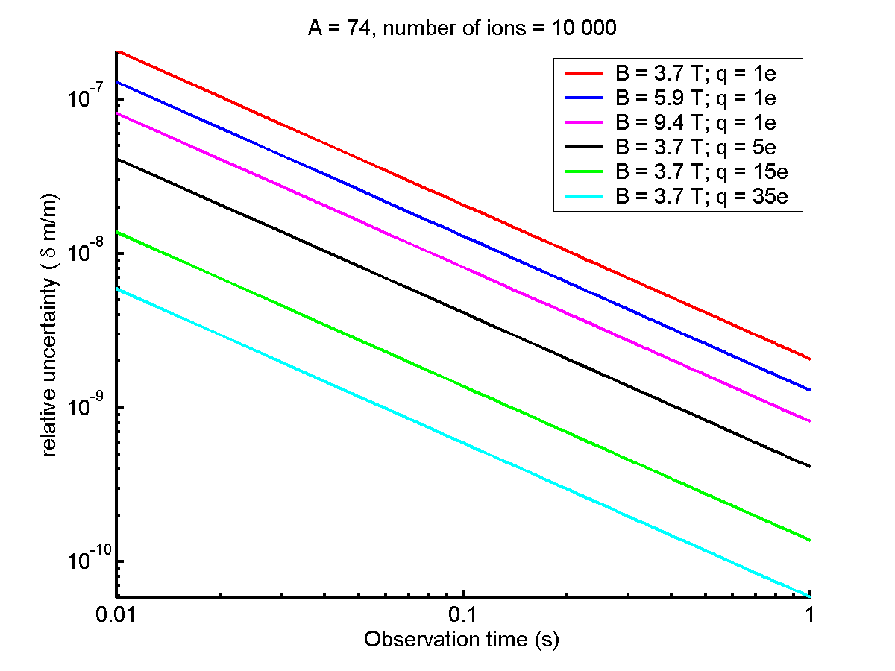
As an Example…He-like ⁷⁴Rb (T_{1/2}=65 ms)
2x10⁻⁸
q=1e
6x10⁻¹⁰
dm/m increases
by a factor of q=35
q=35e

Slide 12
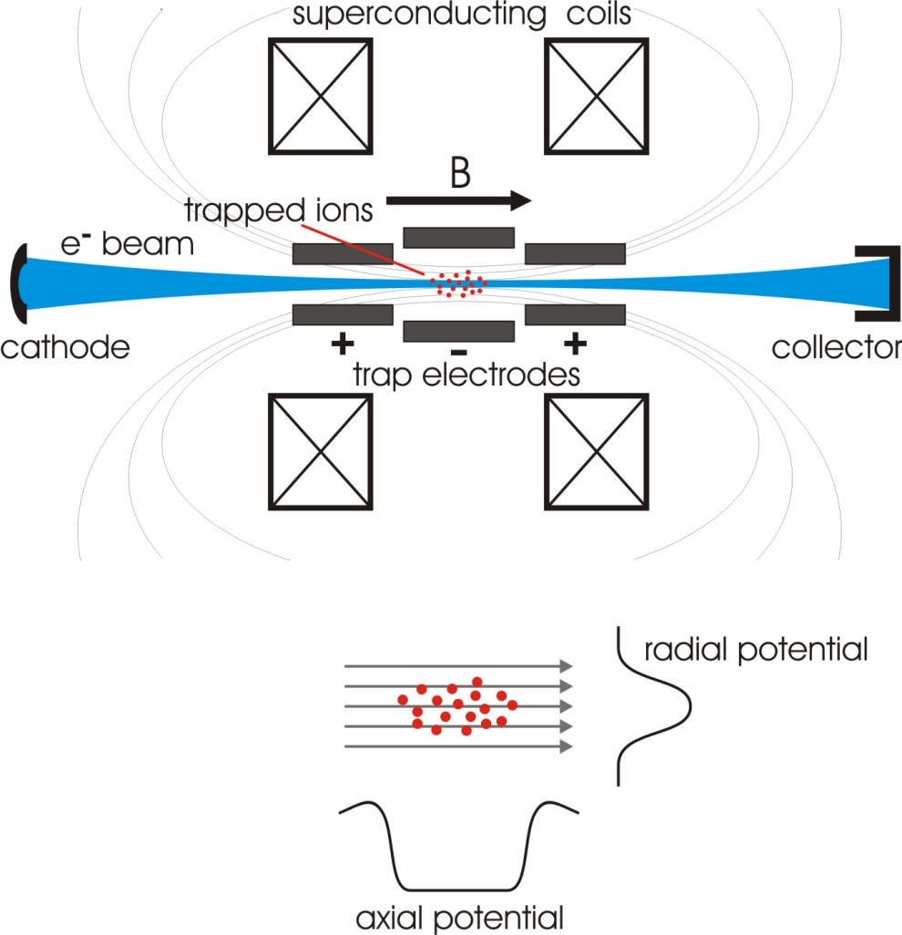
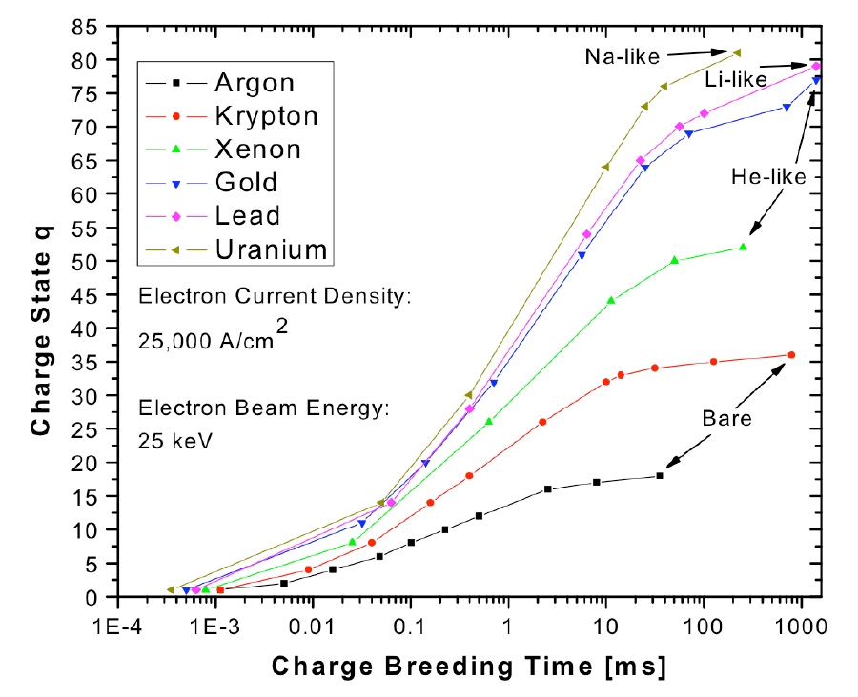
Electron Beam Ion Trap (EBIT)
Confinement:
  axial by electrostatic field
  radial by electron beam
B-field (6 T) compresses e⁻ beam
  e⁻ density up to 40 000 A/cm²
  increased ionization rate
⁷⁴Rb
half-life: 65 ms
He-like:~10ms
Bare: ~100 ms

Slide 13
Rendered Cut of the TITAN EBIT
Design values
Liquid helium-free superconducting coils
Max. e-beam energy | ~70 keV
Max. e-beam current | 500 mA
Max. magnetic field strength | 6 T
Cathode upgrades | 1 A & 5 A
Herrmann) beam diameter (FWHM) | ~40 μm
Electron beam current density | ~10⁵ A/cm²
Split Einzel
lenses
Electron gun
is
adjustable
Electron collector
Trap
Electron gun
Number of trapped ions: 10⁶-10⁸
_
_
+
Electron number density: ~5x10²² e/cm²/s
Up to ~60 kV
0 to ~10 kV
Up to ~60 kV
Beam energy spread: ~50 eV
The gun & collector must be biased at high voltages to reach high electron beam energies.
Highest charge state: ~ He-like U⁹⁰⁺
Notes:
EBIT is made of three parts.
Highly charged ions basically produced by, first, producing electrons from the cathode and applying a high voltage to the gun. Due to a high electrostatic potential difference between the gun and the center of the trap, electrons are then accelerated to the center of trap. In the center of the trap, the electron beam produced by the cathode is compressed by the high magnetic field…

Slide 14
TITAN – scientific program

Slide 15
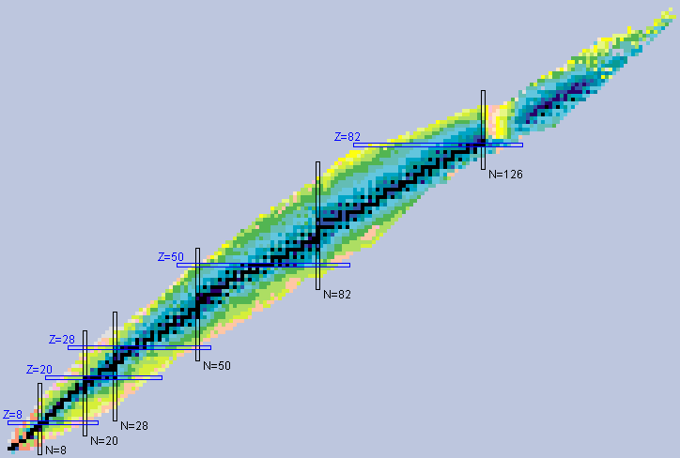
TITAN – scientific program
1: Halo nuclei
2: Nuclear structure, ‘Island of Inversion’
3: Nuclear astrophysics; ν-rp-, rp-process,
& Test of CVC
4: Neutron-rich: r-process, crust process
and nuclear structure
In addition
Laser spectroscopy
In-trap decay spectroscopy

Slide 16
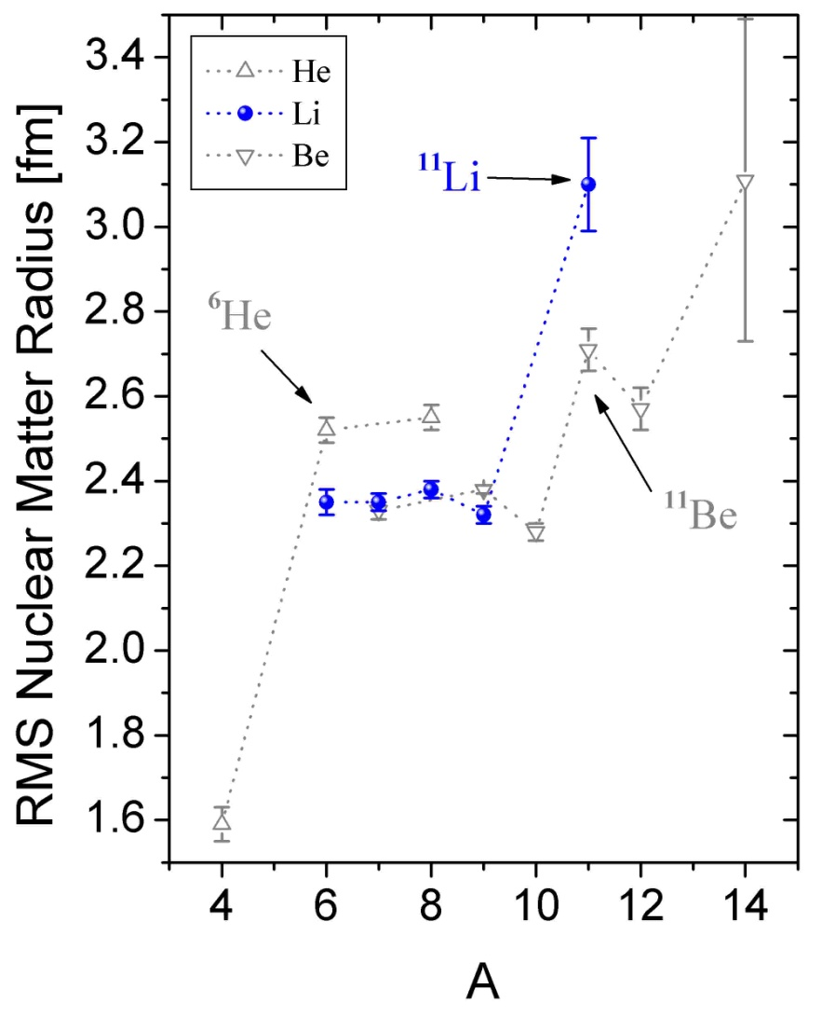
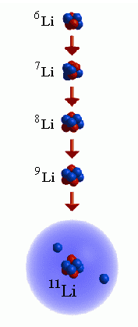
Strange form of matter: Halo nuclei
an ‘old’ phenomena, but new methods
⁶Li
∞
1
⁷Li
∞
3/2
⁸Li
838 ms
2
⁹Li
178 ms
3/2
¹¹Li
8.6 ms
3/2
In 1985 Tanihata et al. fired light nuclei at Beryllium, Carbon and Aluminum targets
They found the radius of ¹¹Li to be much larger than expected
Extra neutrons or protons on forbidden orbits
I. Tanihata et. al. PRL 55, 2676 (1985)
I. Tanihata et. al. PL B 206, 592 (1988)
⁹Li +2n
369 keV
3/2 ⁻
0 keV
¹¹Li
Very low binding of neutrons

Slide 17

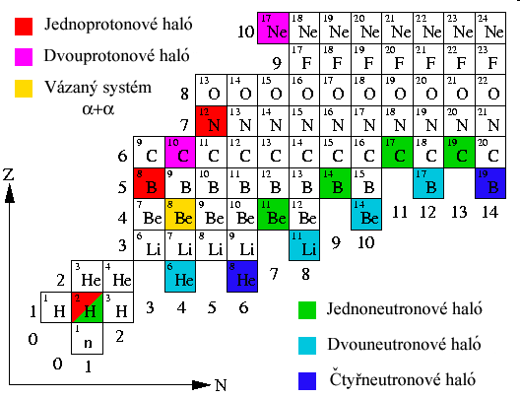


Halo Nuclei = extra large nuclei
Know halos (more out there)
one proton halo
two proton halo
12 fm
one neutron halo
two neutron halo
four neutron halo
Short-lived
few nucleon system
  test for theory
  at extreme conditions
  difficult to produce and measure
  Few have ever been
  directly measured
Halo | T_{1/2}
⁸He | 119 ms
¹¹Li | 8.8 ms
¹⁴Be | 4.4 ms
7 fm
Notes:
This nucleus consists of a ⁹Li core and two weakly bound halo neutrons. Due to the small binding energy of only approximately 300 keV, these neutrons are smeared out over a huge range and their root-means square (rms) matter radius is as large as the rms matter radius of ²⁰⁸Pb.
The matter distribution in ¹¹Li extends very far out of the ⁹Li core. The rms matter radius is as large as that of ⁴⁸Ca, and the radius of the halo neutrons as large as for the outermost neutrons in ²⁰⁸Pb.

Slide 18






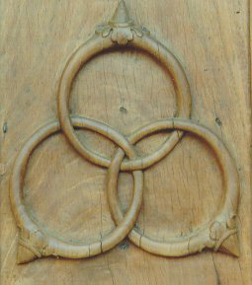

The helium isotope chain
Shows many interesting features:
....
bound
bound
unbound
bound
unbound
bound
halo
halo
Three rings interlinked in such a way that all three hold together.
Remove any one, and the other two fall apart!
  Like: ⁴He + n + n
  But not ⁴He + n
    Not n + n
Borromean system
Most exotic nucleus “on earth”
lives 806 ms
lives 108 ms

Slide 19
Halo Nuclei: A simple model ⁹Li + 2n
Schrödinger equation for a spherically symmetric square-well:
I | II
G.P. Hansen & B. Jonson EPL 4, 409, 1987

Slide 20
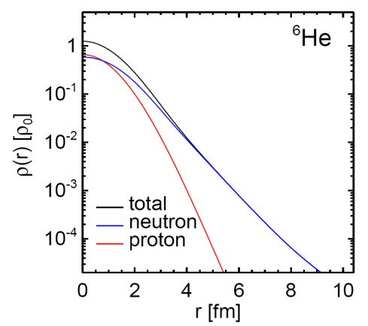


Halo Nuclei – ‘real’ theory
Halo nuclei are a challenge to theory
It is difficult to describe the extended wave function properly
They test nuclear forces at the extremes, where less has been
described theoretically or tested
Cluster models:
3-body models with phenomenological interactions
⁶He, ¹¹Li - borromean systems
can do reactions, specialized calculations
but difficult to add core polarizations
n
core
n
Notes:
While GFMC can use two and 3NF forces, for technical reasons, they cannot make use of non local forces as EFT are.
On the other hand NCSM is the only method that up to now has investigated property of p-shell nuclei from chiral NN and 3NF forces.
Nevertheless, this is not the most suited method to tackle halo nuclei, as the w.f. has by construction the wrong fall off, which is gaussian and depend on the
HO frequency.
These two sohrtcoming ...
\psi_{nl}(r)\sim e^{-\nu r^2}L_n^{l+1/2}(2\nu r^2)
| \psi \rangle=e^{T} | \phi \rangle
| \psi (\vec{r}_1,\vec{r}_2,\vec{r}_3,\vec{r}_4) \rangle
= | \varphi(\vec{R}_{CM}) \textcolor{red}{\Psi} (\vec{\eta}_1,\vec{\eta}_2,\vec{\eta}_3) \rangle
T=T_1+T_2+T_3 ...
T_1=\sum_{i,a} t_i^a~a^{\dagger}_a a_i
T_2=\sum_{ij,ab} t_{ij}^{ab}~a^{\dagger}_a a^{\dagger}_b a_j a_i
T_3\!=\!\!\!\!\sum_{ijk,abc}\!\!\! t_{ijk}^{abc}a^{\dagger}_a a^{\dagger}_b a^{\dagger}_c a_k a_j a_i
| \psi (\vec{r}_1,\vec{r}_2,...,\vec{r}_A) \rangle = e^T | \phi (\vec{r}_1,\vec{r}_2,...,\vec{r}_A \rangle

Slide 21
  Halo Nuclei – ‘real’ theory
Halo nuclei are a challenge to theory
It is difficult to describe the extended wave function properly
They test nuclear forces at the extremes, where less has been
described theoretically or tested
Ab-initio calculations:
treat the nucleus as an A-body problem
s2
full antisymmetrization of the w.f.
use modern Hamiltonians to predict halo properties
s1
...
r2
r1
rA
sA
Methods: GFMC, NCSM, CC
Notes:
While GFMC can use two and 3NF forces, for technical reasons, they cannot make use of non local forces as EFT are.
On the other hand NCSM is the only method that up to now has investigated property of p-shell nuclei from chiral NN and 3NF forces.
Nevertheless, this is not the most suited method to tackle halo nuclei, as the w.f. has by construction the wrong fall off, which is gaussian and depend on the
HO frequency.
These two sohrtcoming ...
\psi_{nl}(r)\sim e^{-\nu r^2}L_n^{l+1/2}(2\nu r^2)
| \psi \rangle=e^{T} | \phi \rangle
| \psi (\vec{r}_1,\vec{r}_2,\vec{r}_3,\vec{r}_4) \rangle
= | \varphi(\vec{R}_{CM}) \textcolor{red}{\Psi} (\vec{\eta}_1,\vec{\eta}_2,\vec{\eta}_3) \rangle
T=T_1+T_2+T_3 ...
T_1=\sum_{i,a} t_i^a~a^{\dagger}_a a_i
T_2=\sum_{ij,ab} t_{ij}^{ab}~a^{\dagger}_a a^{\dagger}_b a_j a_i
T_3\!=\!\!\!\!\sum_{ijk,abc}\!\!\! t_{ijk}^{abc}a^{\dagger}_a a^{\dagger}_b a^{\dagger}_c a_k a_j a_i
| \psi (\vec{r}_1,\vec{r}_2,...,\vec{r}_A) \rangle = e^T | \phi (\vec{r}_1,\vec{r}_2,...,\vec{r}_A \rangle

Slide 22
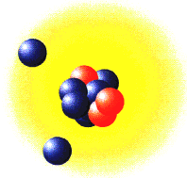
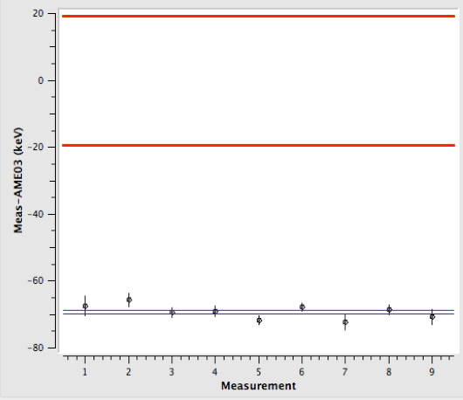
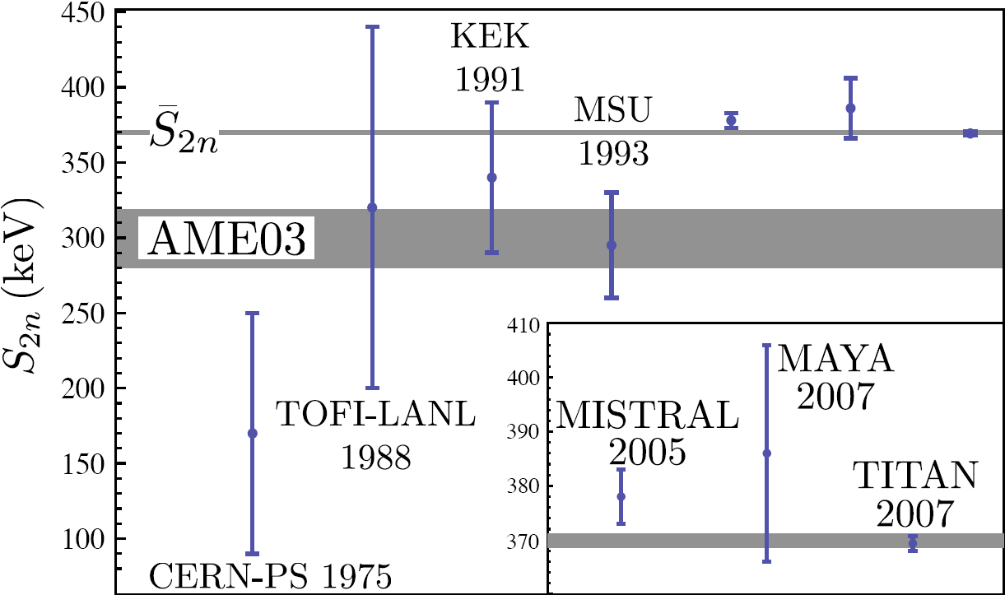
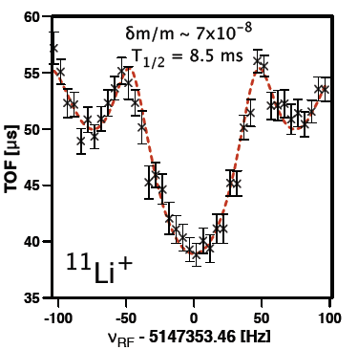
  Halo mass measurements
AME2003 δm=19 keV
TITAN mass measurement of ^{6,7,8,9,11}Li
Improved precision, S_{2n} improved by factor 7
Shortest-lived isotope (T_{1/2}=8.6 ms) for Penning trap mass measurement!
Final analysis δm = 650 eV
PRL M. Smith et al PRL 101, 202501 (2008)
TITAN_{(stat)}δm(¹¹Li)=0.555 keV
CERN TRIUMF
Fastest measurement due to
rapid ion preparation with TITAN.
Also found deviations at stable
⁶Li from AME 2003
TITAN
PRL’08 PRL’08 PRL’08

Slide 23
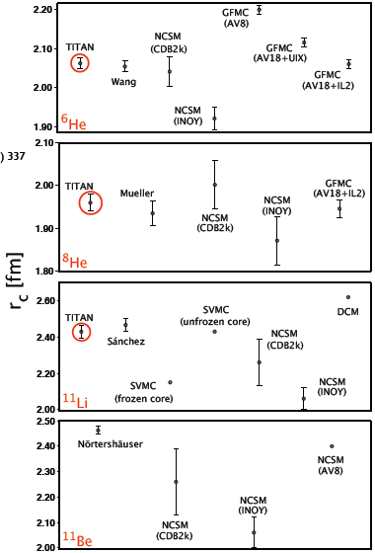
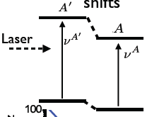
  Halo mass harvest
Charge radii using TITAN masses
Link to nuclear theory (via laser spec).
NEW
⁶Li: Brodeur et al, PRC 80 (2009) 044318
TITAN measurements
Isotope shift measurement
Mass shift
Field shift
TITAN is fastest on-line Penning trap system.
Measurement of the shortest-lived isotope on-line
Measurement of the most extreme isotope on Earth
More mass measurements planned for 2010/11:
Limit of sensitivity ~ 5-10 ions / sec

Slide 24
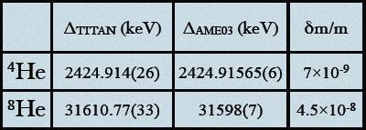
Helium measurements
First direct measurements of the mass of ^{6,8}He carried out at ISAC with TITAN
V. Ryjkov et al. PRL 101, 012501 (2008)
charge radius
matter radius
TITAN
⁶He (Wang)
=1.925±0.012 fm
⁶He (TITAN)
=1.910±0.011fm
⁸He (Muller)
=1.808±0.028 fm
P. Muller et al. PRL
99, 252501 (2007)
Better and different mass value.
Requires re-evaluation of charge
radius, theory is very interested!
⁸He (TITAN)
=1.835±0.019 fm
Revised charge radius (prelim.)
Calculation G. Drake
(in prep for PRL M. Brodeur et al.)
radius, fm

Slide 25
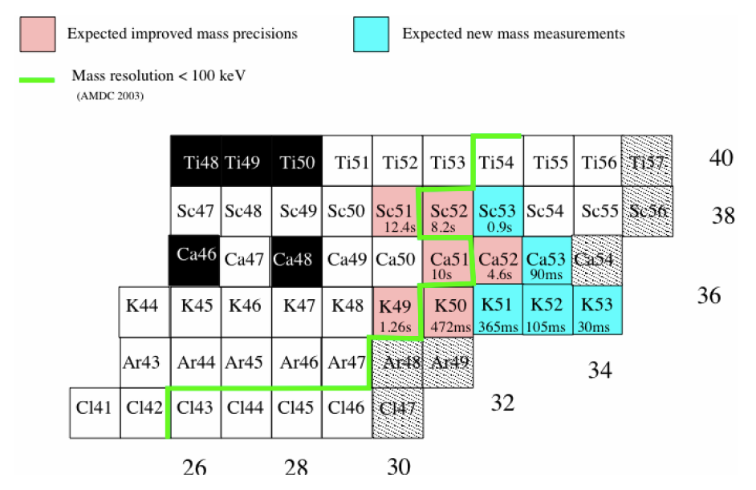
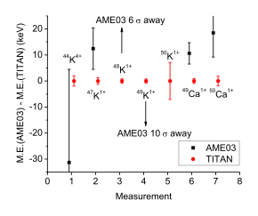
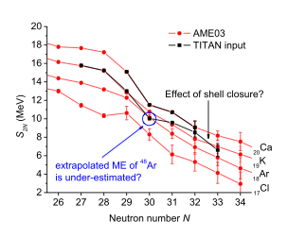
Mass measurements near new magic number N=34
Masses (or separation energies) sensitive to shell structure, and indication of closed shell.
⁴⁴K⁴⁺: First on-line mass measurement using EBIT breeder
⁴⁸K¹⁺ and ⁴⁹K¹⁺: deviations of 6 and 10 sigma from AME03
⁴⁷⁻⁵⁰K¹⁺ and ^{49,50}Ca¹⁺: masses improved by factor of up to 100 (in prep A. Lapierre et al., PR C)
Extension of measurements planned for 2010 (U-target)

Slide 26
Reverse Extraction for
Laser Spectroscopy

Slide 27
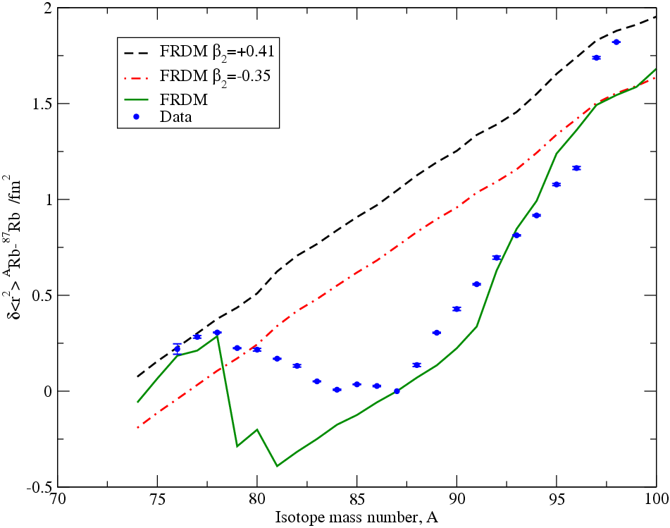
Reverse Extraction for
Laser Spectroscopy
Motivation for the study of ⁷⁴Rb (N=Z=37)‏
N~Z nuclei are useful to study aspects of nuclear structure such as pairing and isospin
Any change in the charge radius of ⁷⁴Rb might reveal dynamic deformation effects
...with implications for isospin breaking correction for ft values in superallowed β decays
C. Thibault et al. PRC 23 6 (1981)‏

Slide 28
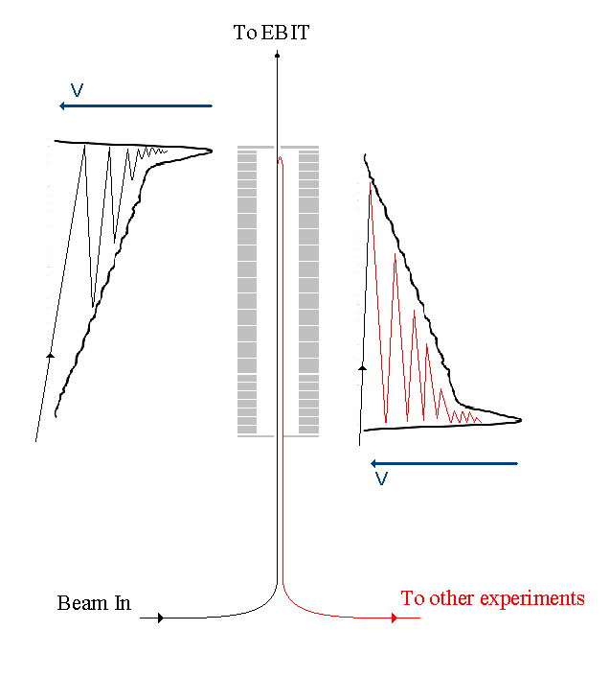
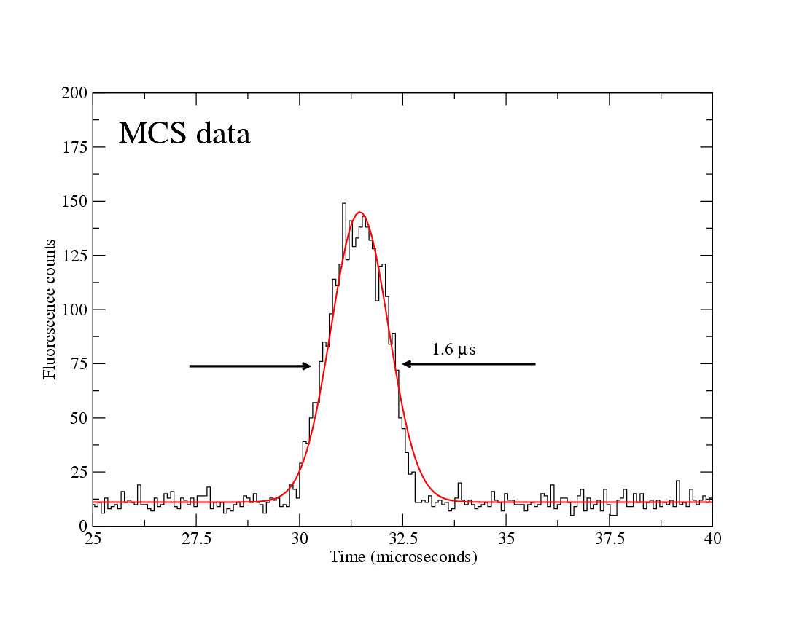
Unique Feature – Reverse Extraction
Forward Potential
Reverse
Potential
PMT
Collinear laser spectroscopy
Ions
Laser
ToF of fluorescent photons
⁷⁸Rb
Unique Features:
Square-wave-driven for broadband operation
Symmetric trap structure allows for reverse extraction
Reversed extraction allows for laser spectroscopy on cooled and bunched ions
~ 10⁵ ions/bunch, 50 Hz cycle
28 keV beam energy

Slide 29
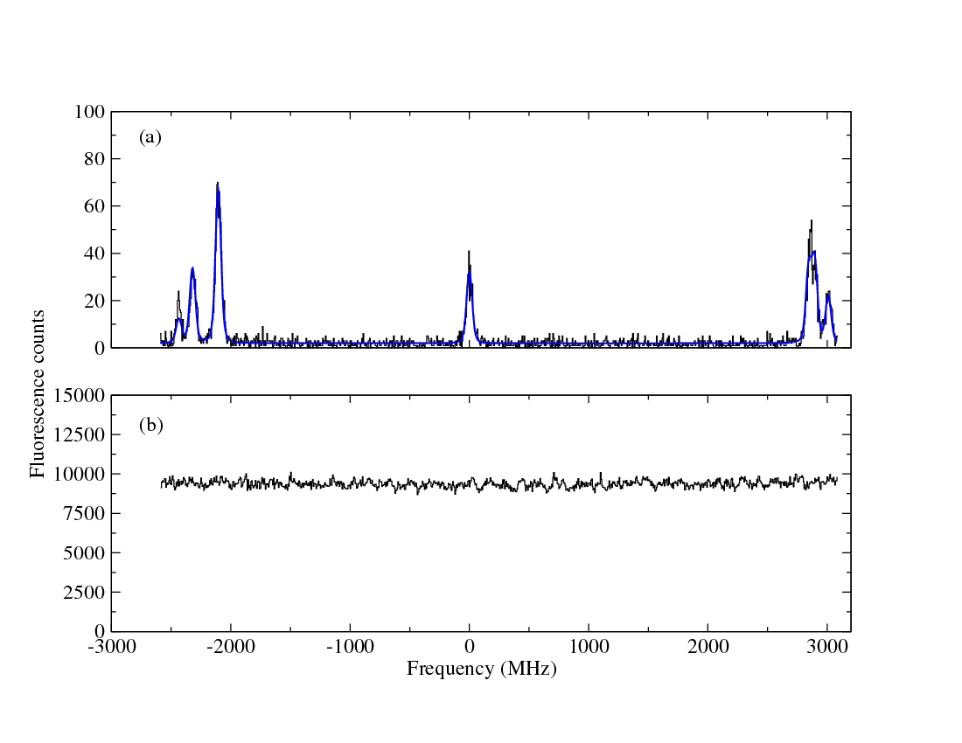
Laser Spectroscopy in RVE
First on-line data ^{78,78m}Rb ( I=0,4) D2 line, ~ 1pA
Gated
isomer
g.s.
Singles
background
29/10/2009 : 08:49-09:39
Laser spectroscopy on bunched ions:
Reduced beam emittance after cooling
Gating on ion bunch drastically reduces background

Slide 30
In-trap decay spectroscopy…
… ββ decay spectroscopy in a Penning trap

Slide 31
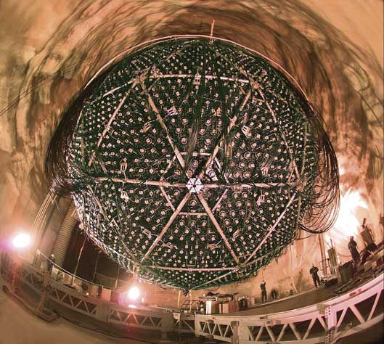
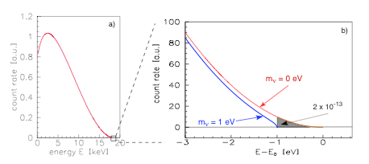
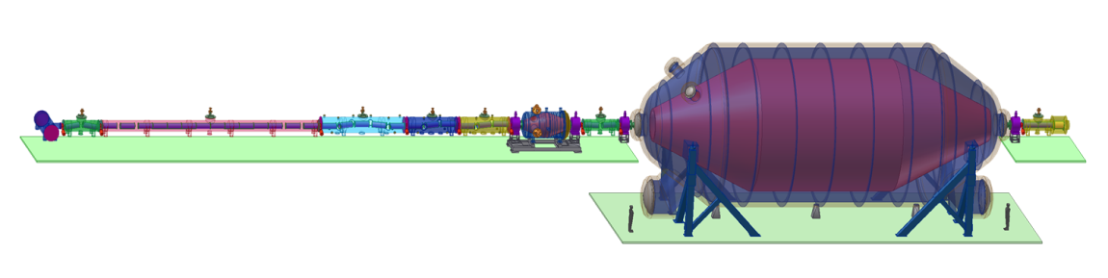
Neutrino experiments and the neutrino mass
Neutrino oscillation
Tritium decay
KATRIN, picture taken from http://students.washington.edu
SNO, picture taken from http://www.oit.on.ca
Relative mass scale
Absolute mass scale
Indicate a neutrino mass [1]
Determination of mixing angle θ_{ij}
Indicate mass hierarchy
Determination of δm²
Endpoint energy of ³H decay
Effective mass for degenerated neutrinos:
[1] T. Kajita and Y. Totsuka, Rev. Mod. Phys. 73(2001)85

Slide 32
Double β decay and m_{ν}
Some ββ decay experiments
GERDA, CUORE, CUORICINO, COBRA, MOON, EXO
Worldwide topic
Standard model
New physics
2ν double β - decay
0ν double β - decay
Lepton number violation
Half life> 1.9x10 ²⁵ years [1] (⁷⁶Ge)!!!
If observed:
Half life> 10 ¹⁷ years (⁷⁶Ge)
Dirac - Neutrino
Majorana - Neutrino
0ν and 2ν described in same theoretical framework
[1] C.E. Aalseth et al., Phys. Rev. D65(2002)092007
[2] S.R. Elliott and P. Vogel, Annu. Rev. Nucl. Part. Sci. 52(2002)115

Slide 33
Theoretical benchmark
Knowledge of EC and β⁻ BR can be used to benchmark the theoretical framework of ββ decays
Theoretical frameworks are
- Interacting Boson Model
- Schell Model
- pn-QRPA
S.K.L. Sjue et al., Phys. Rev. C78(2008)064317
But:
Difficult measurement due to a small EC branch and difficult X-ray signatures
High background due to dominating beta decay and possible bremsstrahlung
Isobaric contamination

Slide 34

EC-BR measurements
Traditional method: tape station & observe X-rays after EC
Drawbacks:
Contaminations
Intense β background
X-ray absorption in the backing material
Recent development:
Contamination free due to ion trap
Implantation into hole in scintillator (veto 90% of β events)
Novel approach proposed:
EC-BR measurement of ions stored in a Penning trap at TITAN
remedy to all drawbacks in TITAN setup at TRIUMF
S. K. L. Sjue et al., Phys. Rev. C 78, 064317 (2008)
J. Dilling et al., Can. J. Phys. 85, 57 (2007)

Slide 35

Novel technique
Use TITAN facility at ISAC
make use of the open access Penning trap EBIT (no e-beam)
Spatially separate X-ray and β detection
Electron Beam Ion Trap (EBIT) in Penning trap mode for EC-BR measurement
→ e-gun replaced by β detector
Electron Beam Ion Trap (EBIT) in Penning trap mode for EC-BR measurement
Penning trap
A^{q+}
Helmholtz
coils
A⁺
β detector
Short-lived isotopes from an Isotope
Separator and Accelerator (ISAC)
X-ray
detector
A⁺
Notes:
35

Slide 36



Novel technique
Silicon detector for β-decay measurements
X-ray detector
X-ray detector
γ
B_{max} ~ 3T
6 T magnet
Novel method:
Backing free
Isobaric sample
Spatial separation of β⁻ and X-ray detection
Ion injection
Beta detector
(PIPS)
Ø5 mm
β
5 kV
4.7 kV
5 kV
A⁺
Trap electrodes
Penning trap
A⁺
Storage and
detection
Penning trap
10⁵ – 10⁶ ions
trapped

Slide 37




¹⁰⁷In EC signature
¹⁰⁷In
t_{1/2}= 32.4 min
¹⁰⁷In has a strong EC branch and comparable
half live of 32.4 min
EC ~ 63.9%
¹⁰⁷Cd
t_{1/2}= 6.5 h
Signature ¹⁰⁷Cd decay
EC ~ 99.8%
Signature ¹⁰⁷In decay
¹⁰⁷Ag
Goals of the beam time
Shoot through EBIT
Identify ¹⁰⁷In after EBIT
Store radioactive ions in trap
Observe X-rays following an EC
Identify X-rays from EC
Observe electrons from β decays
Signature ¹⁰⁷In decay
√
√
√
√
√
X
First observation of an EC in a Penning trap
BR(EC) = 55 (20) %
S. Ettenauer et al., AIP Conf. Proc. 1182(2009)100
Only one detector
0.02% solid angle!

Slide 38
Systematic studies with ^{124, 126}Cs
Injection of ¹²⁶Cs (~1ms)
Monitoring PIPS
V
z
Storage of ¹²⁶Cs (25ms)
Observation of decays
LeGe detector
X-ray detection
Ejection of ¹²⁶Cs (1ms)
The trap is kept open to empty completely
PIPS
β detection
Empty trap (25ms)
Background measurement
RFQ
Ge detector
X/γ-ray detection

Slide 39





Observation of ¹²⁴Cs EC X-rays
Xe X-ray
K lines
354 keV
¹²⁴Cs signature
LeGe detector
~ 0.1% ε_{geo}
~ 2.5 T B field at detector position
Cu K_{α} line
89.5 keV &
96.6keV
¹²⁴Cs isomer
Monitoring
β detector
Cs X-ray lines
LeGe detector
X-ray detection
Xe X-ray lines: due to ¹²⁴Cs EC
Cs X-ray lines: probably dominant due to ¹²⁴Ba contamination and decay of ^{124m}Cs
RFQ
Ge detector
X/γ-ray detection
PIPS
Passivated Implanted Planar Silicon
β detection

Slide 40
γ – β⁺ time correlation
Ge detector
~ 0.15% ε_{geo}
Outside vacuum vessel
PIPS detector
Si detector (500μm)
on magentic field axis
at exit of Penning trap
511 keV
491 keV
¹²⁶Cs
Monitoring
PIPS
388 keV
¹²⁶Cs
γ spectrum in coincidence with β⁺ event
LeGe detector
X-ray detection
PIPS spectrum in coincidence with γ event
First time:
β⁺ spectrum from ¹²⁶Cs ions stored inside the trap
PIPS
β detection
RFQ
Ge detector
X/γ-ray detection

Slide 41
Summary
Electron Capture branching ratio measurement
ββ nuclear matrix elements needed for theoretical framework
EC-BR measurement as benchmark experiment for theoretical description
TITAN EBIT offers a novel approach for EC-BR measurements
  Backing free method
  Low background at X-ray detector – spatial separation of β and X-ray detection
  Isobaric sample
Successful storage of radioactive ions (long storage times: P < 10⁻¹¹ mbar)
First observation of an Electron Capture decay in a Penning trap
Collinear laser spectroscopy on bunched ion beams
Background reduction of more than 3 oom
High precision mass measurements
High precision mass measurements (Δm/m < 10⁻⁸) – singly and highly charged
Fastest Penning trap system currently on the market (¹¹Li with t_{1/2}=8.59ms)
Handles very low intensities (⁸He beam time with as low as 3 ions/minute at MPET-MCP)
For the future
Improve charge breeding efficiency
Cooler penning trap to cool HCI
Optimize the system to handle exotic beams (¹⁴Be, ¹⁹C, …)

Slide 42












People/Collaborations
M. Brodeur, T. Brunner, J. Dilling, P. Delheij, S. Ettenauer, A. Gallant, M. Good, E. Mane, M. Pearson, V. Simon…
… and the TITAN collaboration
as well as A. Lapierre, R. Ringle, V. Ryjkov, M. Smith and TRIUMF staff.
U. of Manitoba
McGill U.
Muenster U.
MPI-K
GANIL
Colorado School of Mines
U. of Calgary
U. of Windsor
SFU
UBC
TU München
Yale

Slide 43
Backup slides

Slide 44
# Ions per Bunch
Idea:
Determine number of ions per bunch by implanting bunches of radioactive isotopes onto an Al foil and observe their radioactive decay
Monitoring PIPS
Half life data obtained with a MCS
PIPS- Passivated Implanted Planar Si detector
Aluminum foil
EBIT
Radioactive isotopes
RFQ

Slide 45


# ions/shot & Half Life of ¹²⁶Cs
Monitoring PIPS
Half life data obtained with a MCS
6 hrs beam off before first 10 pulses ¹²⁶Cs
t_{½} = 97.4 ± 2.1 s (fit) (lit: 98.4 ± 1.2s) for first 10 shots (1st spike)
Beam intensity ≈ 3 * 10⁵ ions/RFQ extraction pulse @ 10 Hz
BUT:
Half life increases for the following t_{½} measurements
→ Contamination built up on PIPS detector
EBIT
RFQ

Slide 46



Evolution of magic numbers in NP
Nuclear shell model for stable nuclei
R. Janssen Nature 459 (2009)
32
34
‘New’ magic number identified in
O-24 (dripline) but this has been seen
at various places: Island of Inversion
28
2
2
4
GOAL:
Provide more experimental evidence to test and refine theoretical predictions
(3-body forces may be needed)
NEED:
very sensitive
experiments!
S.Zhu, PRC 80, 024318 (2009)
Prediction of new magic number for Ca depends on chosen interaction
Atomic shell model holds true for entire periodic table.
Nuclear SM doesn’t work for all isotopes!

Slide 47




Cooling of ¹³³Cs
Time of Flight
RFQ
MCP
Ions
Stop
Start
¹³³Cs at 100 Hz
Beam gate reduces incoming beam
Ions cool after 5 ms
No significant loss of ions up to 25 ms

Slide 48


¹³³Cs Transmission
DC transmission
AC transmission
Preliminary
50V RFDC @ 250 kHz → q = 0.29
80V RFDC @ 350 kHz → q = 0.24
200V RFDC @ 850 kHz → q = 0.10
315 Vpp at 600 kHz
(80 ± 2)% DC transmission
Maximum transmission at ∼35 x 10⁻³ mbar
0.2 nA at Faraday cup
Stable ion motion for different frequency to RF voltage ratios

Slide 49



MPET
B
Confinement:
  strong axial, hom. B-field (4 T)
  electrostatic quadrupolar field
3 eigenmotions
Cyclotron frequency
Quadrupolor rf- field (ring electrode) leads to conversion: magnetron ↔ reduced cyclotron
Radial energy:
Notes:
nu_+ >> nu_z >> nu_-
not generally true, but set like that

Slide 50



Minimal gas pressure
¹³³Cs with He buffer gas
V_{PP} 315 V at 600 kHz
DC beam on Faraday cup after RFQ
Two modes: trap open and trap constantly closed
Trap open
0 V
V
-7.2 V
1 sccm: 1.77 x 10⁻⁵ mbar
2 sccm: 2.58 x 10⁻⁵ mbar
3 sccm: 3.02 x 10⁻⁵ mbar
4 sccm: 3.34 x 10⁻⁵ mbar
1
Trap closed
+5 V
2
0 V
3
4
1
2
3
4

Slide 51



Linking back to Theory:
EFT-TRIUMF
EFT-TRIUMF
S.Bacca et al., arXiv:0902.1696
Experimental data
SOME IMPROVEMENT NEEDED:
But very promising progress.
PLAN: develop global approach for
scalable 3-body forces

Slide 52




Simulations
Ø5 mm
5 kV
4.7 kV
5 kV
Loss through magnetic bottle for θ > 79deg:
3 MeV electrons
B_{max} = 6T
25 mm
284 mm to center
3 MeV electrons hitting a 500μm Si waver
Loss through wall collisions
→ Rotating wall cooling or side-band cooling

Slide 53




Analytic Considerations of the RFQ
Meissner equations determine ions motion in square-wave-driven trap:
Stability parameter
Analytic solution shows a simple harmonic macro-motion perturbed by a coherent micro-motion
As q increases so does the amplitude of the micro-motion
For q > 0.7 the motion becomes unbound
(50% duty cycle, ideal square wave)

Slide 54


TITAN RFQ - Facts and Figures
Ions trapped by pseudo potential
Sine-Wave α = 0.13
Square-Wave α = 0.21
For same RF amplitude pseudo potential 1.5 times deeper for digital RF
TITAN RFQ facts
700 mm long, r₀ = 10 mm
C ≈ 1500 pF
Stack of optically triggered MOSFETs to produce RF
200 kHz to 1200 kHz frequency range
Up to 800 V_{PP}
RF box
Stack of MOSFETs

