Slide 1
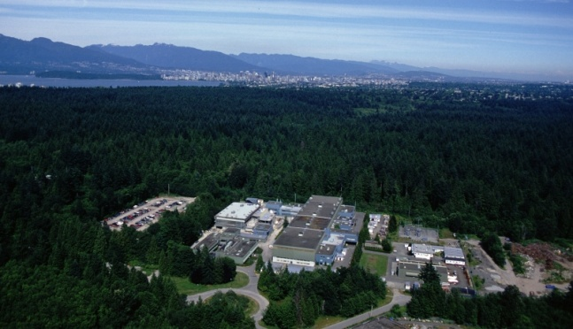


Ion Preparation in TITAN’s
RFQ
T. Brunner, M. Brodeur, S. Ettenauer, E. Mane, M. Pearson, and J. Dilling
for the TITAN collaboration
Outline
TITAN Overview
TITAN RFQ - 101
TITAN RFQ Systematic Studies
Canada’s National Laboratory for Nuclear and Particle Physics,
Vancouver, British Columbia, Canada

Slide 2
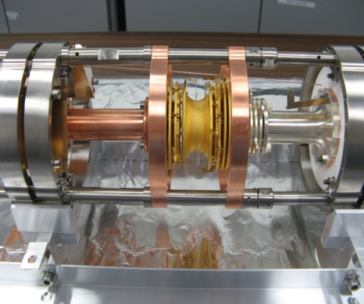
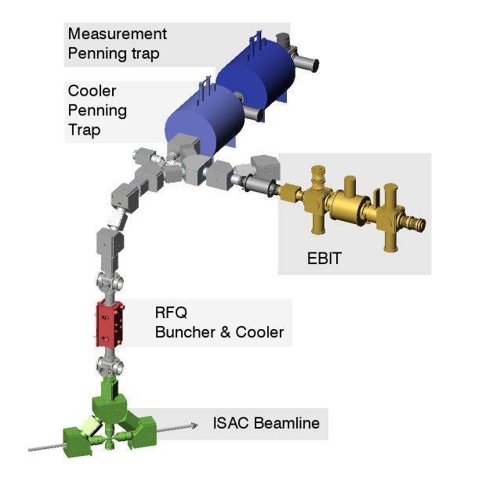
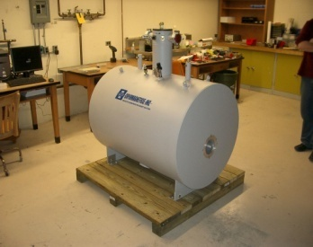
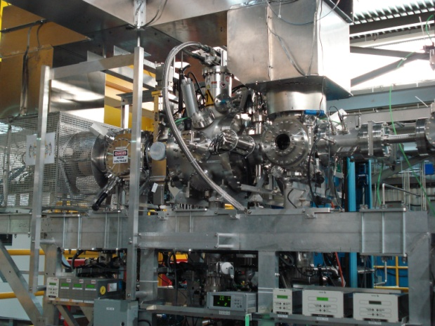
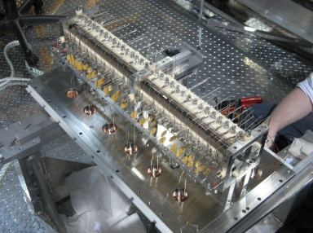
What is TITAN ?
TRIUMF’s Ion Trap for Atomic & Nuclear Physics
  Facility to perform high-precision atomic mass measurements.
  Main motivations: Mass measurements on short-lived isotopes (level of precision: Δm/m<10⁻⁸) for nuclear-structure theory tests, nuclear astrophysics, etc.
A^{q+}
~2 kV • q
Under construction: Installation planned
for Dec. 2010
(see talk by V. Simon)
A⁺
~2 ke V
Decelerates beams
  TITAN composed of 3 ion traps (presently)
  Electron Beam Ion Trap (EBIT): Produces Highly Charge Ions
~20 - ~60 keV
A⁺
Radioactive isotopes from an ISOL facility (TRIUMF ISAC).

Slide 3
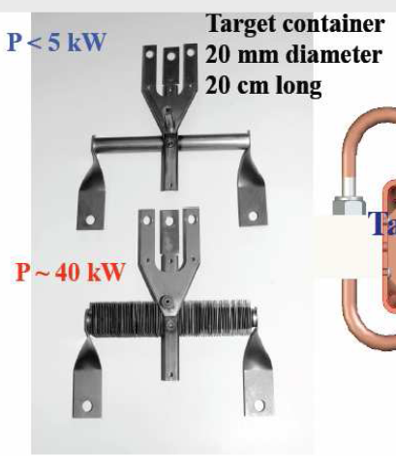
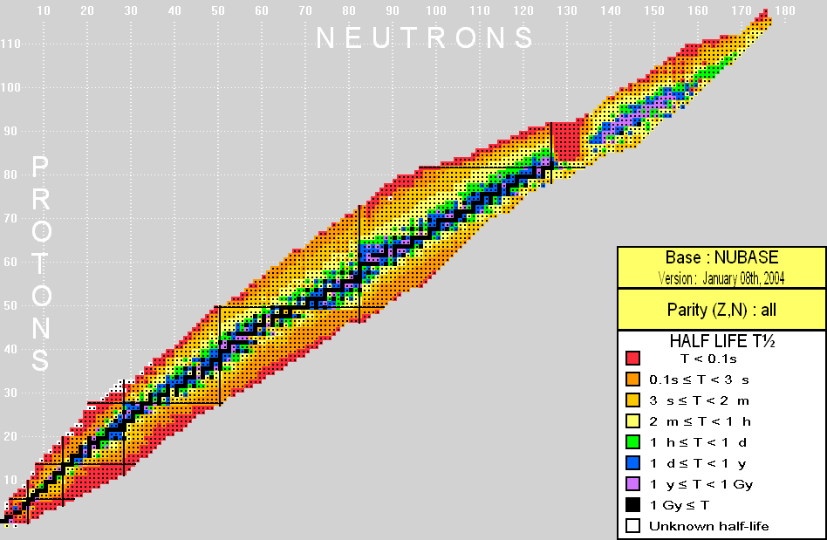
Radioactive Isotope Production
Carbide targets:
Si, Ta, W, …
Residual
proton beam
500-MeV proton beam
Exotic isotopes
A>170 under development
Some heavy masses may be produced presently from test actinide targets (e.g., UO_{x}).
Proton
target ass’y
Beam extraction at 20 kV – 60 kV
A<170
Notes:
3
ISAC stands for Isotope Sepearot and Accelerator
Short-lived isotopes produced at ISAC are produced by a methode called In-flight separation where…
This method can yield isotopes far from the valley of stability of nuclear mass of less then about 120.

Slide 4
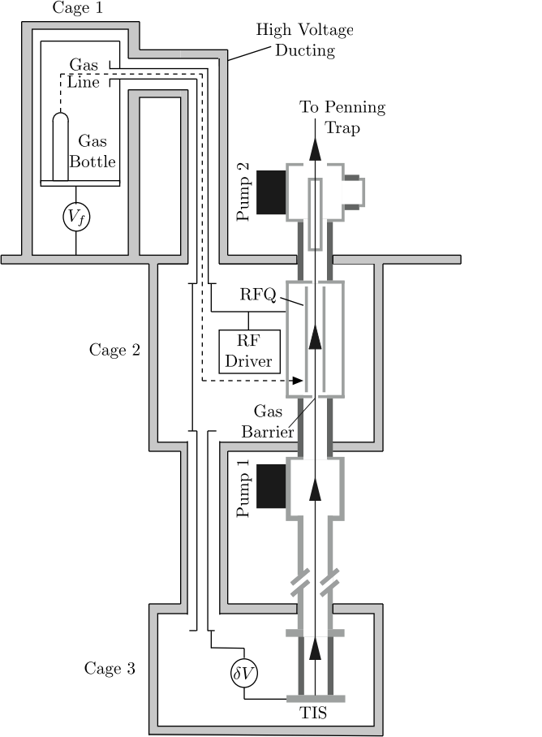
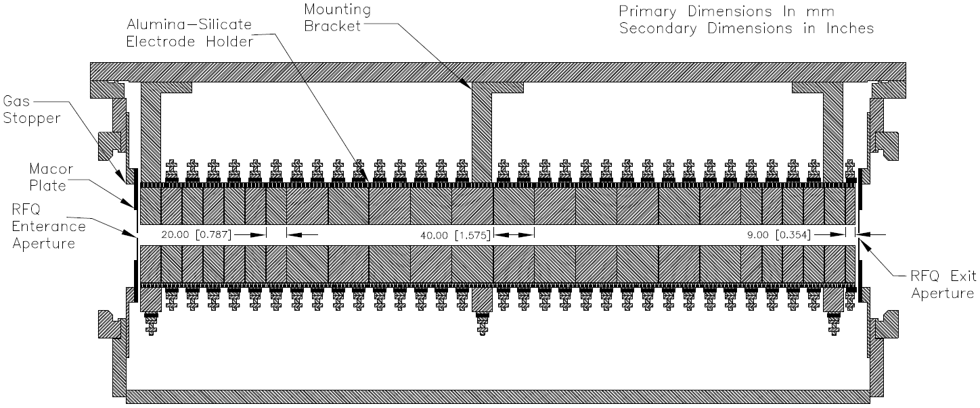
TITAN RFQ
TITAN RFQ needed to:
Decelerate ISAC’s radioactive beam from <40 keV to 2 keV
Cool the incoming beam (reduce the phase space volume)
Bunch the incoming DC beam and send pulses to TITAN
TITAN RFQ:
Gas filled linear Paul trap with 24 segments
Symmetric trap structure allows for
reverse extraction
Digitally driven square wave frequency
ISAC
TITAN

Slide 5
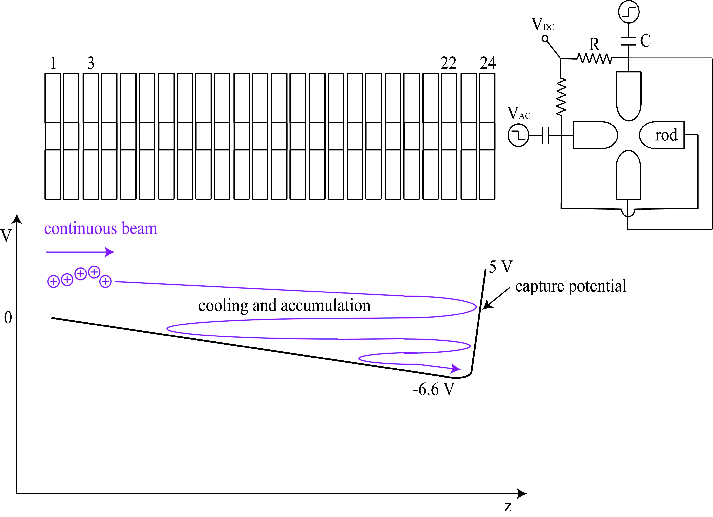
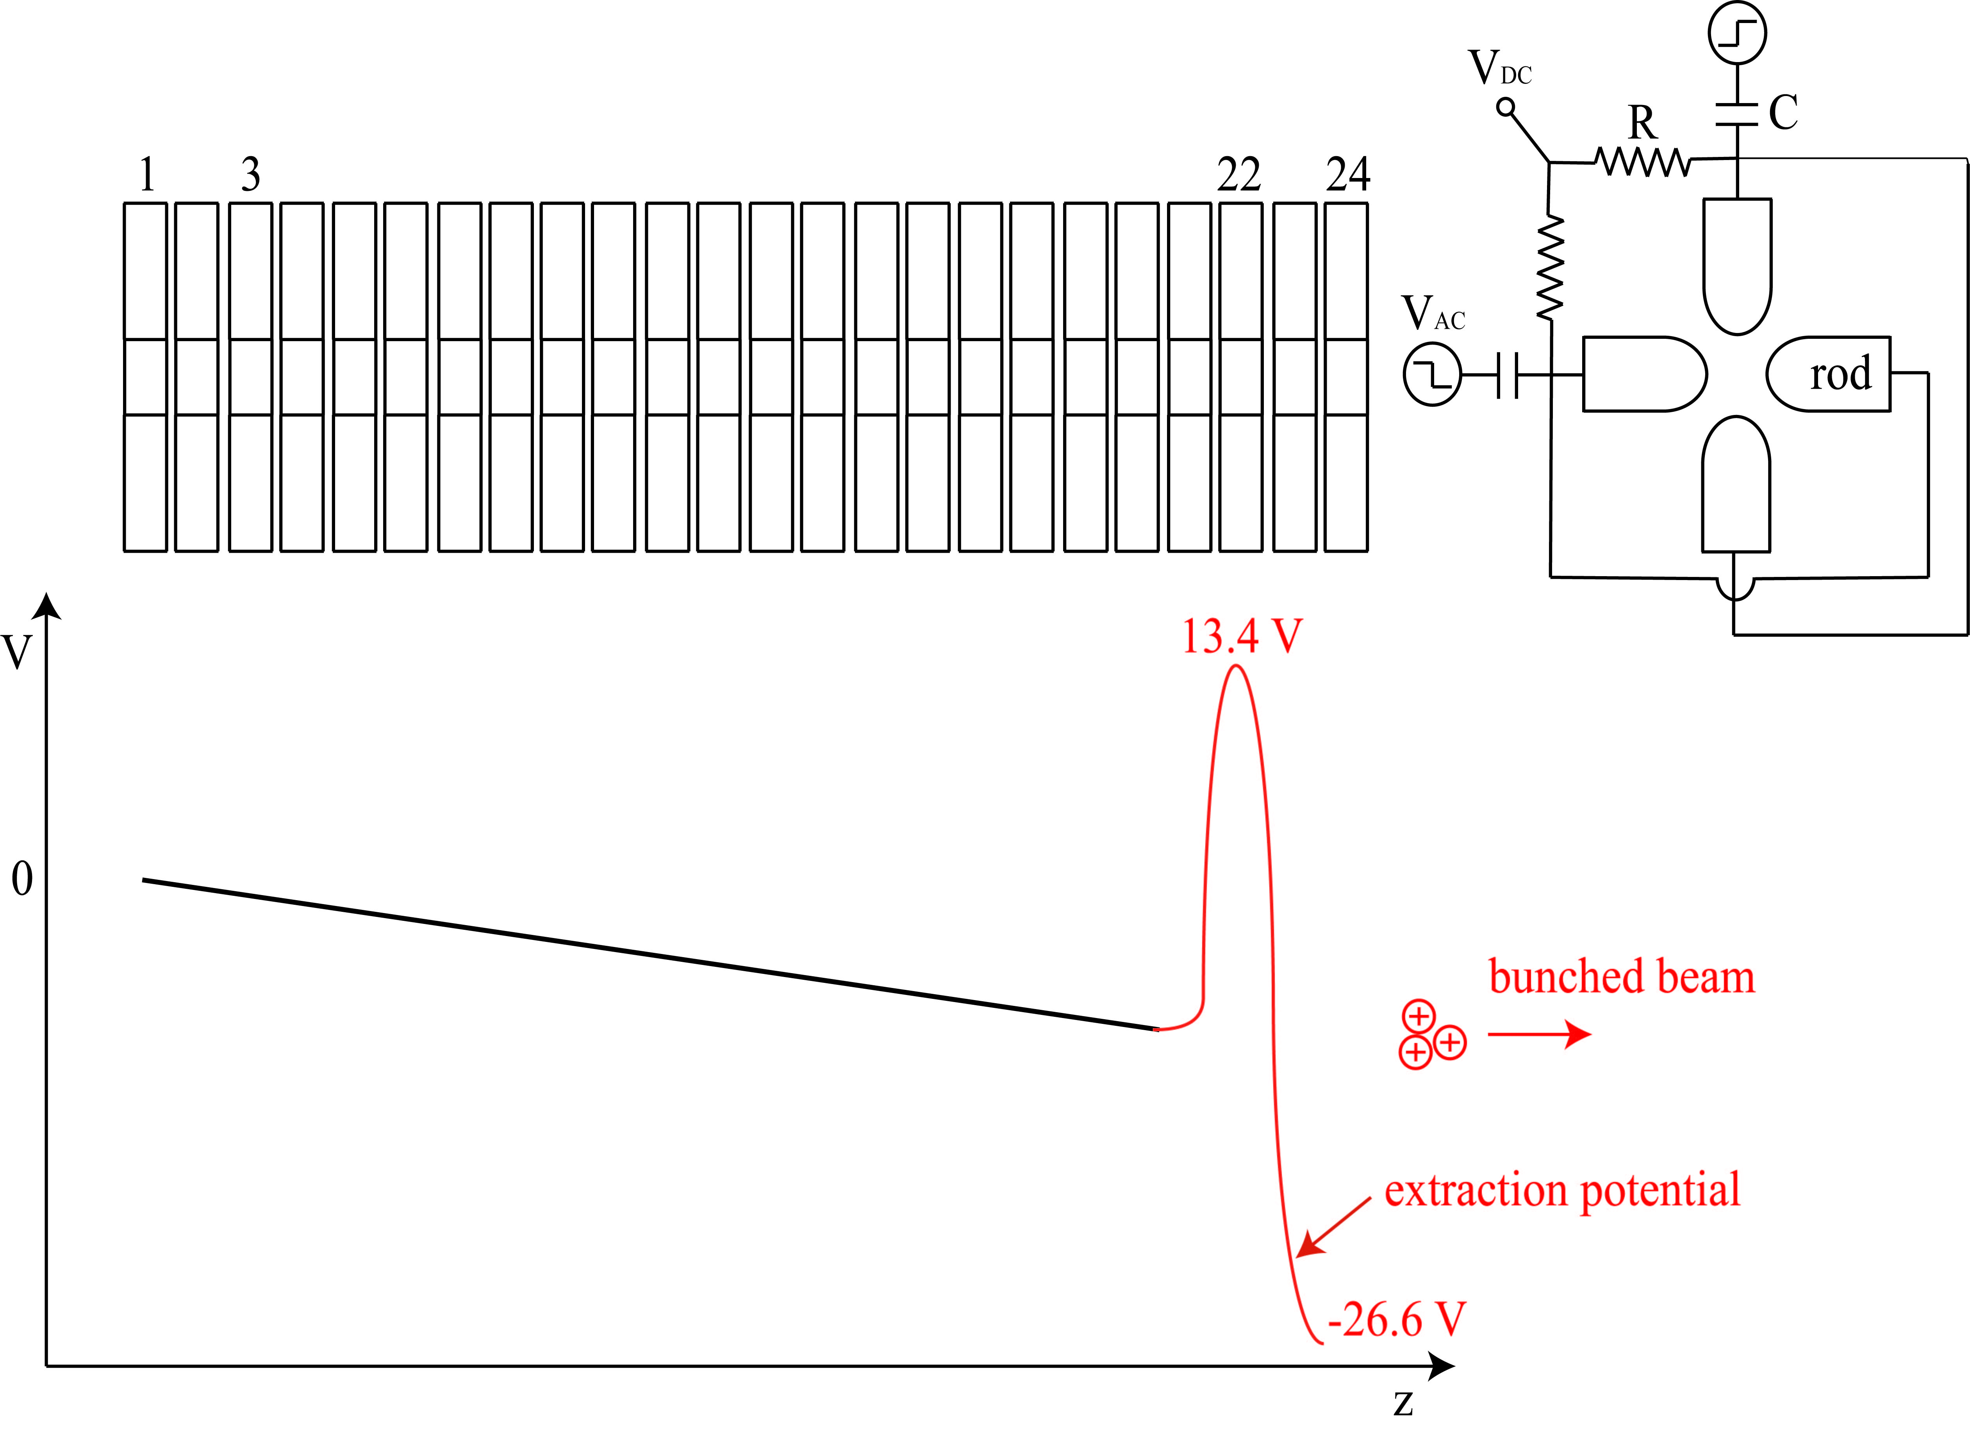
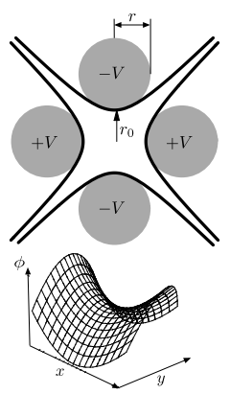
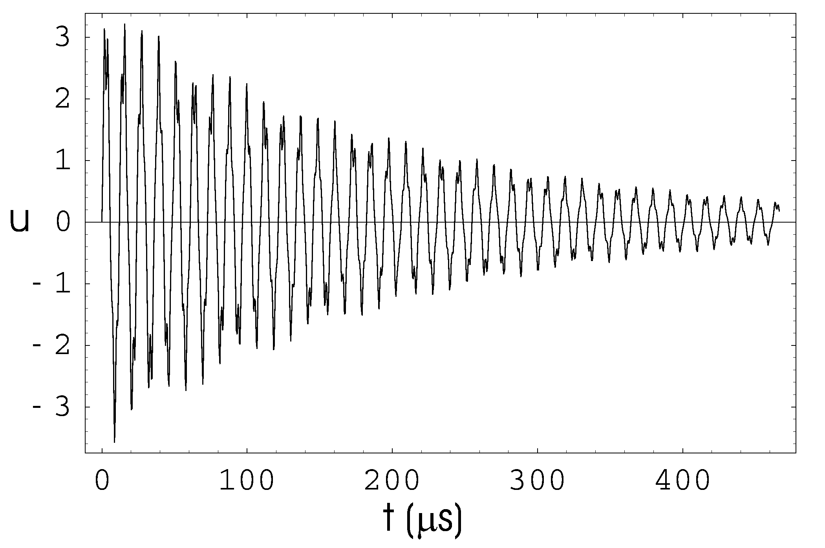
Linear Paul Trap
The TITAN RFQ
10 mm
Necessary ingredients
250 kHz to 1 MHz RF along the electrodes
Axial DC gradient
Buffer gas cooling
(mm)
Radial trajectory of ¹³³Cs in 2.5 x 10⁻² mbar
Viscous drag model calculation

Slide 6
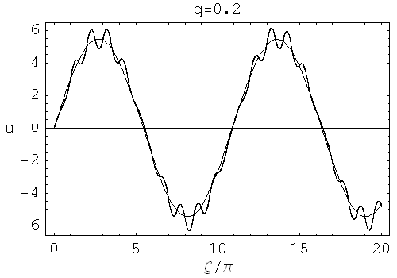
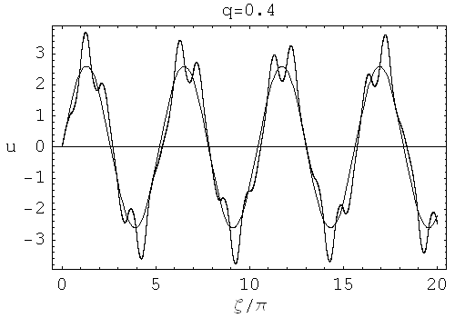
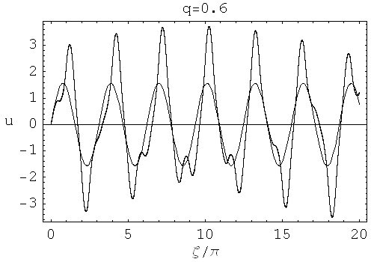
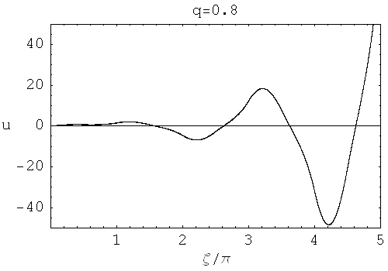
Analytic Considerations of the RFQ
Meissner equations determine ions motion in square-wave-driven trap:
Stability parameter
Analytic solution shows a simple harmonic macro-motion perturbed by a coherent micro-motion
As q increases so does the amplitude of the micro-motion
For q > 0.7 the motion becomes unbound
(50% duty cycle, ideal square wave)

Slide 7
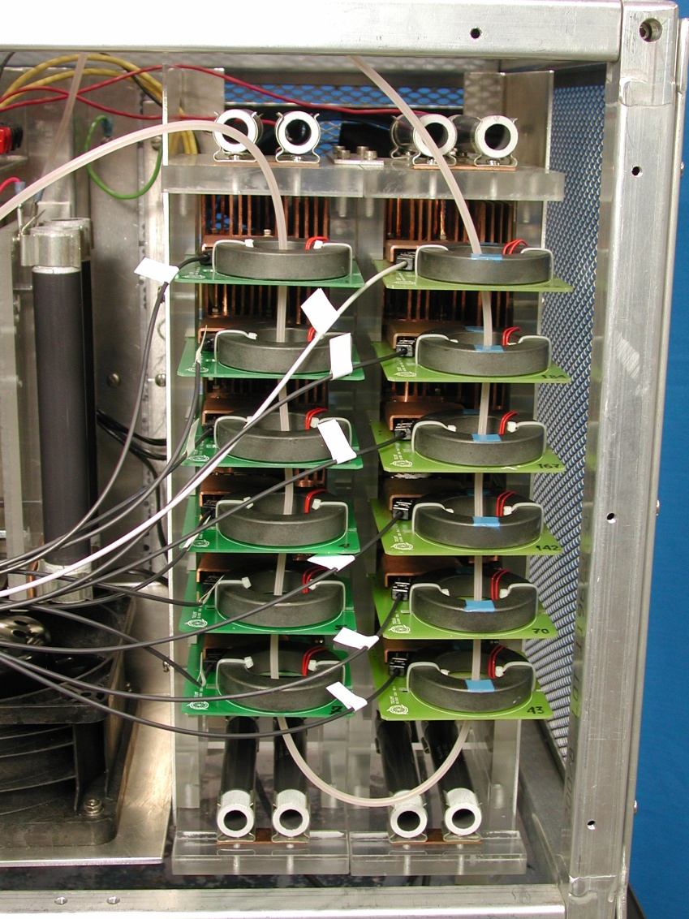
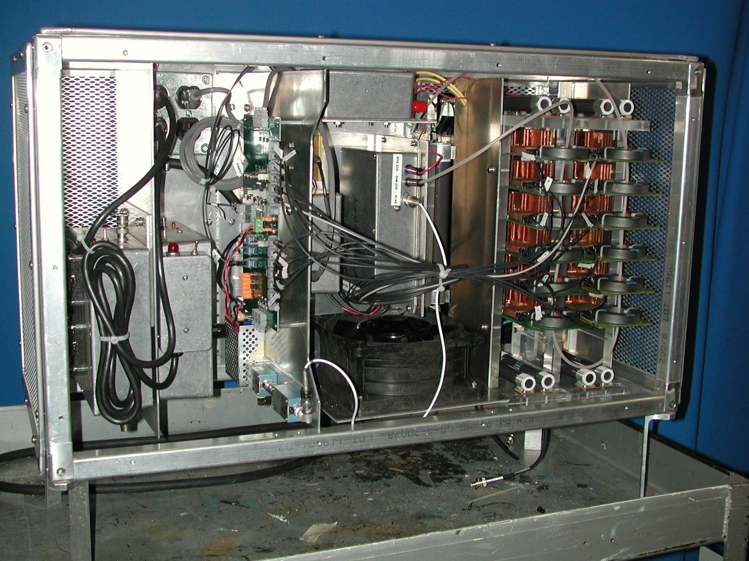
TITAN RFQ - Facts and Figures
Ions trapped by pseudo potential
Sine-Wave α = 0.13
Square-Wave α = 0.21
For same RF amplitude pseudo potential 1.5 times deeper for digital RF
TITAN RFQ facts
700 mm long, r₀ = 10 mm
C ≈ 1500 pF
Stack of optically triggered MOSFETs to produce RF
200 kHz to 1200 kHz frequency range
Up to 800 V_{PP}
RF box
Stack of MOSFETs

Slide 8
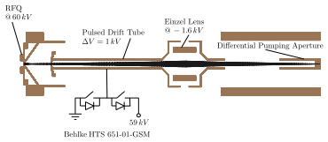
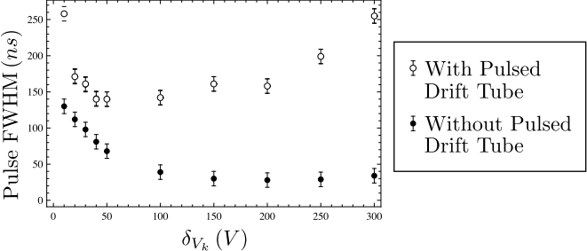
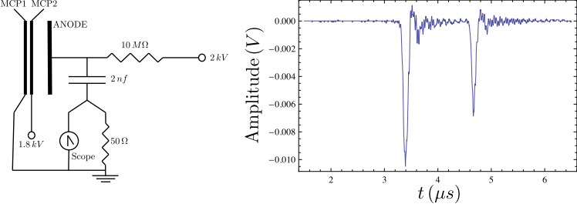
Pulsed Drift Tube
Defines beam energy
Switches ions to GND potential
Incoming beam energy 20 keV
RFQ 20 kV
PDT
18 kV
Ion elevator
Outgoing beam energy 2 keV
V
GND
Pulse width for different extraction voltages
⁶Li and ⁷Li extracted onto a MCP

Slide 9
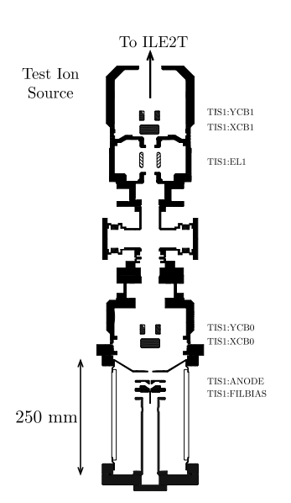
Systematic studies
Off line studies
Alkali ion source
Available all year
Online studies
Radioactive ¹²⁶Cs
MCPs
FC after RFQ
FC before RFQ
ISAC radioactive
Isotope beam
TITAN off-line
Ion source

Slide 10
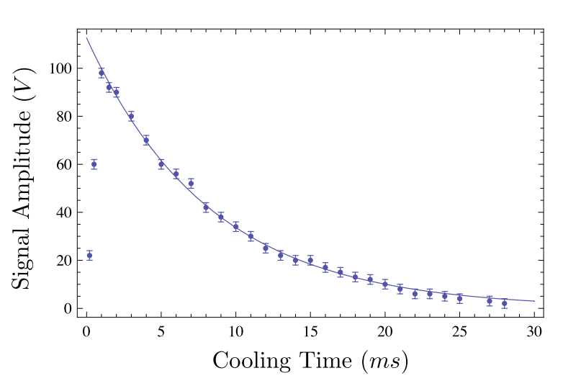
Survival Time in the Trap
TITAN off-line ion source (Li)
100μs incoming beam
60 V_{PP} RF at 1150 kHz
Gas at 4.5 x 10⁻³ mbar
Signal amplitude on MCP
Helium buffer gas
Li in He t_{1/2} = (5.7 ± 0.1) ms
Hydrogen buffer gas
No change of signal amplitude for Li in H for cooling times up to 30 ms
⁷Li

Slide 11
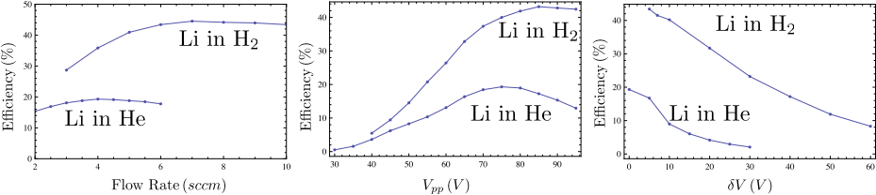
Li transmission
Efficiency vs. flow rate
Efficiency vs. RF amplitude
Efficiency vs. source potential
1200 kHz 79 V_{PP}
q_{6Li} = 0.20 q_{7Li} = 0.24
Because of better momentum transfers, transmission efficiency better when using H2
For ¹¹Li mass measurement, H2 was used due to better transmission efficiency in the RFQ

Slide 12
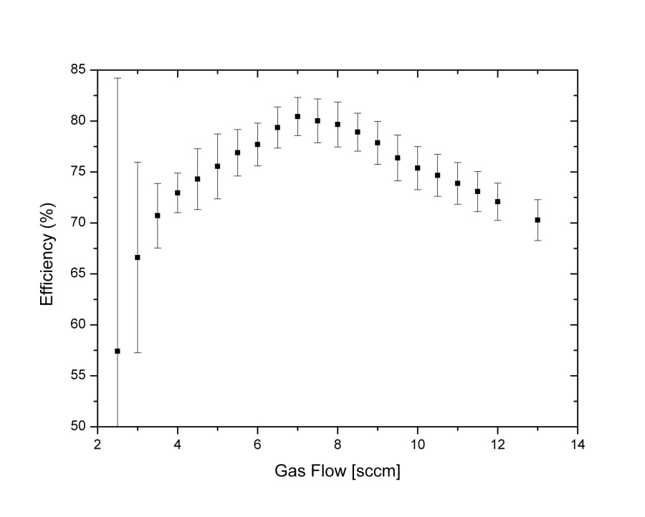
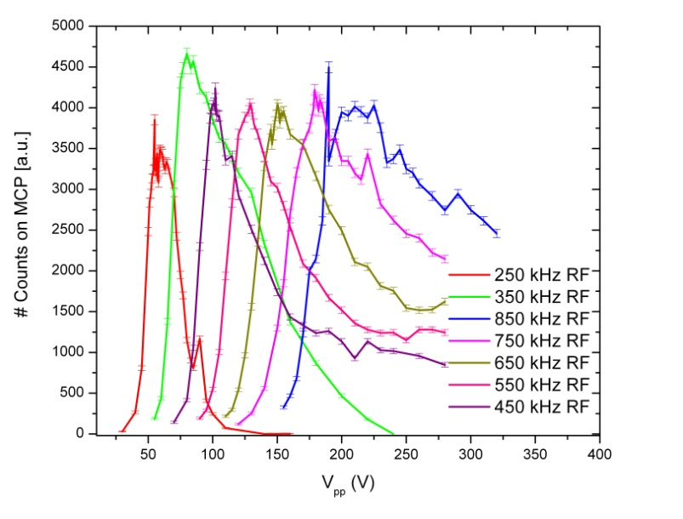
¹³³Cs Transmission
DC transmission
AC transmission
Preliminary
50V RFDC @ 250 kHz → q = 0.29
80V RFDC @ 350 kHz → q = 0.24
200V RFDC @ 850 kHz → q = 0.10
315 Vpp at 600 kHz
(80 ± 5)% DC transmission
Maximum transmission at ∼35 x 10⁻³ mbar
0.2 nA at Faraday cup
Stable ion motion for different frequency to RF voltage ratios

Slide 13
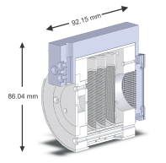
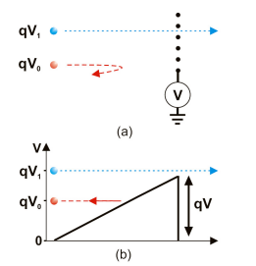
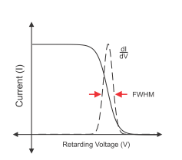
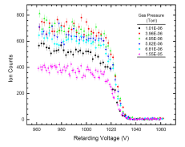
Longitudinal emittance
Determination of longitudinal energy spread
Scan retarding potential vs. count rate on MCP
1 keV ⁶Li⁺ beam cooled with He
→ Typical longitudinal energy spread of (12 ± 5) eV
Preliminary!
Counts at MCP (a.u.)
Counts at MCP (a.u.)
Retarding voltage (V)
Retarding voltage (V)

Slide 14
# Ions per Bunch
Idea:
Determine number of ions per bunch by implanting radioactive isotopes onto an Al foil and observing their radioactive decay
Monitoring PIPS
Half life data obtained with a MCS
PIPS- Passivated Implanted Planar Si detector
Aluminum foil
EBIT
Radioactive isotopes
RFQ

Slide 15
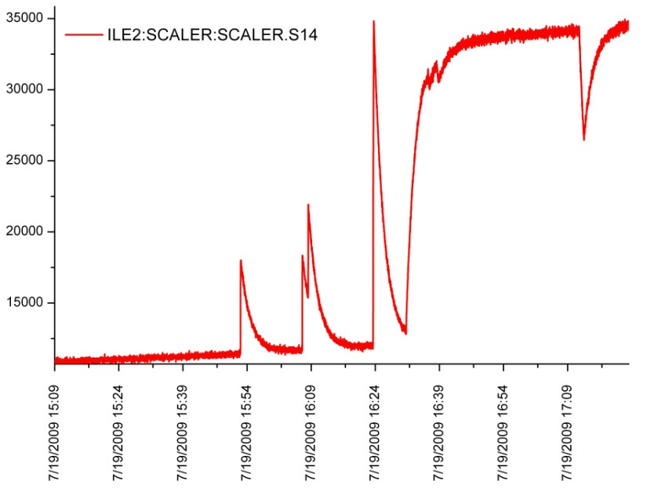
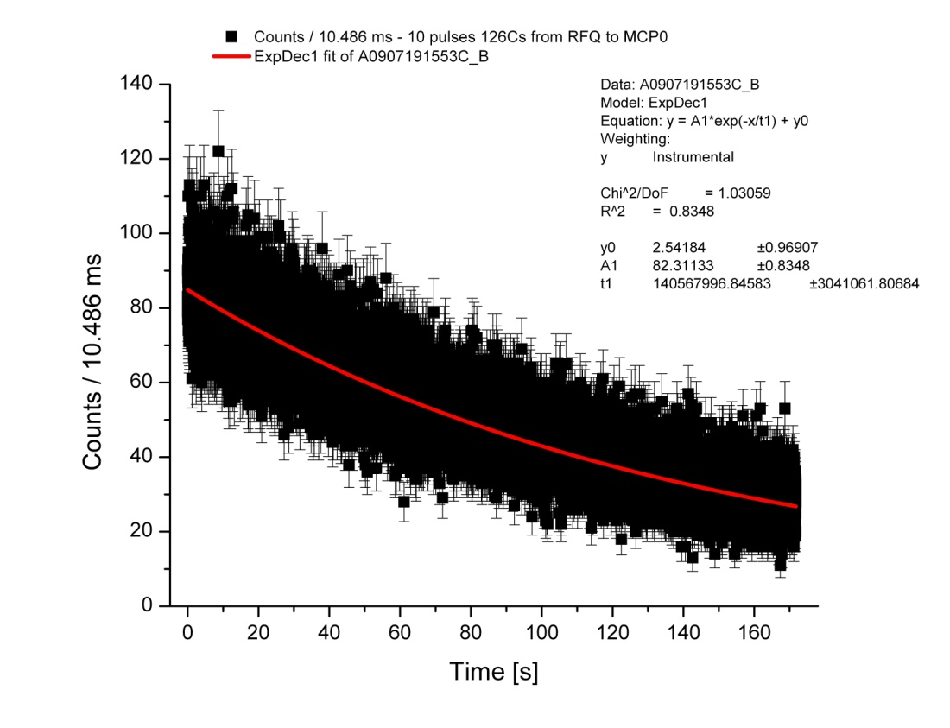
# ions/shot & Half Life of ¹²⁶Cs
Monitoring PIPS
Half life data obtained with a MCS
6 hrs beam off before first 10 pulses ¹²⁶Cs
t_{½} = 97.4 ± 2.1 s (fit) (lit: 98.4 ± 1.2s) for first 10 shots (1st spike)
Beam intensity ≈ 3 * 10⁵ ions/RFQ extraction pulse @ 10 Hz
BUT:
Half life increases for the following t_{½} measurements
→ Contamination built up on PIPS detector
EBIT
RFQ

Slide 16
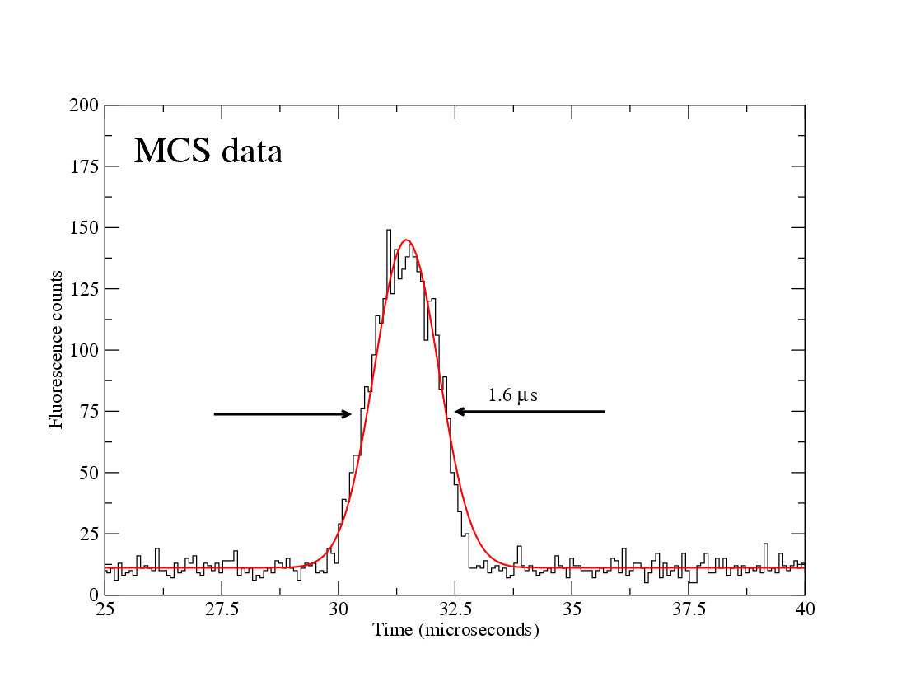
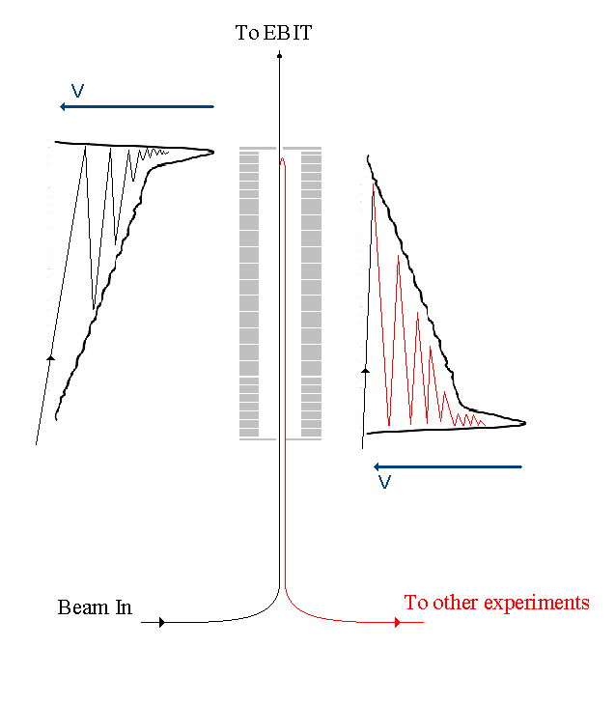
Unique Feature – Reverse Extraction
ToF of fluorescent photons
⁷⁸Rb
~ 10⁵ ions/bunch, 50 Hz cycle
28 keV ISAC beam energy
Ions
Laser
Collinear laser spectroscopy
Unique Features:
Square-wave-driven for broadband operation
Symmetric trap structure allows for reverse extraction
Reversed extraction allows for laser spectroscopy on cooled and bunched ions
PMT

Slide 17
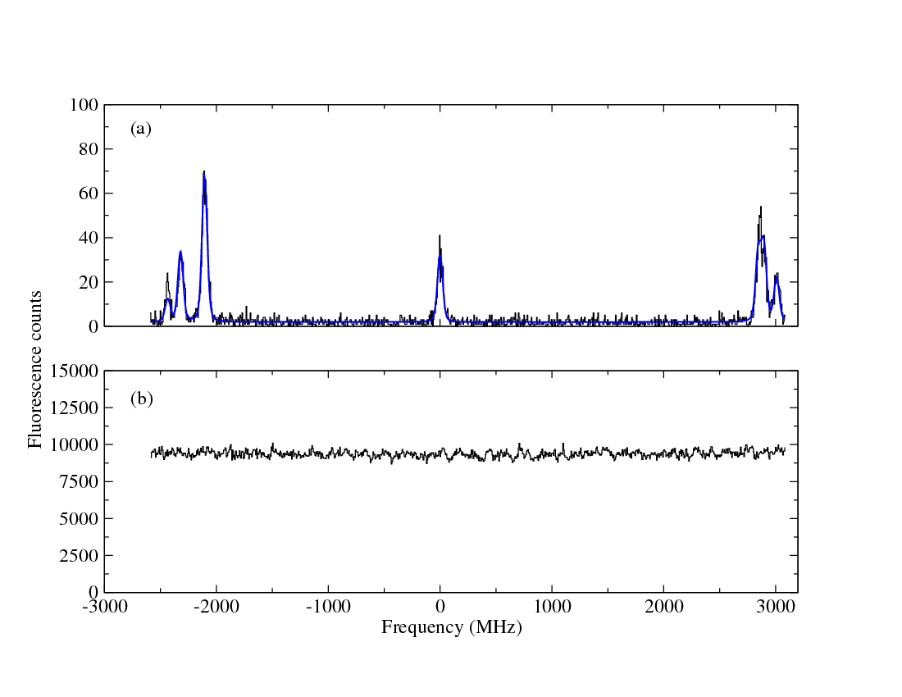
Laser Spectroscopy in RVE
First on-line data ^{78,78m}Rb ( I=0,4) D2 line, ~ 1pA
Gated
isomer
g.s.
Singles
background
29/10/2009 : 08:49-09:39
Laser spectroscopy on bunched ions:
Reduced beam emittance after cooling
Gating on ion bunch drastically reduces background

Slide 18
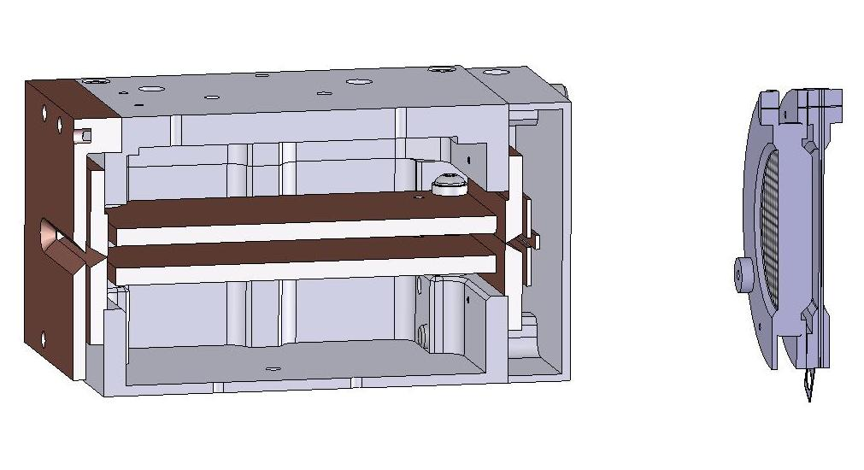
Summary
TITAN RFQ
Fully operational at 20 kV (⁸He beam time with 3 ions/minute at MPET MCP)
Commissioned for 40 kV
Frequency range from 250 kHz to 1200 kHz
DC transmission of up to 80 % for Cs
Broad mass range demonstrated for ion masses from 6 to 133
Cooling with He and H possible
Several online beam times with radioactive He, Li, K, Rb, Ca, In, Cs
One of a kind – reverse extraction for laser spectroscopy
… for the future
Upgrade vacuum system to accept C, O, …
Investigate chemistry inside the RFQ
Determine longitudinal and transversal emittance
Optimize system for reverse extraction
Many more radioactive beam times to come …
Transversal emittance

Slide 19
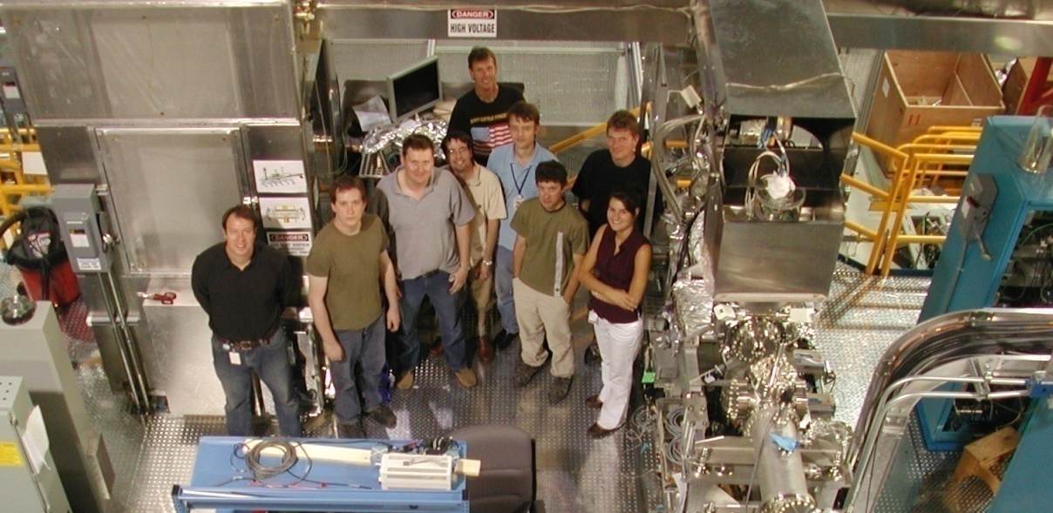











People/Collaborations
M. Brodeur, T. Brunner, J. Dilling, P. Delheij, S. Ettenauer, A. Gallant, M. Good, E. Mane, M. Pearson, V. Simon…
… and the TITAN collaboration
as well as A. Lapierre, R. Ringle, V. Ryjkov, M. Smith, Joe Vaz and TRIUMF staff.
U. of Manitoba
McGill U.
Muenster U.
MPI-K
GANIL
Colorado School of Mines
U. of Calgary
U. of Windsor
SFU
UBC
TU München
Yale

Slide 20
Backup slides

Slide 21
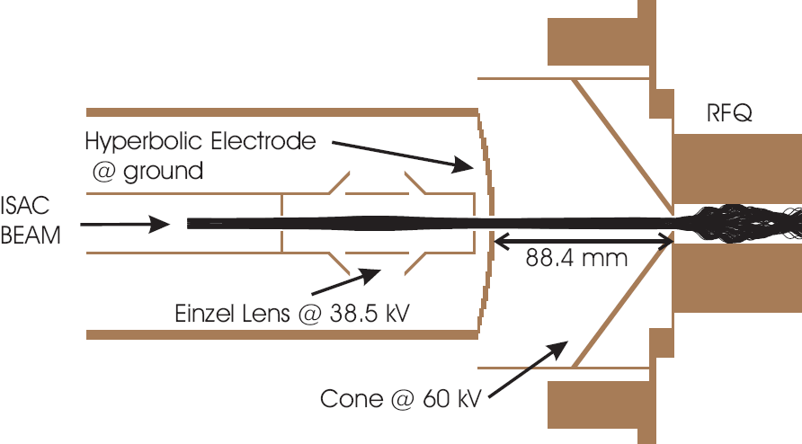
Injection
Unique Feature
New: harmonic deceleration optics

Slide 22

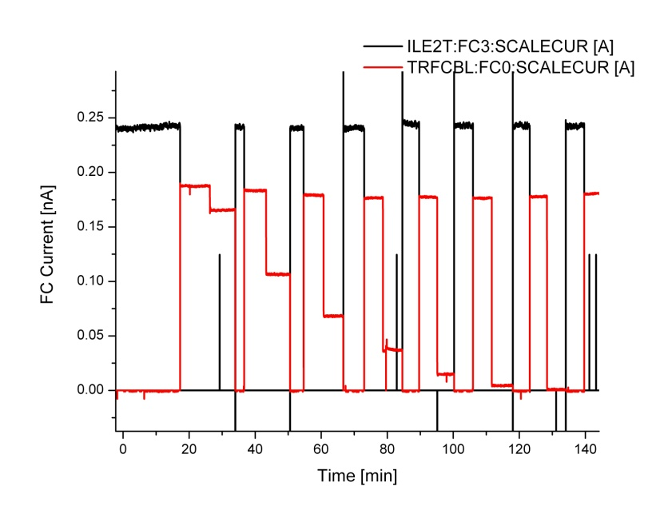
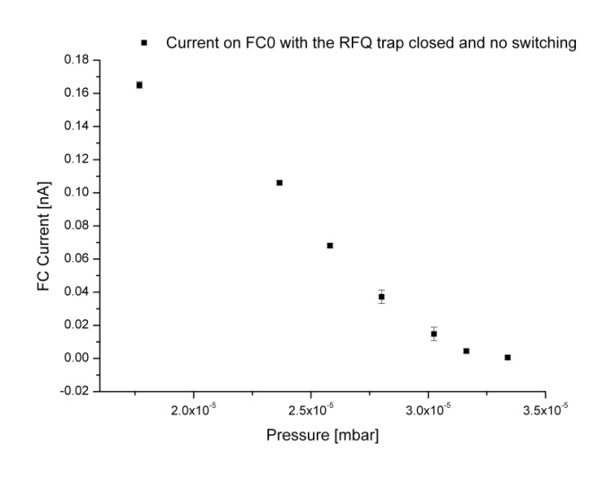
Minimal gas pressure
¹³³Cs with He buffer gas
V_{PP} 315 V at 600 kHz
DC beam on Faraday cup after RFQ
Two modes: trap open and trap constantly closed
Trap open
0 V
V
-7.2 V
1 sccm: 1.77 x 10⁻⁵ mbar
2 sccm: 2.58 x 10⁻⁵ mbar
3 sccm: 3.02 x 10⁻⁵ mbar
4 sccm: 3.34 x 10⁻⁵ mbar
1
Trap closed
+5 V
2
0 V
3
4
1
2
3
4

Slide 23
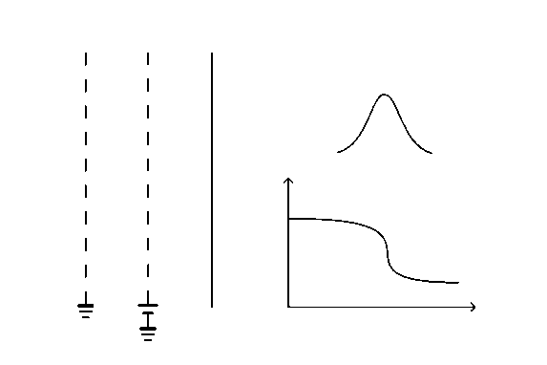
Emittance measurements
Emittance measurements and optimization
Transverse emittance
Longitudinal emittance
Energy
spread
I
V
V
MCP

Slide 24

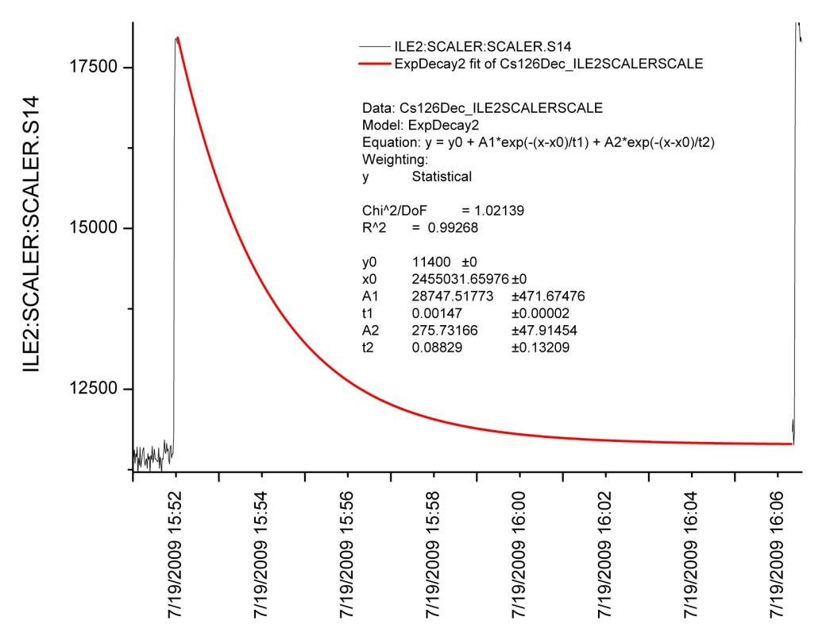
Contamination of ¹²⁶Cs beam
Monitoring PIPS
Half life data obtained with a MCS
Fit of strip tool data under the assumption of ¹²⁶Ba contamination:
t_{½} is fixed to the literature values
Intensities are the only free parameter
→ ~ 35% ¹²⁶Ba contamination ???
EBIT
RFQ

Slide 25
ISAC – Isotope Separation and Acceleration
500-MeV proton beam
The technique used:
Isotope separation online (ISOL):
(proton spallation)
Target: Ta, W, SiC
Exotic isotopes are
produced in the target
TRIUMF (now!)
A<120

Slide 26
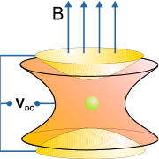
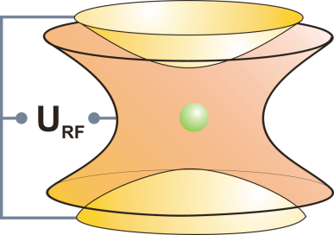
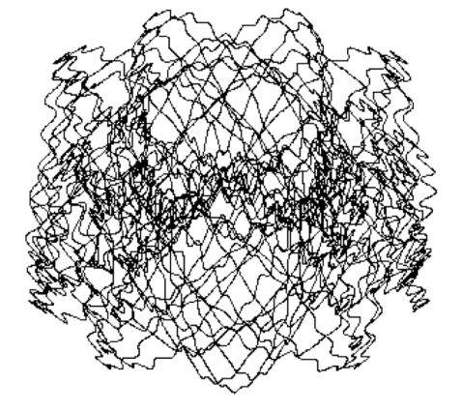
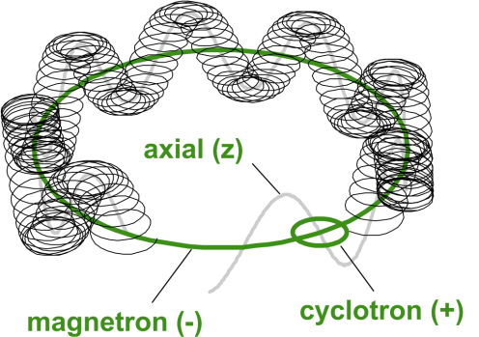
Basic Ion Trap Concepts
Basic ion trap concepts
Penning trap
Static electric quadrupole
and magnetic field
Paul trap
Oscillating electric quadrupole field
3D confinement
3 harmonic oscillations
Suited for precision experiments
micromotion + macromotion
Suited for manipulation techniques

Slide 27
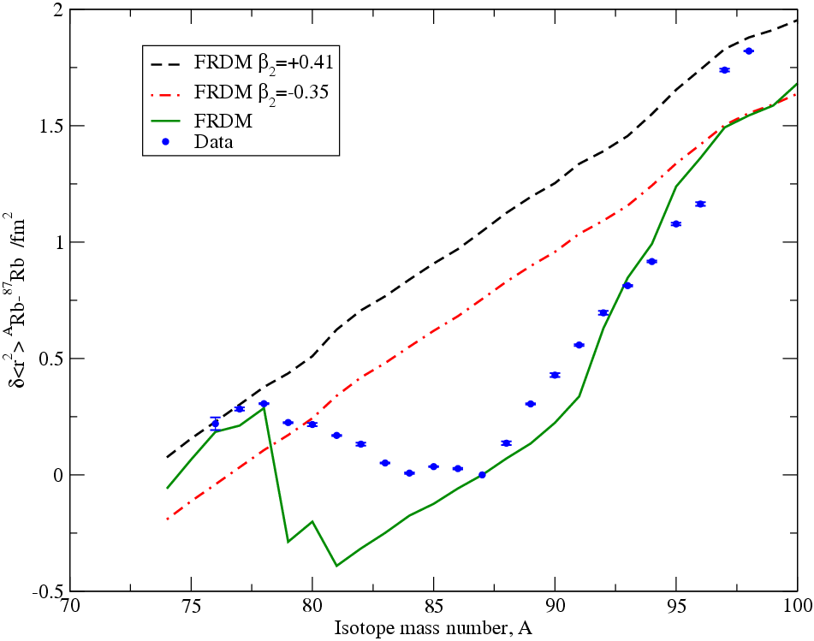
74
Motivation for the study of Rb (N=Z=37)‏
N~Z nuclei are useful to study aspects of nuclear structure such as pairing and isospin.
74
Any change in the charge radius of Rb might reveal dynamic deformation effects
...with implications for isospin breaking correction for ft values in superallowed  decays
78,78m
First on-line data Rb ( I=0,4) D2 line, ~ 1pA
Gated
isomer
g.s.
C. Thibault et al. PRC 23 6 (1981)‏
Reverse extracted bunches
Singles
78
Rb
background
29/10/2009 : 08:49-09:39
~ 10⁵ ions/bunch, 50 Hz cycle
E. Mané, M. R. Pearson et al.

