Slide 1
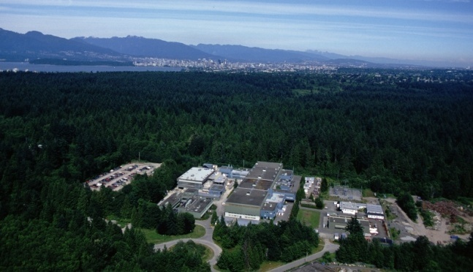


Electron Capture branching ratio measurements at TITAN-TRIUMF
T. Brunner, D. Frekers, A. Lapierre, R. Krücken, I. Tanihata, and J. Dilling for the TITAN collaboration
Canada’s National Laboratory for Nuclear and Particle Physics,
Vancouver, British Columbia, Canada

Slide 2
Outline
Neutrino experiments and the neutrino mass
Double beta decay experiments and their theoretical description
Electron Capture Branching Ratio measurements (EC-BR) with the EBIT

Slide 3
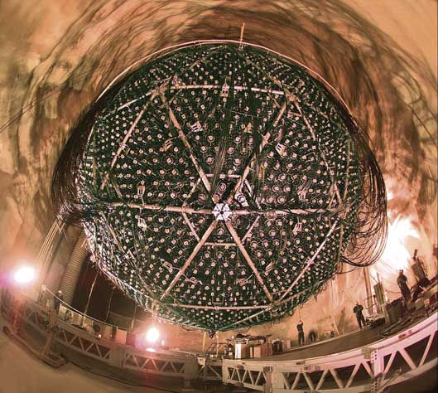
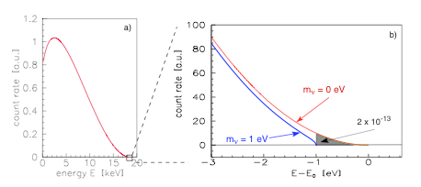
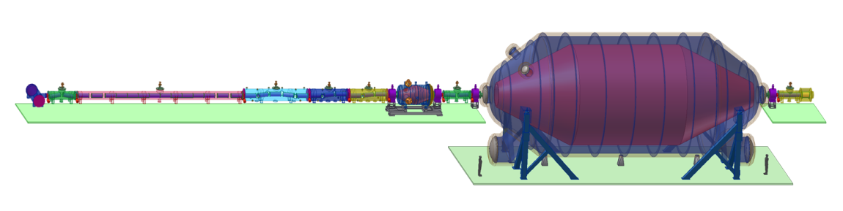
Neutrino experiments and the neutrino mass
Neutrino oscillation
Tritium decay
KATRIN, picture taken from http://students.washington.edu
SNO, picture taken from http://www.oit.on.ca
Relative mass scale
Absolute mass scale
Indicate a neutrino mass [1]
Determination of mixing angle θ_{ij}
Indicate mass hierarchy
Determination of δm²
Endpoint energy of ³H decay
Effective mass for degenerated neutrinos:
[1] T. Kajita and Y. Totsuka, Rev. Mod. Phys. 73(2001)85

Slide 4
Double β decay
Underground labs
Worldwide topic
SNO Lab
GERDA
CUORE
COBRA
EXO
NEMO3
Standard model
New physics
2ν double β - decay
0ν double β - decay
Lepton number violation
Half life> 1.9x10 ²⁵ years [2] (⁷⁶Ge)!!!
Half life> 10 ¹⁷ years (⁷⁶Ge)
Dirac - Neutrino
Majorana - Neutrino
[2] C.E. Aalseth et al., Phys. Rev. D65(2002)092007
[3] S.R. Elliott and P. Vogel, Annu. Rev. Nucl. Part. Sci. 52(2002)115

Slide 5
Double β decay
Underground labs
Worldwide topic
SNO Lab
GERDA
CUORE
COBRA
EXO
NEMO3
Standard model
New physics
2ν double β - decay
0ν double β - decay
Lepton number violation
Half life> 1.9x10 ²⁵ years [2] (⁷⁶Ge)!!!
If observed:
Half life> 10 ¹⁷ years (⁷⁶Ge)
Dirac - Neutrino
Majorana - Neutrino
[2] C.E. Aalseth et al., Phys. Rev. D65(2002)092007
[3] S.R. Elliott and P. Vogel, Annu. Rev. Nucl. Part. Sci. 52(2002)115

Slide 6
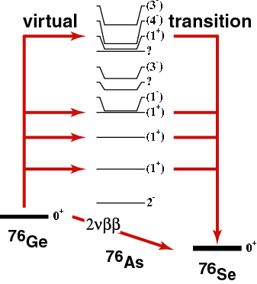
2νββ decay
Primakoff-Rosen approximation [4]
accessible thru charge-
exchange reactions in
(n,p) and (p,n) direction
( e.g. (d,²He) or (³He,t) )
as well thru EC-BR
[4] H. Primakoff and S.P. Rosen, Rep. Prog. Phys. 22(1959)121

Slide 7
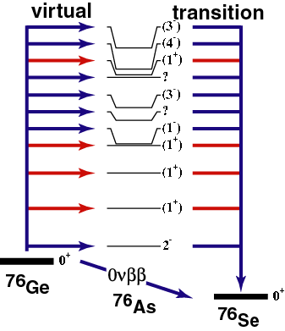
0νββ decay
mass of Majorana neutrino
nucl. matrix element
NOT accessible thru
charge-exchange reactions
Forbidden in Standard Model
lepton number violated
neutrino enters as virtual particle
J. Dilling et al., Can. J. Phys. 85(2007)57

Slide 8
Theoretical description
Description of double β decay nuclei with the proton-neutron Quasiparticle Random Phase Approximation (pn-QRPA)
Adjustable particle-particle parameter g_{pp} in pn-QRPA for all single and double β decay calculations (The many-particle Hamiltonian is a function of g_{pp})
Extrapolation of calculated matrix elements to 2νββ half life provides g_{pp} (g_{pp} ~ 1)
2νββ decay is sensitive to g_{pp}, 0νββ decay is insensitive to g_{pp}
Cross check of g_{pp} with single β⁻ and EC decays

Slide 9
Example ¹¹⁶Cd
Recent critical assessment of the theoretical situation
g_{pp} also enters into calculation of single β decay
2. this allows to make (in few cases) precise predictions about EC-rates
in confronting with experiment, theory fails BADLY
(if EC is known)
In case of single state dominance:
expmt
expmt
M_{EC} = 1.4 ε = 0.095% theory [5]
M_{EC} = 0.69 ε = (0.0227 ± 0.0063)% exp 1 [6]
M_{EC} = 0.18 ε = (0.0019 ± 0.003)% exp 2 [7]
[5] J. Suhonen, Phys. Lett. B607(2005)87
[6] M. Bhattacharya et al., Phys. Rev. C58(1998)1247
[7] H. Akimune et al., Phys. Lett. B394(1997)23

Slide 10
Determination of M_{EC}
The use of g_{pp}(ββ) ~ 1.0 reproduces the 2νββ decay half-life but not the single EC and β⁻ decay.
Discrepancies of 1 – 2 orders of magnitude are possible
The loose end:
EC rates are badly known, or not known at all
1+
15.8 s
¹⁰⁰Tc
Q_{EC} = 0.168
ε = (1.8 ±0.9)x10⁻³ % [8]
Q_{β} = 3.202
β⁻β⁻
¹⁰⁰Mo
¹⁰⁰Ru
[8] A. García et al., Phys. Rev. C47(1993)2910

Slide 11
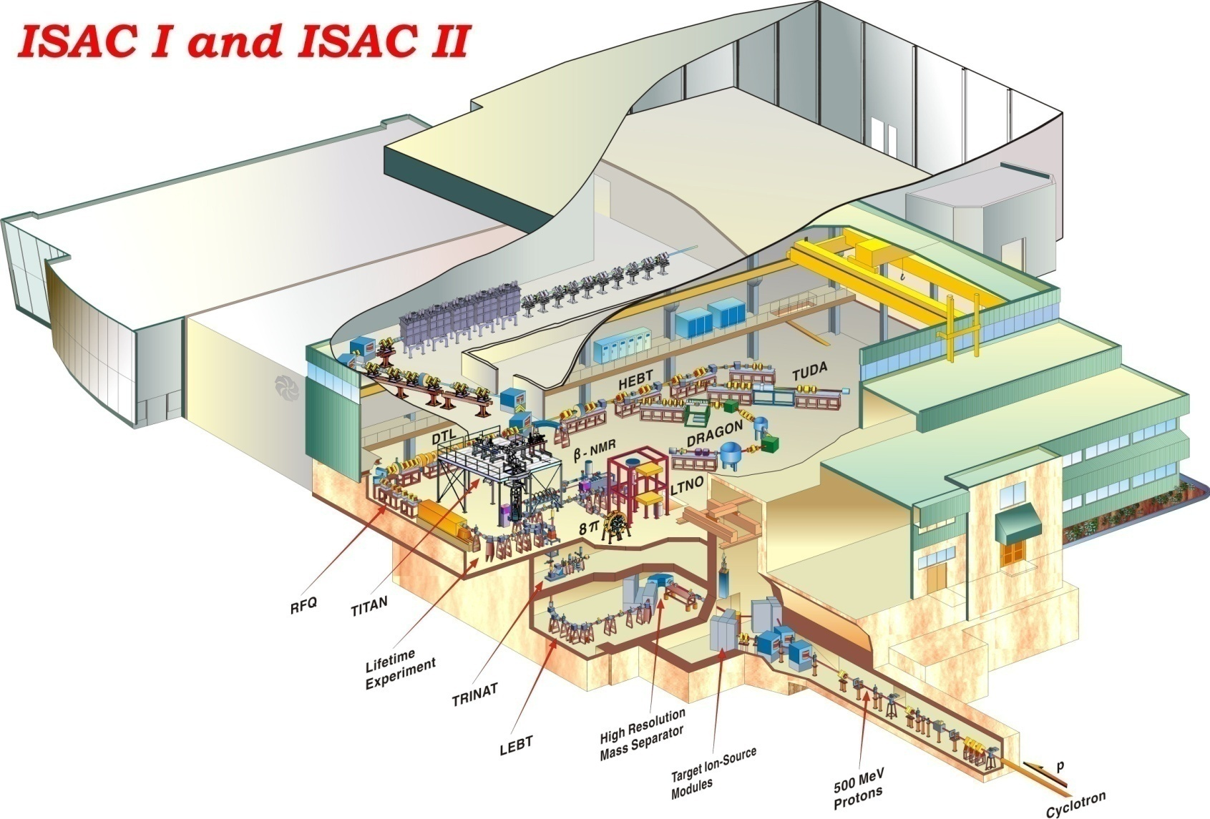
ISAC at TRIUMF
TITAN

Slide 12
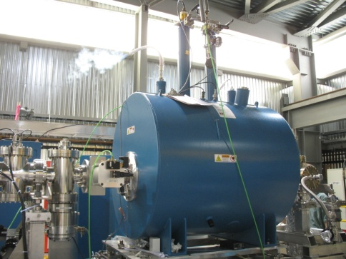
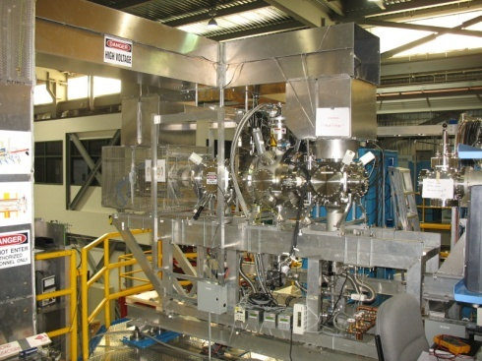
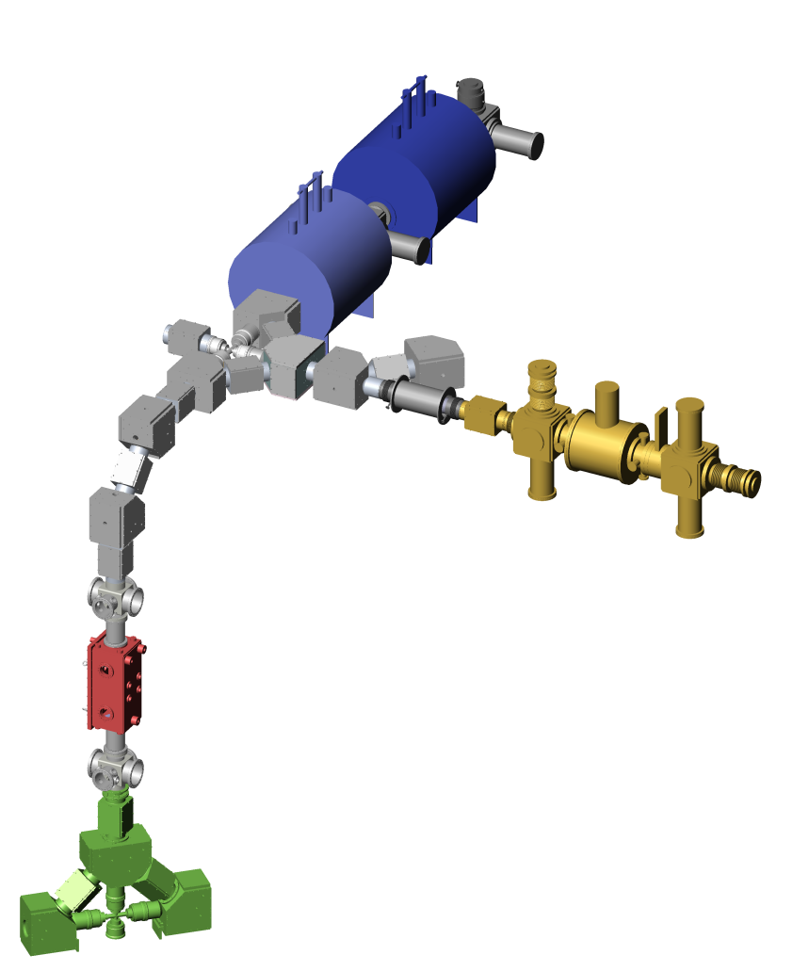
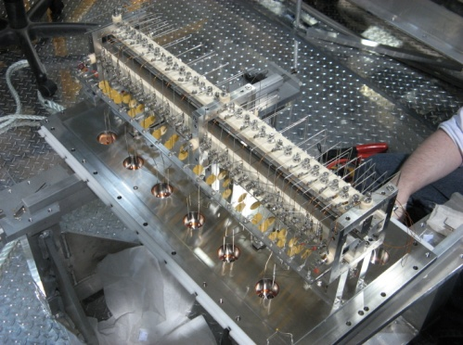
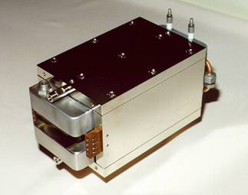
TITAN Facility
TRIUMF Ion Trap for Atomic and Nuclear science
Penning trap for high precision mass measurements
A^{q+}
Electron Beam Ion Trap (EBIT) for charge breeding
~5 kV • q
A⁺
Penning trap to cool HCI from EBIT (under design)
Radio-Frequency Quadrupole (RFQ) cools and bunches ISAC beams
Wien filter:
q/m selection
Short-lived isotopes from an Isotope
Separator and Accelerator (ISAC)
A⁺

Slide 13
The EBIT - Schematic
Cryogen-free superconducting coils
Working parameters:
Max. e-beam energy: ~70 keV
Max. e-beam current: 500 mA (up to 5 A)
Max. magnetic field strength: 6 T
Current density (center): 10⁴ - 10⁵ A/cm²
Einzel
lenses
Retractable e-gun
Magnetic-field distrib.
Taken from M. Froese
Electron collector
Trap
Electron gun
_
_
+
Dip
Up to ~-60 kV
0 to ~10 kV
Up to ~-60 kV
~460 mm
~235 mm

Slide 14
The EBIT - Schematic
Cryogen-free superconducting coils
EC-BR measurements
Einzel
lenses
Beta detector
Magnetic-field distrib.
Taken from M. Froese
Trap
1/7 X-ray detector
Dip
~284 mm

Slide 15
Setup ECBR measurements
X-ray detector
Storage and detection
Penning trap
γ
6 T magnet
Beta detector
(PIPS)
Ion injection
10⁵ – 10⁶ ions
trapped
β⁻
Trap electrodes
TITAN Electron Capture Branching Ratio:
New approach: spatial separation of X-ray and β⁻ detection
Seven X-ray detectors around segmented trap
2.1% solid angle for X-ray detection after EC
No electron background at X-ray detectors due to strong magnetic field (6T)
Long holding times in vacuum of P < 10⁻¹¹ mbar

Slide 16
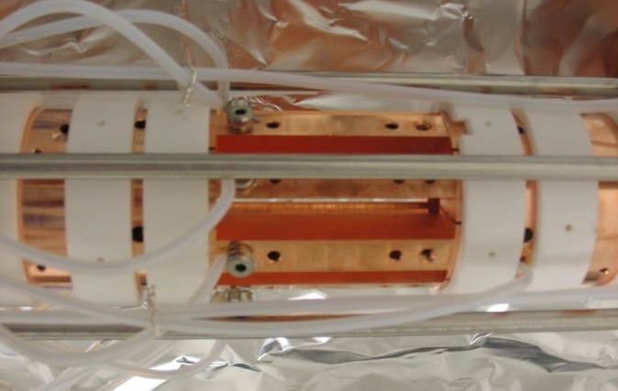
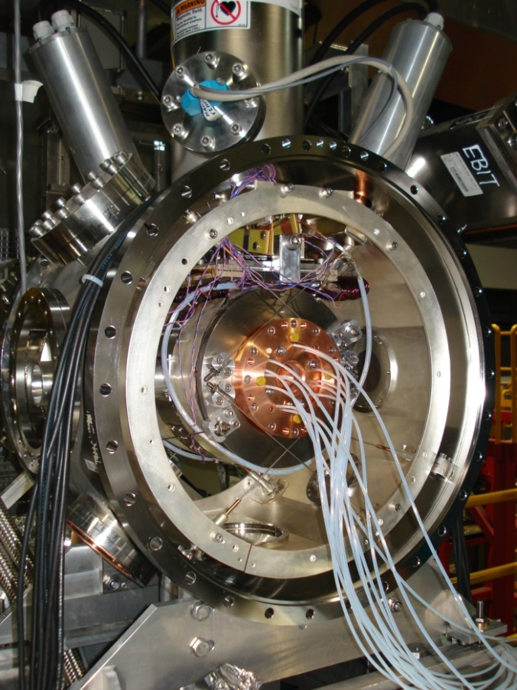
Branching Ratio Measurements
CANDIDATES FOR BRANCHING RATIO MEASUREMENTS
¹⁰⁰Mo : | ¹⁰⁰Tc (EC) | [1+→ 0+, T1/2 = 15.8 s] | K_{α} = 17.5 keV
¹¹⁰Pd : | ¹¹⁰Ag (EC) | [1+→ 0+, T1/2 = 24.6 s] | K_{α} = 21.2 keV
¹¹⁴Cd : | ¹¹⁴In (EC) | [1+→ 0+, T1/2 = 71.9 s] | K_{α} = 25.3 keV
¹¹⁶Cd : | ¹¹⁶In (EC) | [1+→ 0+, T1/2 = 14.1 s] | K_{α} = 25.3 keV
⁸²Se : | ^{82m}Br (EC) | [2-→ 0+, T1/2 = 6.1 min] | K_{α} = 11.2 keV
¹²⁸Te : | ¹²⁸I (EC) | [1+→ 0+, T1/2 = 25.0 min] | K_{α} = 27.5 keV
⁷⁶Ge : | ⁷⁶As (EC) | [2-→ 0+, T1/2 = 26.2 h] | K_{α} = 9.9 keV
1+
15.8 s
¹⁰⁰Tc
Q_{EC} = 0.168
ε ≈ 0.0018%
Q_{β} = 3.202
¹⁰⁰Mo
β⁻β⁻
¹⁰⁰Ru
10⁵ ions in trap with one half-life measurement cycle:
solid angle: 2.1%
detection efficiency: 30%
5.7 x 10⁻³ EC counts/cycle
100 EC counts → 17636 EBIT fills → 74h
88h proposed for ¹⁰⁰Tc

Slide 17
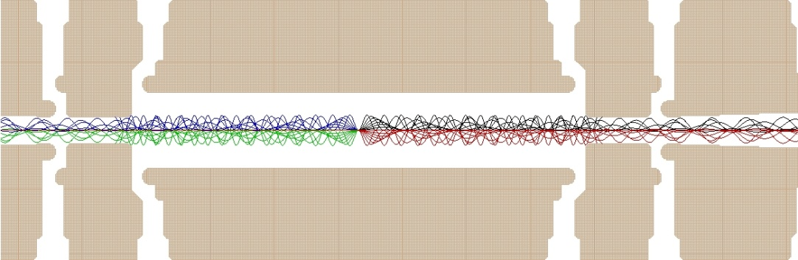
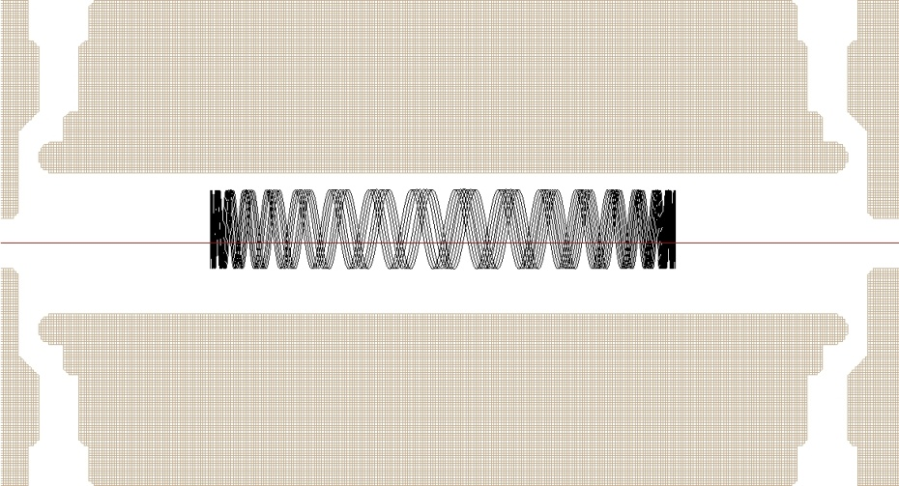
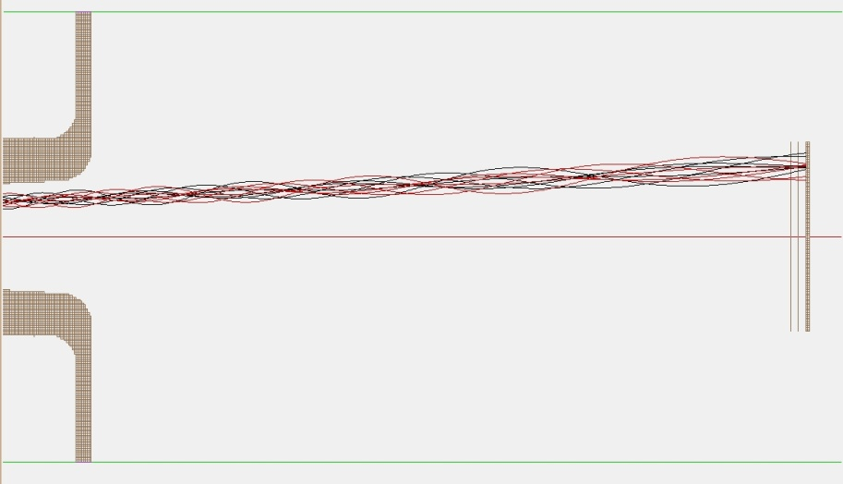
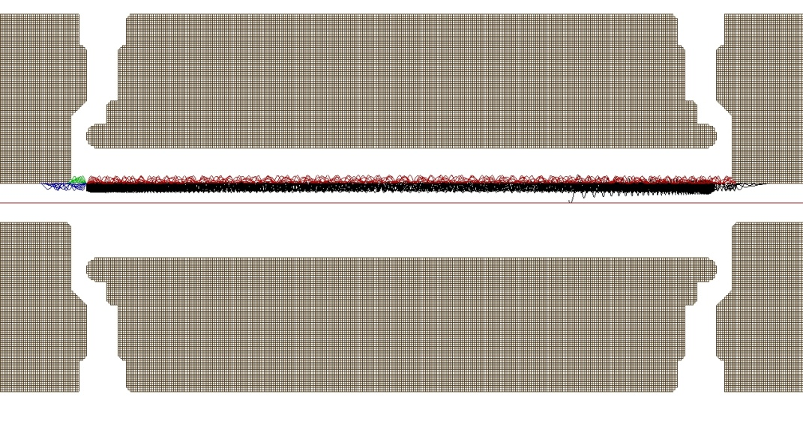
Simulations
B_{max} ~ 3T
Ø5 mm
B_{max} = 6T
5 kV
4.7 kV
5 kV
Loss through magnetic bottle for θ > 79deg:
3 MeV electrons
B_{max} = 6T
25 mm
B_{max} = 6T
284 mm to center
Loss through wall collisions
→ Rotating wall cooling or side-band cooling

Slide 18
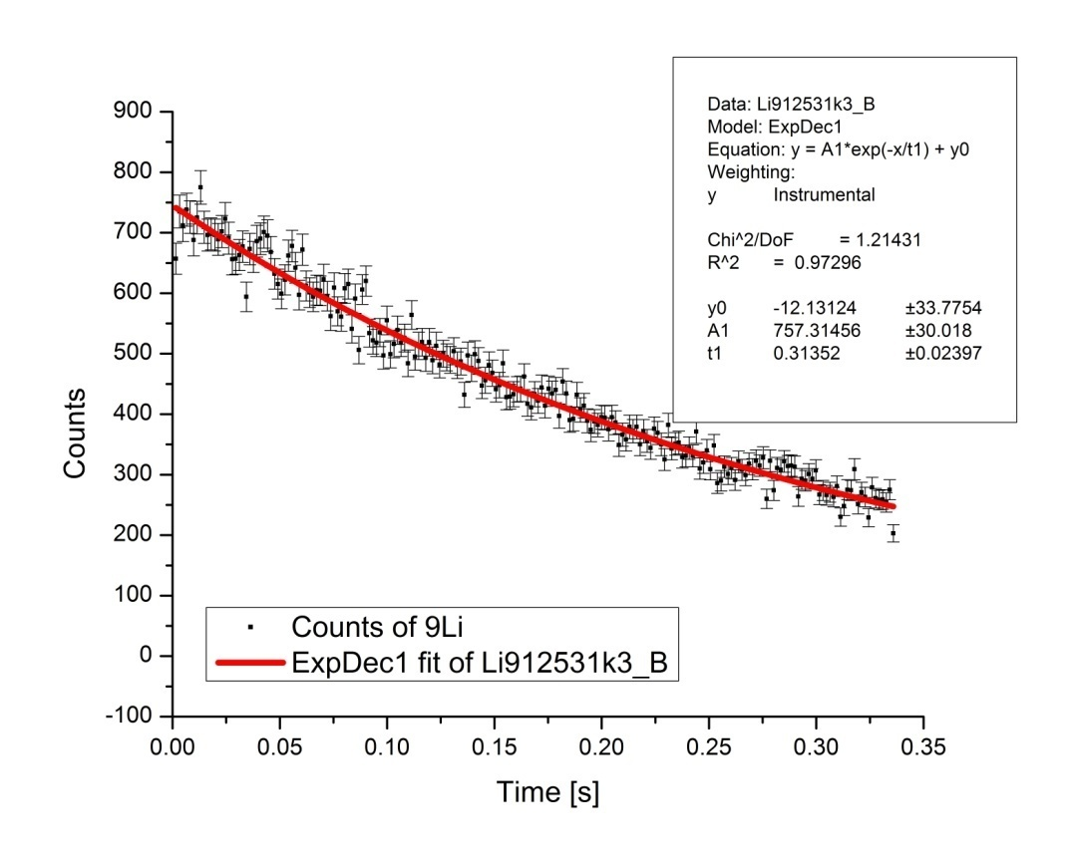
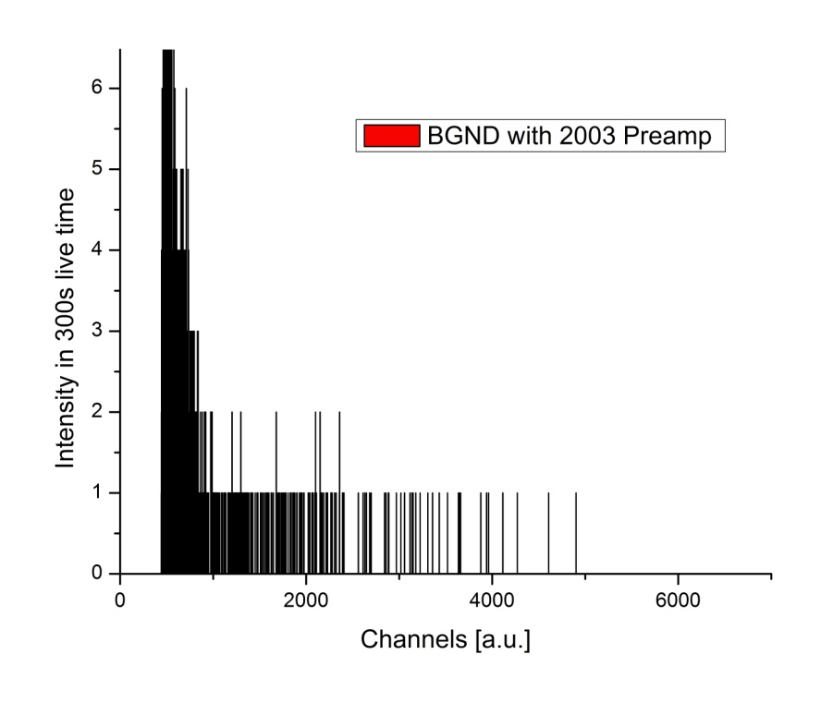
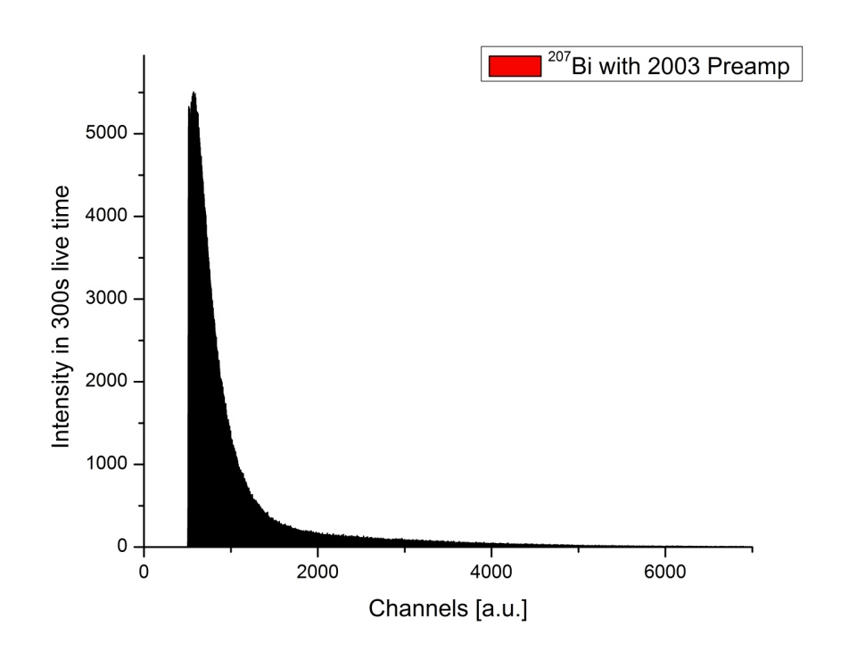
β - detector
Passivated Implanted Planar Silicon detector
PIPS
⁹Li
⁹Li
Q = 13.6 MeV
T_{½} [lit] = 178.3ms
T_{½} [PIPS] = 217.3(16.6)ms
Al- foil
1130 counts
2.1 x 10⁶ counts

Slide 19
Summary
There are discrepancies in the description of 2νββ within the pn-QRPA
M_{EC} and M_{β} for single decays do not agree with those extrapolated from 2νββ decay
TITAN EBIT offers a novel approach for EC-BR measurements
  Long storage times
  Low background at X-ray detector
…for the future
TITAN EBIT will be connected to the TITAN beam line (EBIT was commissioned in August 2006).
First EC branching ratio measurements with the EBIT by the end of this year

Slide 20
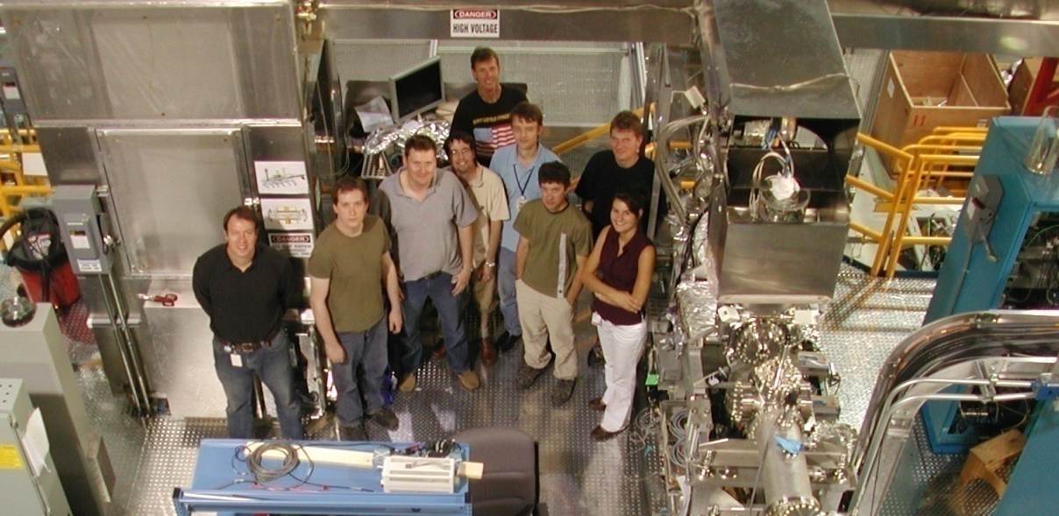









People/Collaborations
M. Brodeur, T. Brunner, C. Champagne, J. Dilling, P. Delheij, S. Ettenauer, M. Good, A. Lapierre, D. Lunney, C. Marshall, R. Ringle, V. Ryjkov, M. Smith, and the TITAN collaboration.
U. of Manitoba
McGill U.
Muenster U.
MPI-K
GANIL
U. of Calgary
U. of Windsor
Colorado School of Mines
UBC
TU München

Slide 21
¹⁰⁰Tc production rate
LaC₂ target with 50μA p beam
Ta target with 70μA p beam
Thanks to
Marik Dombsky

