Slide 1
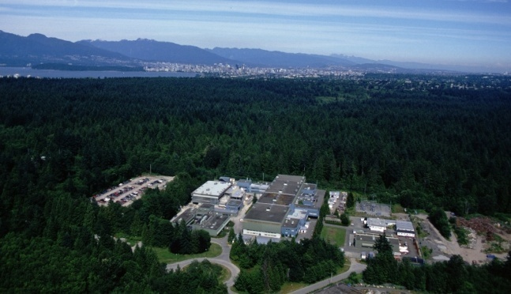


Electron Capture branching ratio measurements at TITAN-TRIUMF
T. Brunner, S. Ettenauer, D. Frekers, A. Lapierre, R. Krücken, I. Tanihata, and J. Dilling
for the TITAN collaboration
Outline:
Motivation: Neutrinoless double beta decay
EC-BR setup at TITAN
Status and first experimental results
Canada’s National Laboratory for Nuclear and Particle Physics,
Vancouver, British Columbia, Canada

Slide 2
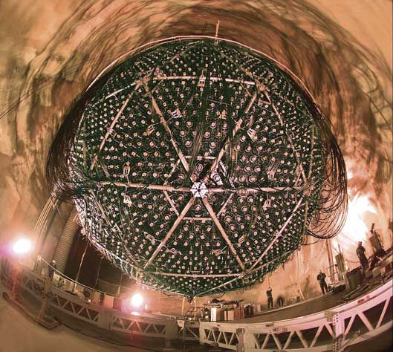
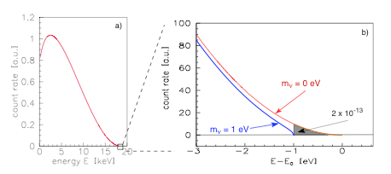
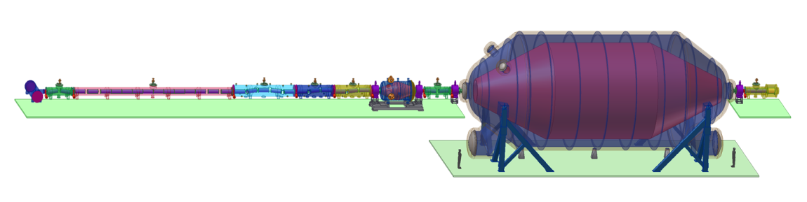
Neutrino experiments and the neutrino mass
Neutrino oscillation
Tritium decay
KATRIN, picture taken from http://students.washington.edu
SNO, picture taken from http://www.oit.on.ca
Relative mass scale
Absolute mass scale
Indicate a neutrino mass [1]
Determination of mixing angle θ_{ij}
Indicate mass hierarchy
Determination of δm²
Endpoint energy of ³H decay
Effective mass for degenerated neutrinos:
[1] T. Kajita and Y. Totsuka, Rev. Mod. Phys. 73(2001)85
2
Notes:
2

Slide 3
Double β decay
Worldwide topic
Some ββ decay experiments
GERDA, CUORE, CUORICINO, COBRA, MOON
Standard model
New physics
2ν double β - decay
0ν double β - decay
Lepton number violation
Half life> 1.9x10 ²⁵ years [2] (⁷⁶Ge)!!!
If observed:
Half life> 10 ¹⁷ years (⁷⁶Ge)
Dirac - Neutrino
Majorana - Neutrino
[2] C.E. Aalseth et al., Phys. Rev. D65(2002)092007
[3] S.R. Elliott and P. Vogel, Annu. Rev. Nucl. Part. Sci. 52(2002)115

Slide 4
Determination of M_{EC}
pn-Quasiparticle Random Phase Approximation
one possibility to determine M^{(2ν)} and M^{(0ν)}
M^{(0n)} needed to an uncertainty of less than 20%
Adjustable particle-particle parameter gpp in
pn-QRPA for all single and double β decays
Extrapolation of calculated matrix elements to
2νββ half life provides g_{pp} (g_{pp} ~ 1)
The loose end:
EC rates are badly known, or not known at all
expmt
expmt
1+
15.8 s
¹⁰⁰Tc
Q_{EC} = 0.168
ε = (2.6 ±0.4)x10⁻³ % [8]
Q_{β} = 3.202
β⁻β⁻
¹⁰⁰Mo
¹⁰⁰Ru
M_{EC} = 1.4 ε = 0.095% theory
M_{EC} = 0.69 ε = (0.0227 ± 0.0063)% exp 1
M_{EC} = 0.18 ε = (0.0019 ± 0.003)% exp 2
4
[4] S.K.L. Sjue et al., Phys. Rev. C78(2008)064317
J. Dilling et al., Canadian Journal of Physics 85(2007)57
Notes:
Add skies data

Slide 5
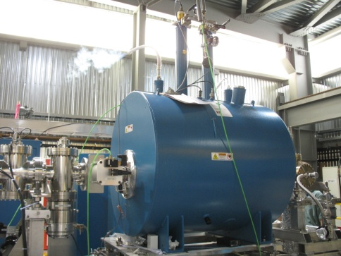
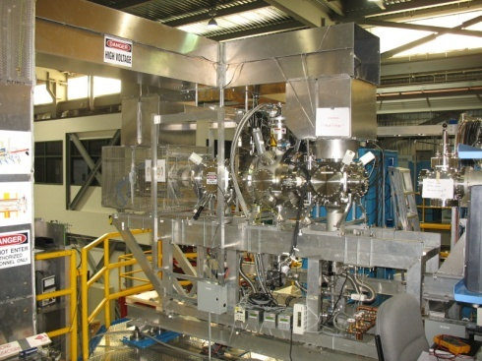
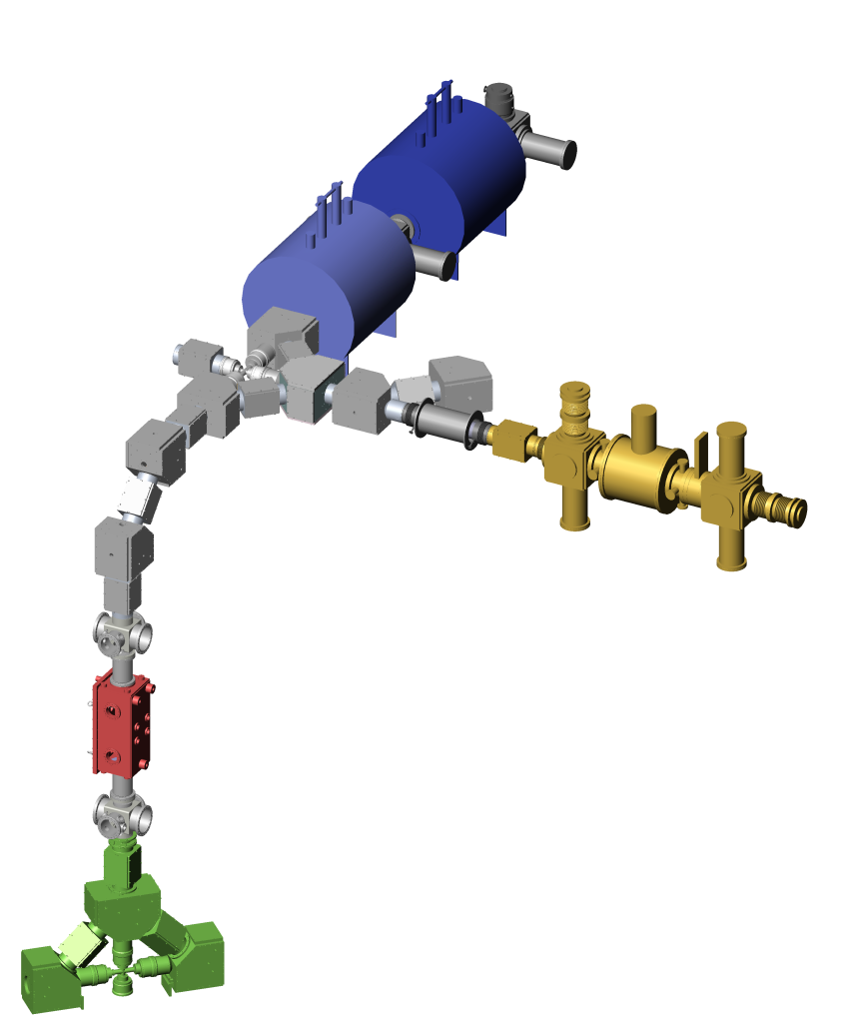
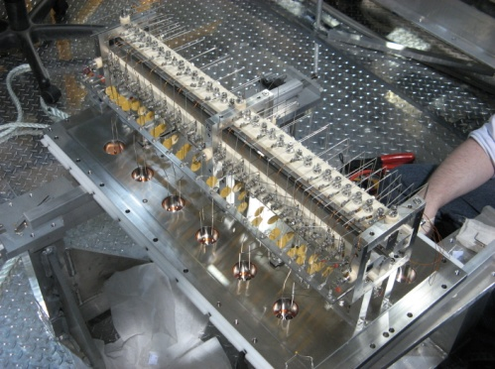
TITAN Facility
TRIUMF Ion Trap for Atomic and Nuclear science
Penning trap for high precision mass measurements
A^{q+}
Electron Beam Ion Trap (EBIT) in Penning trap mode for EC-BR measurement
~5 kV • q
A⁺
Penning trap to cool HCI from EBIT (under design)
Radio-Frequency Quadrupole (RFQ) cools and bunches ISAC beams
Short-lived isotopes from an Isotope
Separator and Accelerator (ISAC)
A⁺
See talks from M. Brodeur and S. Ettenauer

Slide 6
Setup ECBR measurements
X-ray detector
Storage and detection
Penning trap
γ
1+
¹⁰⁰Tc
15.8 s
6 T magnet
Beta detector
(PIPS)
Ion injection
10⁵ – 10⁶ ions
trapped
β⁻
EC
β⁻
¹⁰⁰Mo
β⁻β⁻
¹⁰⁰Ru
Trap electrodes
TITAN Electron Capture Branching Ratio:
New approach: spatial separation of X-ray and β⁻ detection
Seven X-ray detectors around segmented trap
2.1% solid angle for X-ray detection after EC
No electron background at X-ray detectors due to strong magnetic field (6T)
Long holding times in vacuum of P < 10⁻¹¹ mbar
Notes:
Add potential of the trap underlying the trap

Slide 7
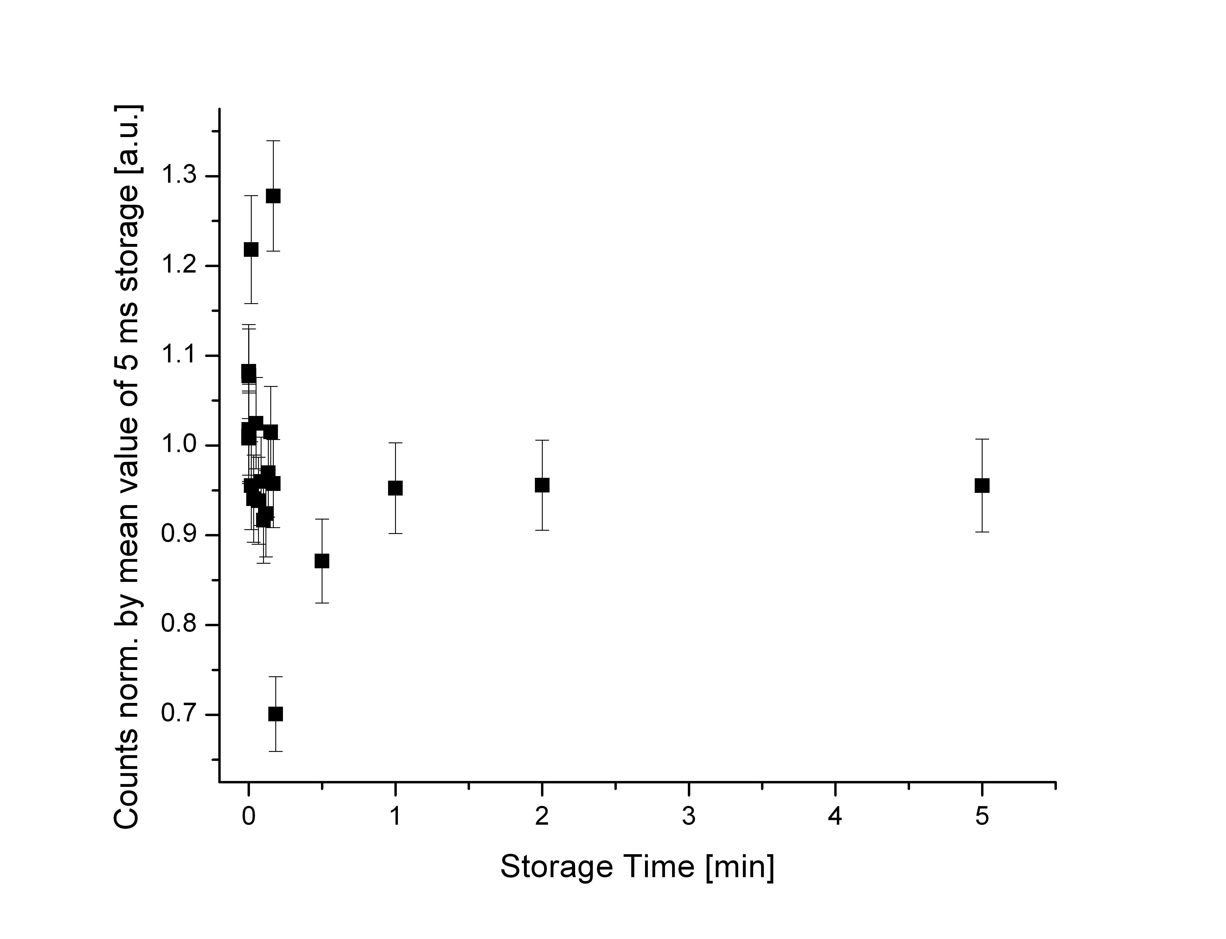
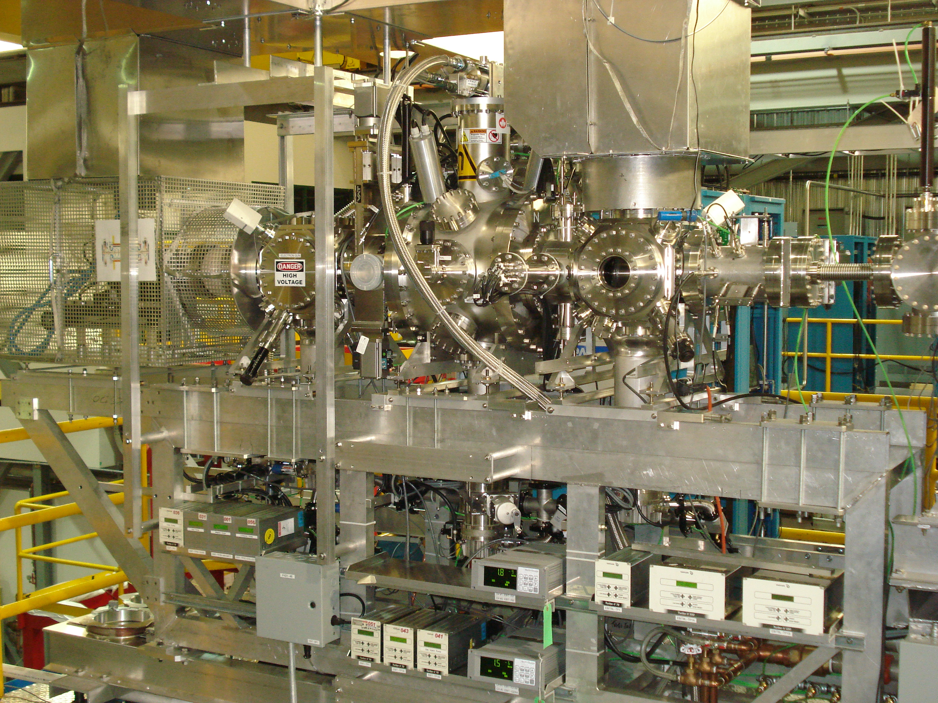
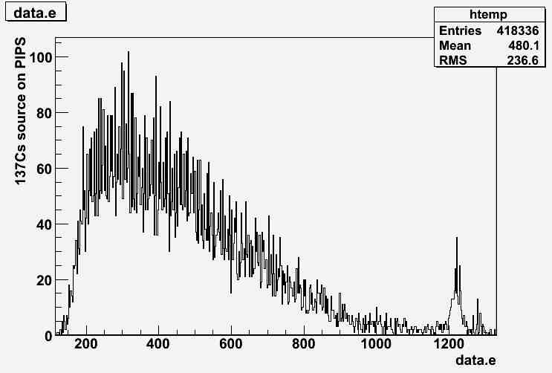
Status of EC-BR
Preliminary
EBIT connected to TITAN beam line
MCP after EBIT to optimize injection
After 5 min storage time loss < 10%
Beta detector installed and working
Two X-ray detectors installed at EBIT
⁶Li⁺
MCP tripped
Ready to take beam…

Slide 8
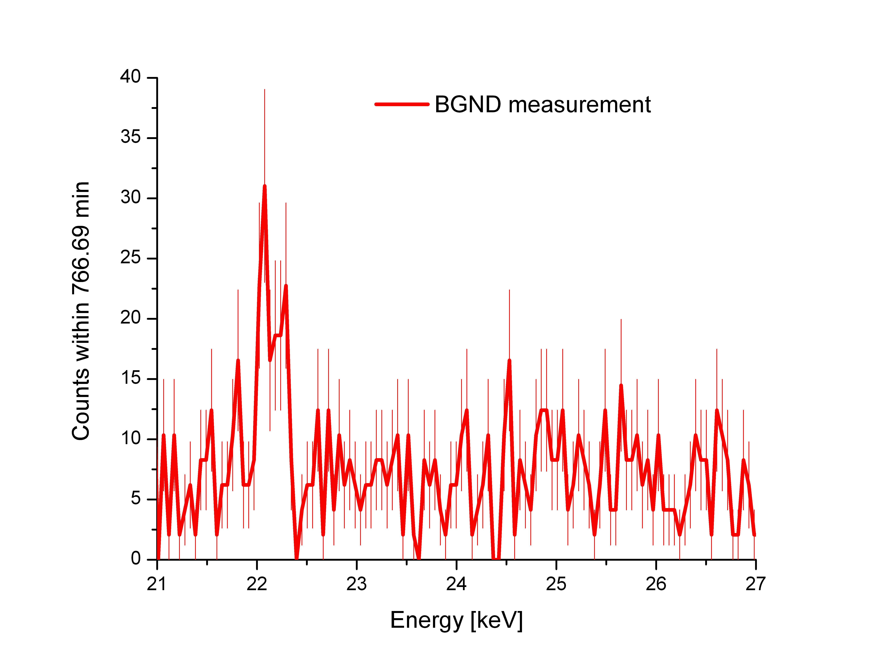
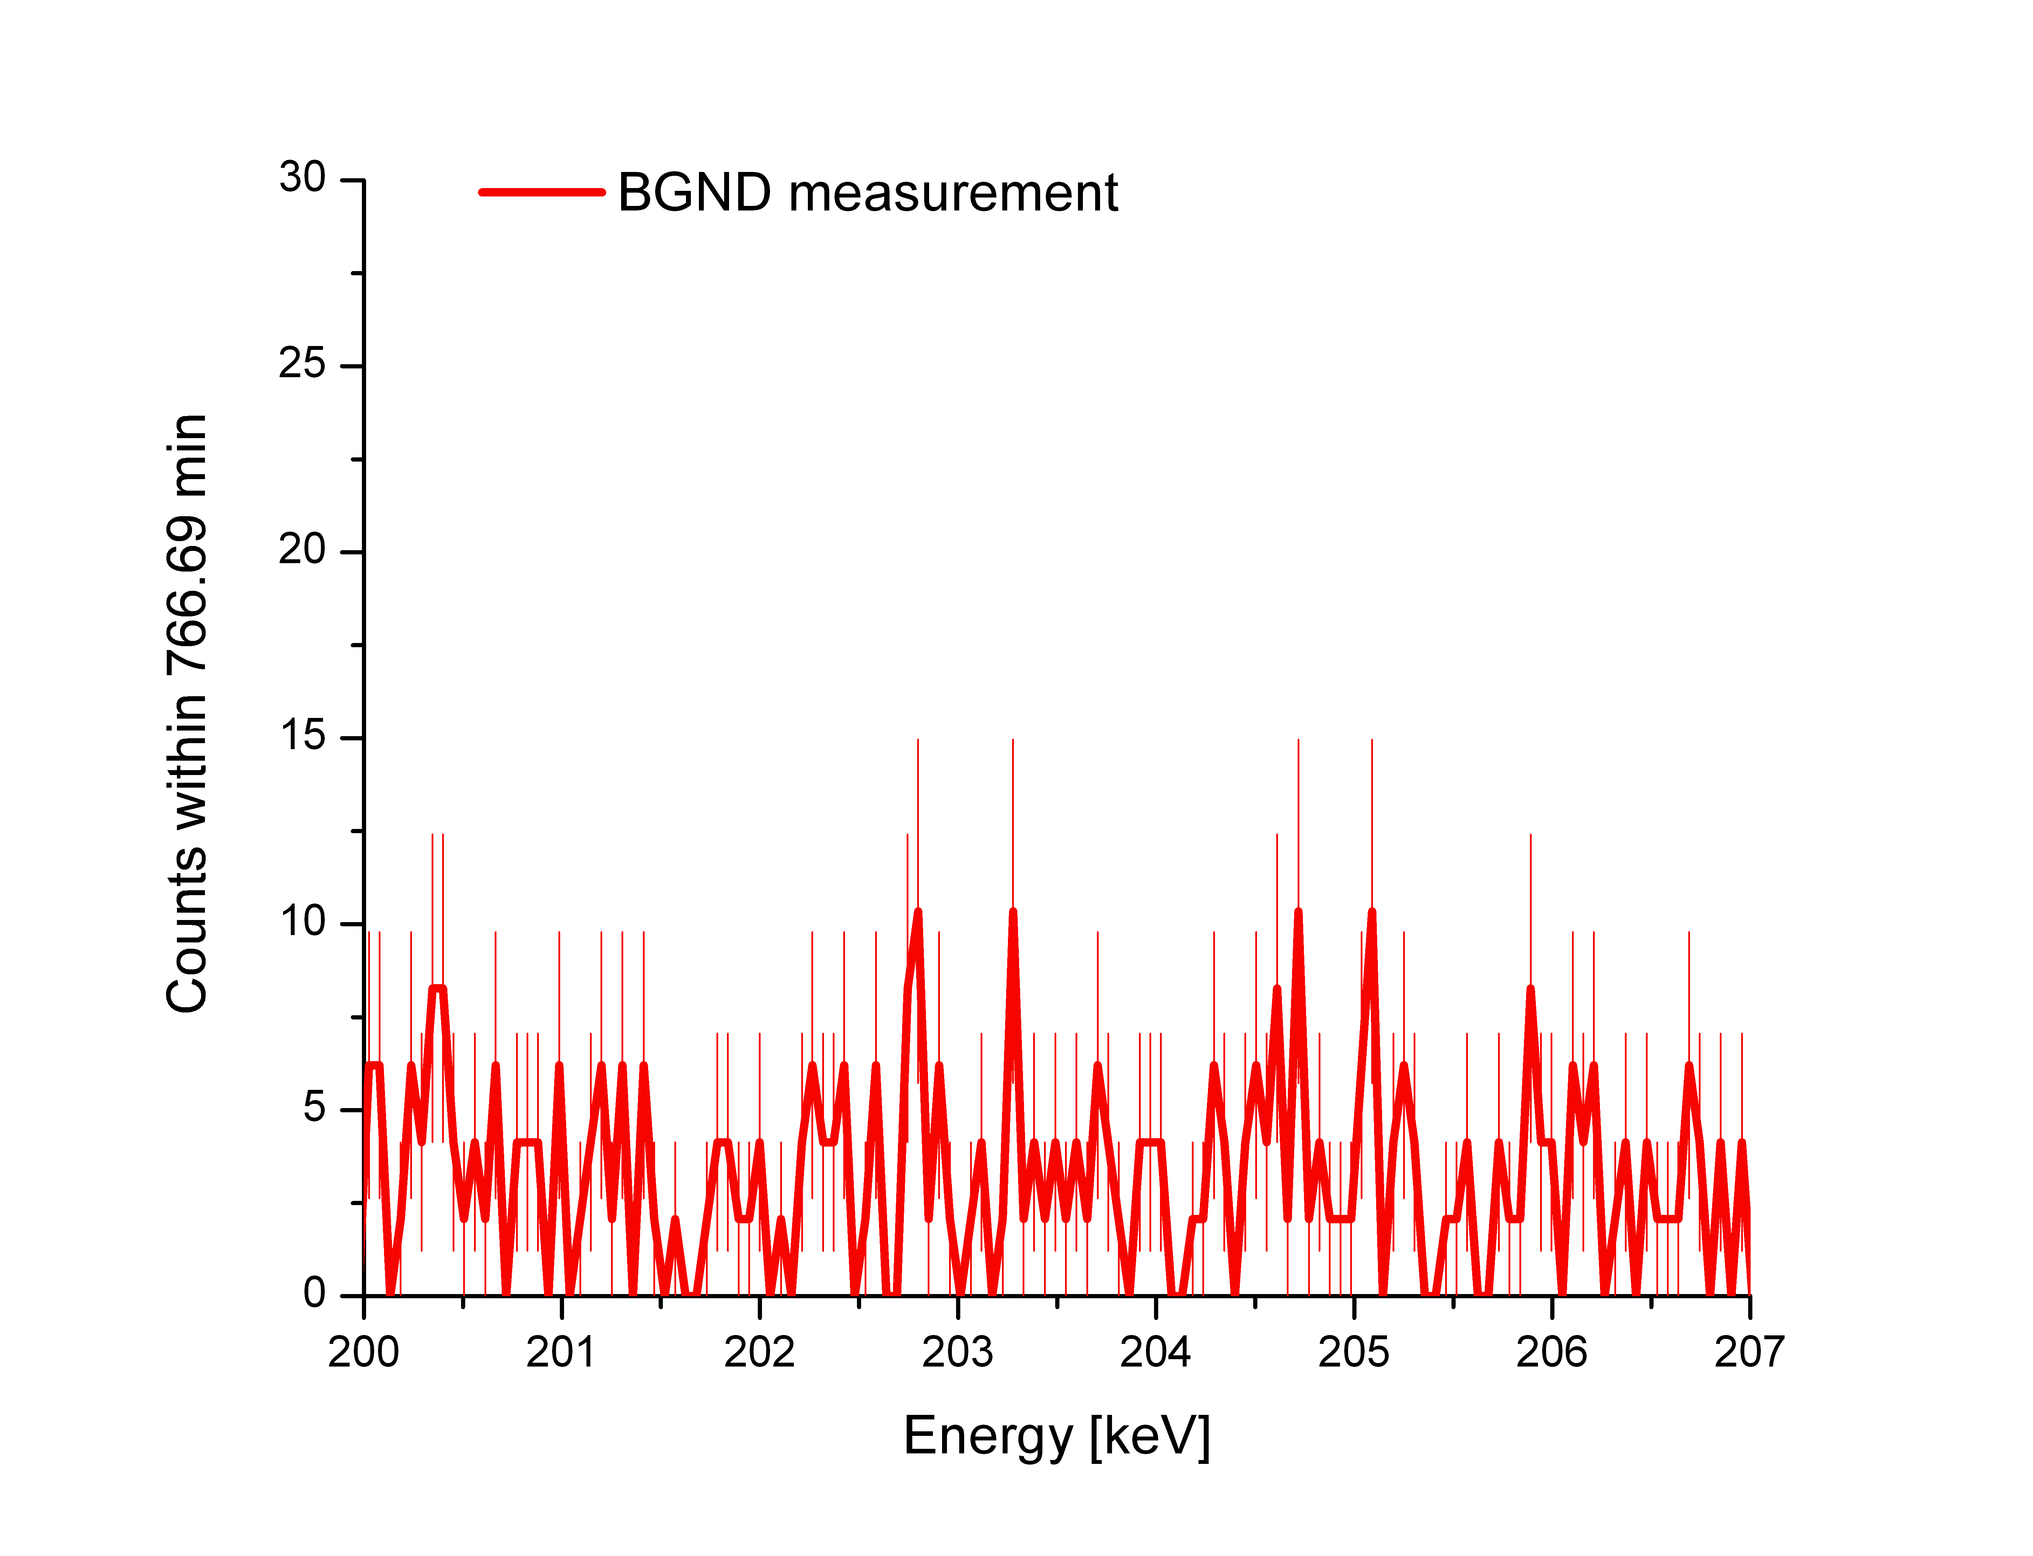
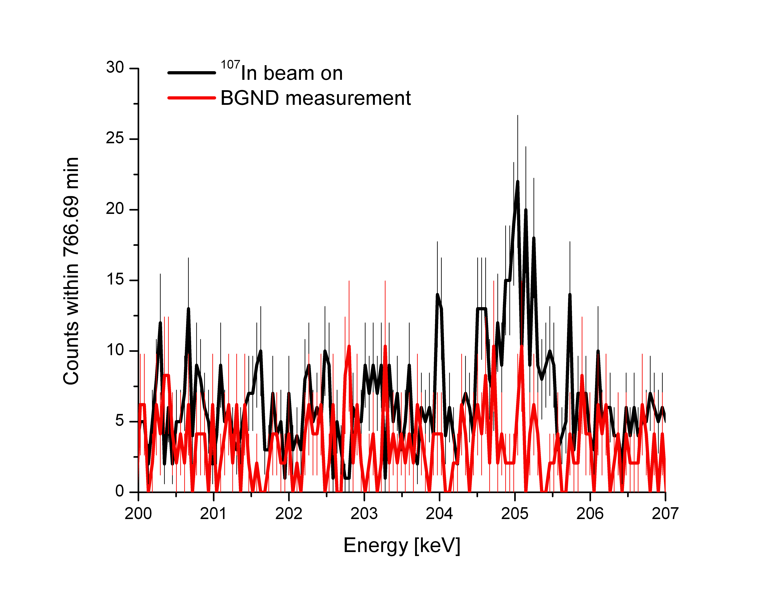
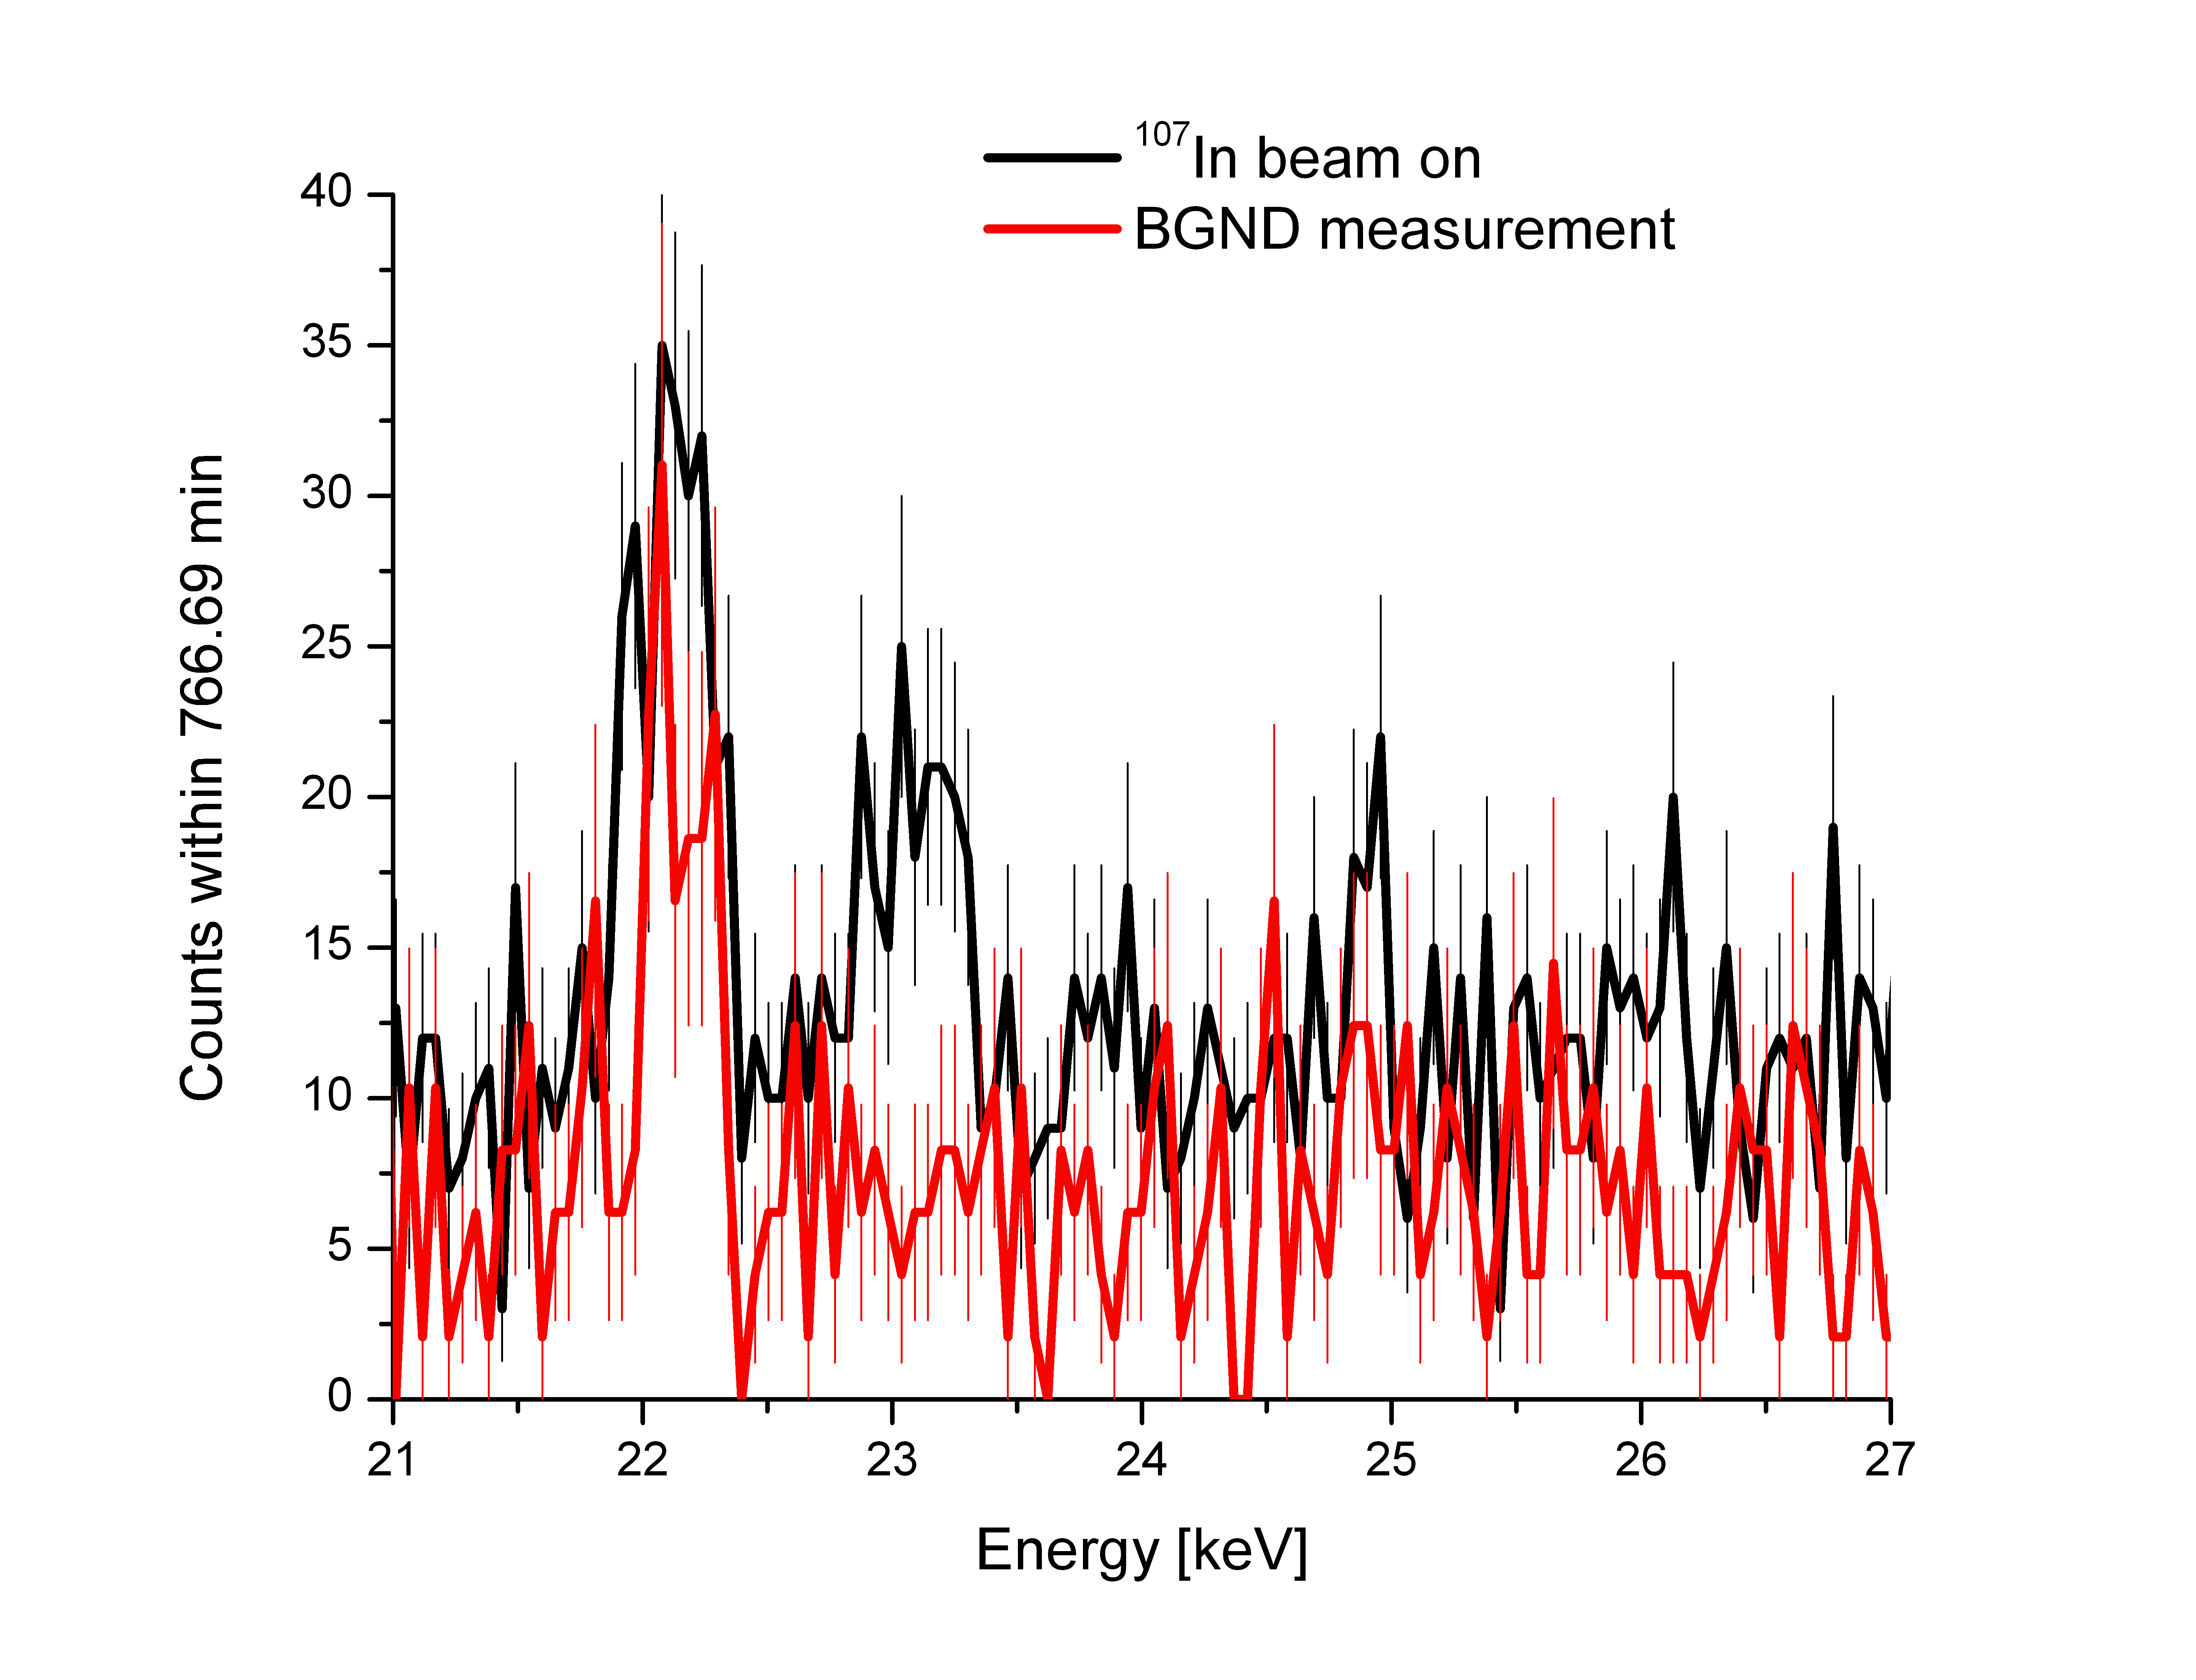
¹⁰⁷In Testrun
¹⁰⁷In
t_{1/2}= 32.4 min
¹⁰⁷In has a strong EC branch and rather short
half live of 32.4 min
EC ~ 63.9%
¹⁰⁷Cd
t_{1/2}= 6.5 h
Signature ¹⁰⁷Cd decay
EC ~ 99.8%
Signature ¹⁰⁷In decay
¹⁰⁷Ag
Goals of the beam time
Shoot through EBIT
Identify ¹⁰⁷In after EBIT
Store radioactive ions in trap
Observe X-rays following an EC
Identify X-rays from EC
Observe electrons from β decays
Signature ¹⁰⁷In decay
√
√
√
√
√
X
Only one detector
0.02% solid angle!
First observation of an EC in a Penning trap

Slide 9
Summary
ββ nuclear matrix elements needed for theoretical description
EC-BR measurement as benchmark experiment for theoretical description
TITAN EBIT offers a novel approach for EC-BR measurements
  Long storage times
  Low background at X-ray detector
Successful storage of radioactive ions
First observation of an Electron Capture decay in a Penning trap
…for the future
Testrun with ¹²⁶Cs to verify anti-coincidence between EC and β decay in July
First EC branching ratio measurements with the EBIT by the end of this year (¹⁰⁰Tc)
EC-BR program @ TITAN: ⁷⁶As → ⁷⁶Ge, ^{82m}Br → ⁸²Se, ¹¹⁰Ag → ¹¹⁰Pd, ¹¹⁴In → ¹¹⁴Cd,
¹¹⁶In → ¹¹⁶Cd, ¹²⁸I → ¹²⁸Te

Slide 10
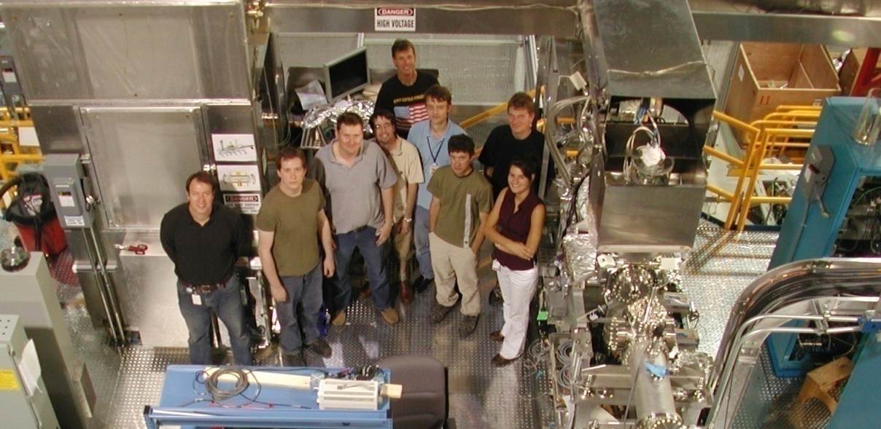









People/Collaborations
M. Brodeur, T. Brunner, J. Dilling, P. Delheij, S. Ettenauer, A. Gallant, M. Good, A. Lapierre and the TITAN collaboration
as well as R. Ringle, V. Ryjkov, M. Smith and TRIUMF staff.
U. of Manitoba
McGill U.
Muenster U.
MPI-K
GANIL
U. of Calgary
U. of Windsor
Colorado School of Mines
UBC
TU München

Slide 11
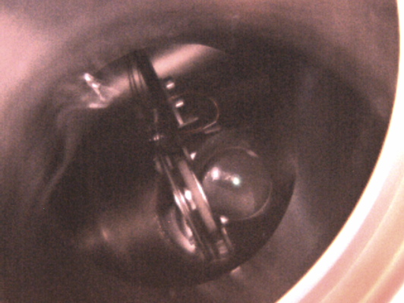
β - detection
Ion beam
Have an image of inj. beams from a mirror
The e-gun can be replaced by detectors
Back view
Front view
Ion beam
image
Silicon detector for β-decay measurements
Imaging MCP with phosphor screen for ion beam alignment
Li-ion beam
Radius: ~1.5mm
MCP w/ phosphor screen placed between the trap and electron gun for alignment of singly charged ion beams (injection).
5/15/2009
11
Notes:
11

Slide 12
The EBIT - Schematic
Cryogen-free superconducting coils
EC-BR measurements
Einzel
lenses
Beta detector
Magnetic-field distrib.
Taken from M. Froese
Trap
1/7 X-ray detector
Dip
~284 mm

Slide 13
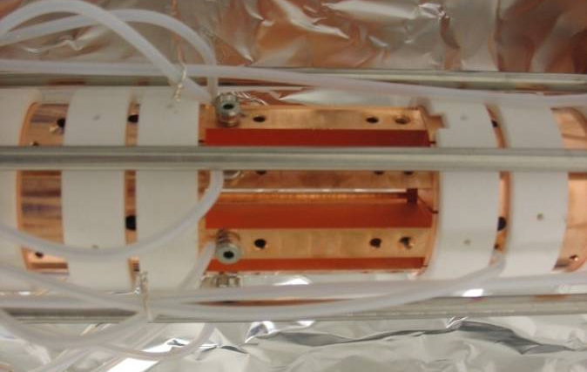
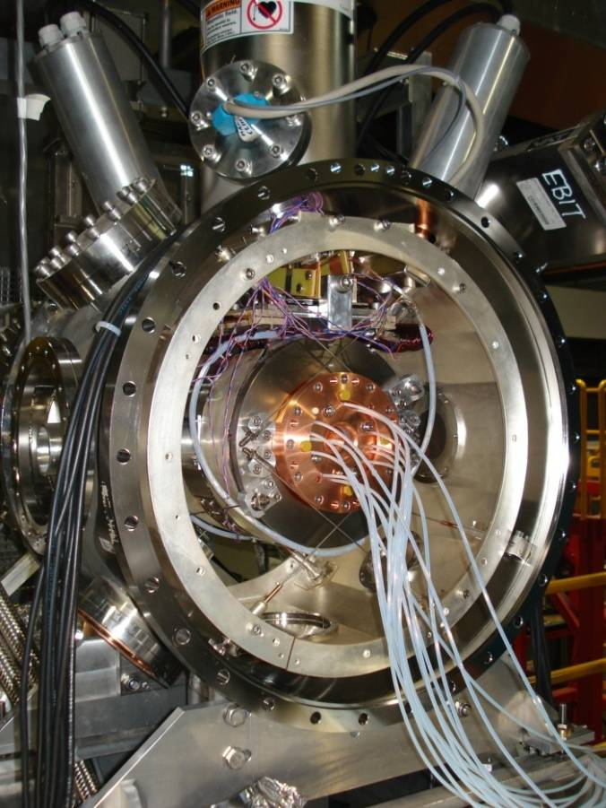
Branching Ratio Measurements
CANDIDATES FOR BRANCHING RATIO MEASUREMENTS
¹⁰⁰Mo : | ¹⁰⁰Tc (EC) | [1+→ 0+, T1/2 = 15.8 s] | K_{α} = 17.5 keV
¹¹⁰Pd : | ¹¹⁰Ag (EC) | [1+→ 0+, T1/2 = 24.6 s] | K_{α} = 21.2 keV
¹¹⁴Cd : | ¹¹⁴In (EC) | [1+→ 0+, T1/2 = 71.9 s] | K_{α} = 25.3 keV
¹¹⁶Cd : | ¹¹⁶In (EC) | [1+→ 0+, T1/2 = 14.1 s] | K_{α} = 25.3 keV
⁸²Se : | ^{82m}Br (EC) | [2-→ 0+, T1/2 = 6.1 min] | K_{α} = 11.2 keV
¹²⁸Te : | ¹²⁸I (EC) | [1+→ 0+, T1/2 = 25.0 min] | K_{α} = 27.5 keV
⁷⁶Ge : | ⁷⁶As (EC) | [2-→ 0+, T1/2 = 26.2 h] | K_{α} = 9.9 keV
1+
15.8 s
¹⁰⁰Tc
Q_{EC} = 0.168
ε ≈ 0.0018%
Q_{β} = 3.202
¹⁰⁰Mo
β⁻β⁻
¹⁰⁰Ru
10⁵ ions in trap with one half-life measurement cycle:
solid angle: 2.1%
detection efficiency: 30%
5.7 x 10⁻³ EC counts/cycle
100 EC counts → 17636 EBIT fills → 74h
88h proposed for ¹⁰⁰Tc

Slide 14
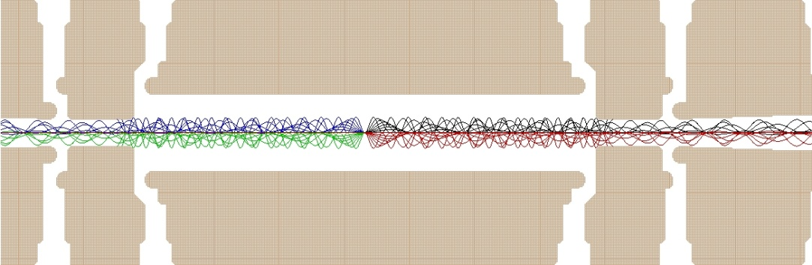
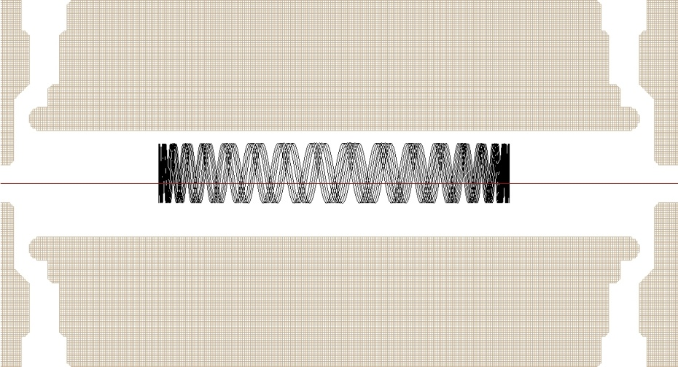
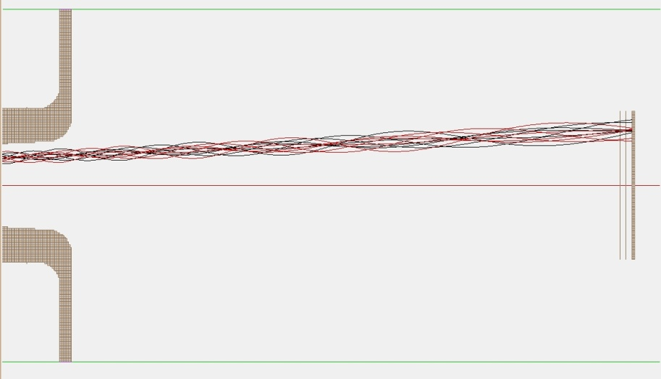
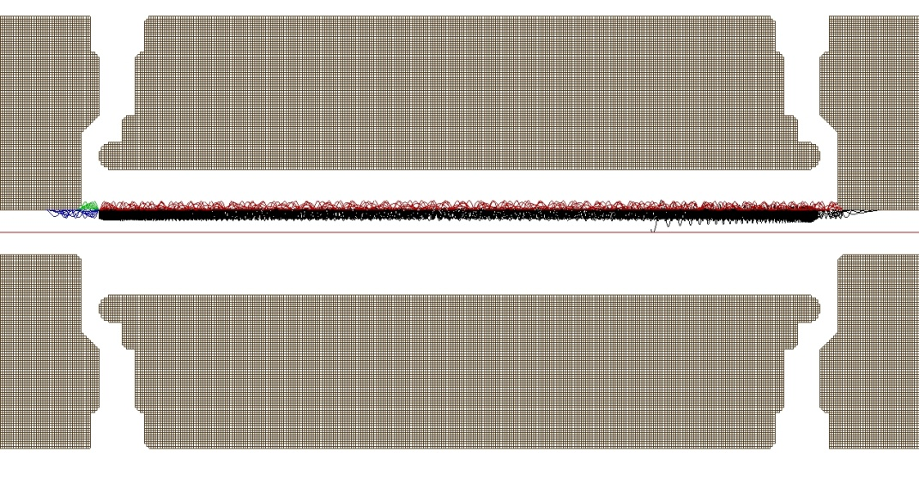
Simulations
B_{max} ~ 3T
Ø5 mm
B_{max} = 6T
5 kV
4.7 kV
5 kV
Loss through magnetic bottle for θ > 79deg:
3 MeV electrons
B_{max} = 6T
25 mm
B_{max} = 6T
284 mm to center
Loss through wall collisions
→ Rotating wall cooling or side-band cooling

Slide 15
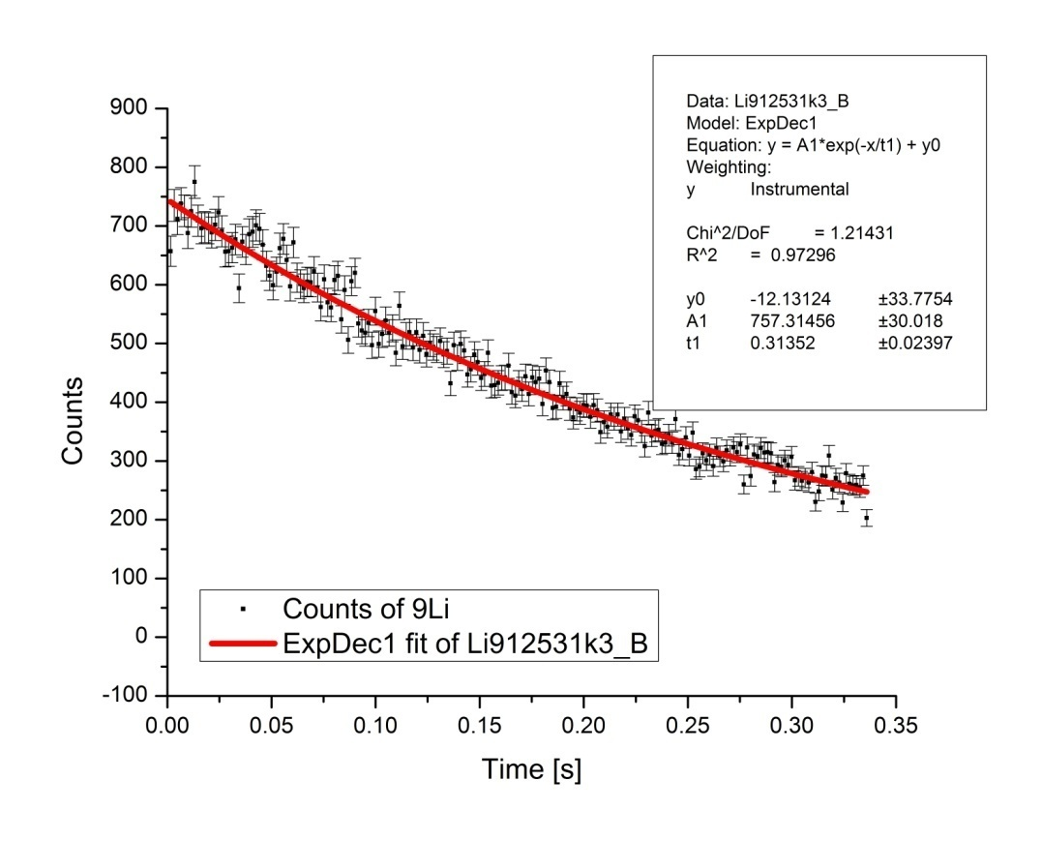
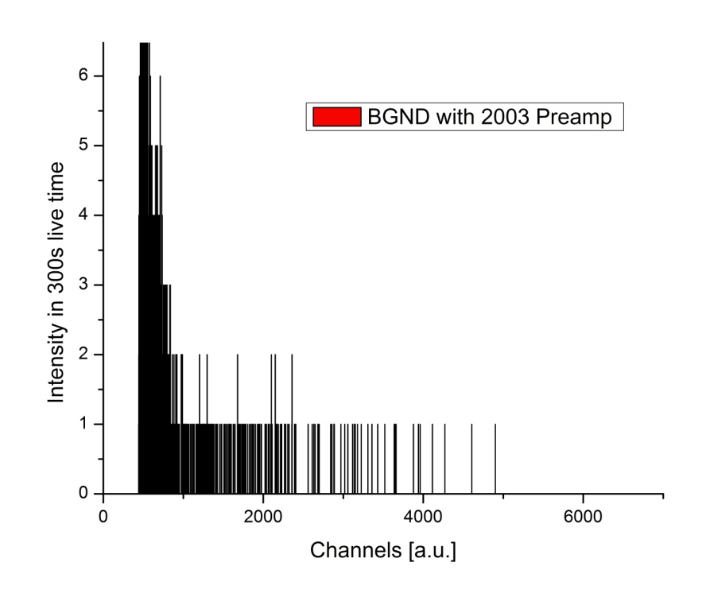
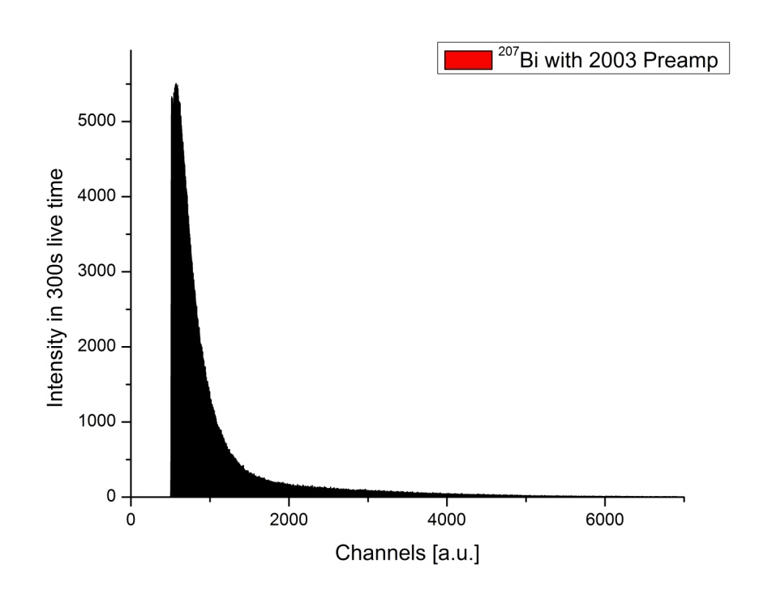
β - detector
Passivated Implanted Planar Silicon detector
PIPS
⁹Li
⁹Li
Q = 13.6 MeV
T_{½} [lit] = 178.3ms
T_{½} [PIPS] = 217.3(16.6)ms
Al- foil
1130 counts
2.1 x 10⁶ counts

Slide 16
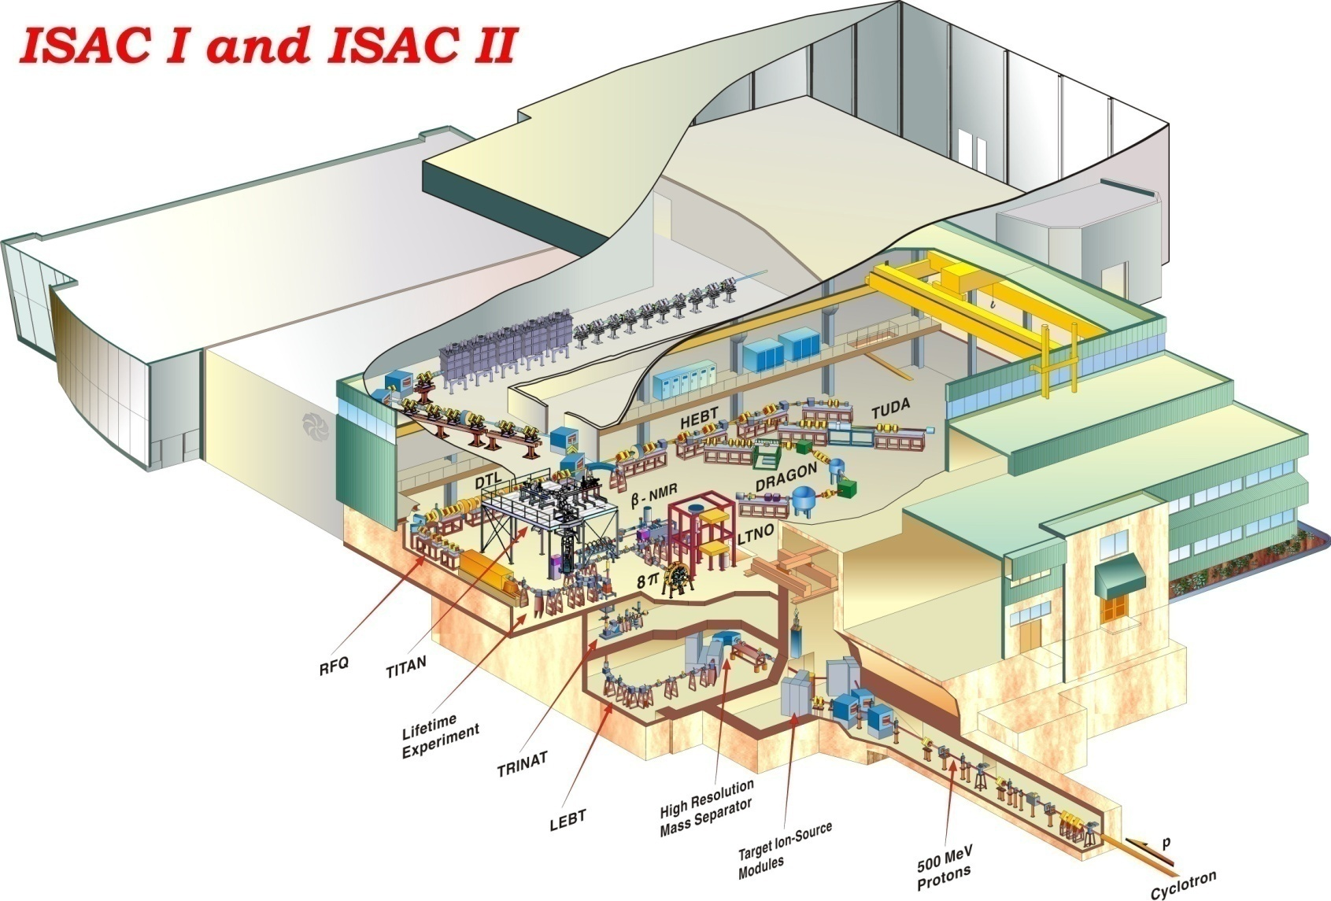
ISAC at TRIUMF
Underground labs
SNO Lab
GERDA
CUORE
COBRA
EXO
NEMO3
TITAN

Slide 17
¹⁰⁰Tc production rate
LaC₂ target with 50μA p beam
Ta target with 70μA p beam
Thanks to
Marik Dombsky

