Slide 1
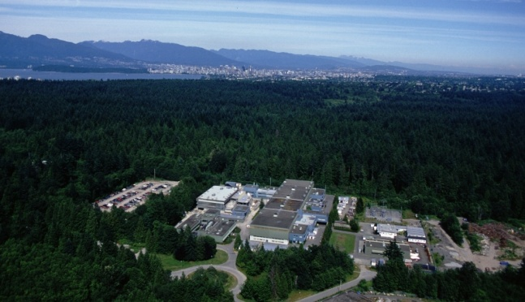


The TITAN Facility at TRIUMF
T. Brunner, A. Lapierre, R. Krücken, and J. Dilling for the TITAN collaboration
Canada’s National Laboratory for Nuclear and Particle Physics,
Vancouver, British Columbia, Canada

Slide 2
Outline
Isotope production at TRIUMF
The TITAN setup
    Radio-Frequency Quadrupole (RFQ)
    Penning-trap mass spectrometer
    Electron Beam Ion Trap (EBIT)
Planned experiments
    Mass measurements of Halo Nuclei
    Electron Capture Branching Ratio measurements (EC-BR)

Slide 3
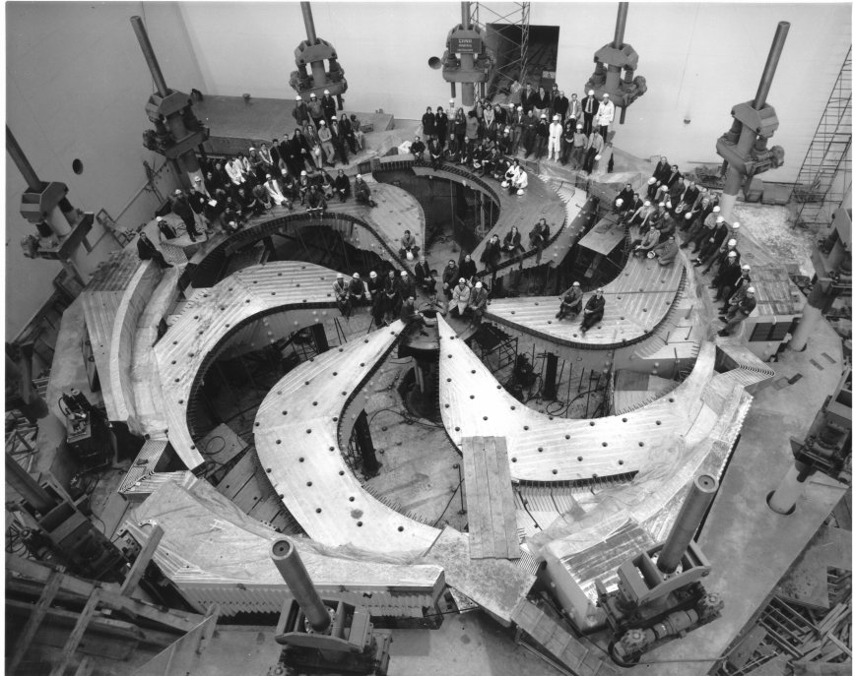
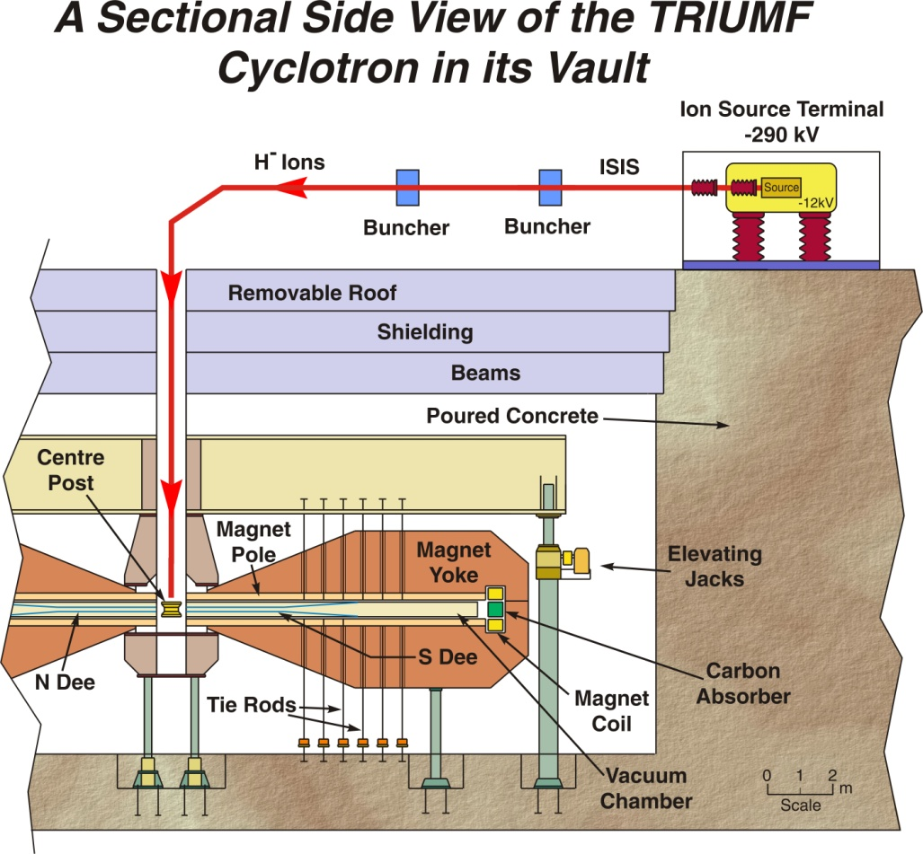
TRIUMF
H⁻ ions accelerated by sector-focussing cyclotron.
Up to 520 MeV protons.
Multiple user facility.
Up to 100 µA for ISAC beam line.
Upgrade to 500-600 µA total possible.

Slide 4
ISAC – Isotope Separation and Acceleration
500-MeV proton beam
The technique used:
Isotope separation online (ISOL):
(proton spallation)
Target: Ta, W, SiC
Exotic isotopes are
produced in the target
TRIUMF (now!)
A<120

Slide 5
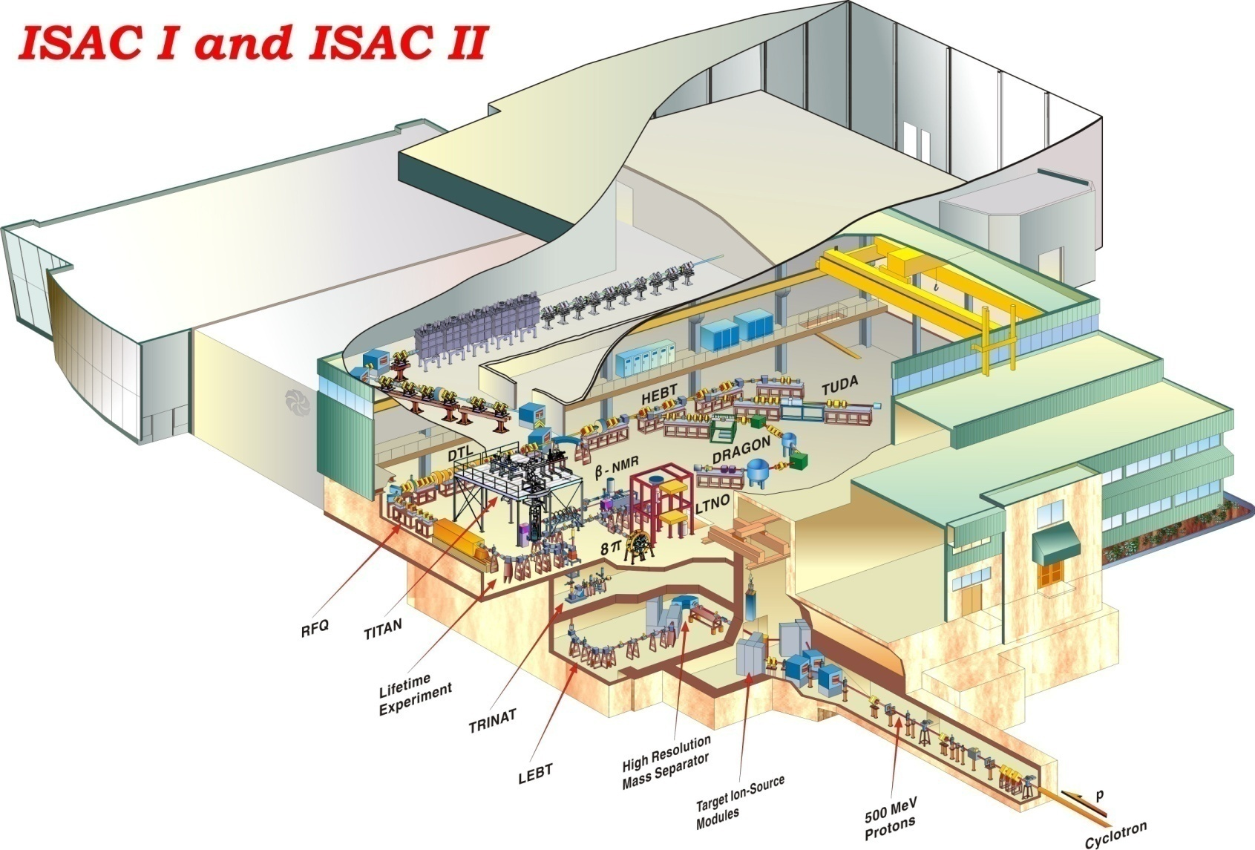
ISAC
ISAC:
Highest yields for on-line
facilities, we go up to 100μA@500MeV DC proton (50kW)
ISAC has 3 experimental areas:
Low energy (60keV)
ISAC I (cont. up 1.8 MeV/u)
ISAC II (up to 10 MeV/u, present licence to 5 MeV/u)
Many experimental stations:
TRINAT, Beta-NMR, 8pi, tape-station, TITAN, Collinear laser spec, polarised beam line, etc
DRAGON, TUDA, TACTIC, GPS (Leuven)
TIGRESS, EMMA (2010), GPS (Maya)
Yields: ¹¹Li 5x10⁴/s, ⁷⁴Rb 2x10⁴/s, ⁶²Ga 2x10³/s

Slide 6
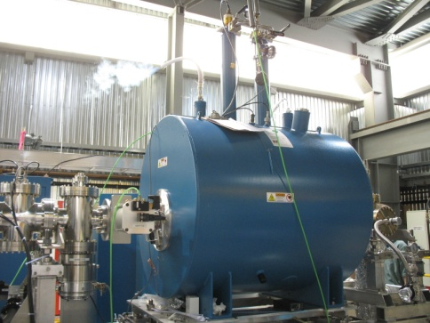
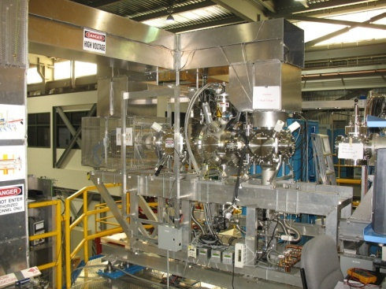
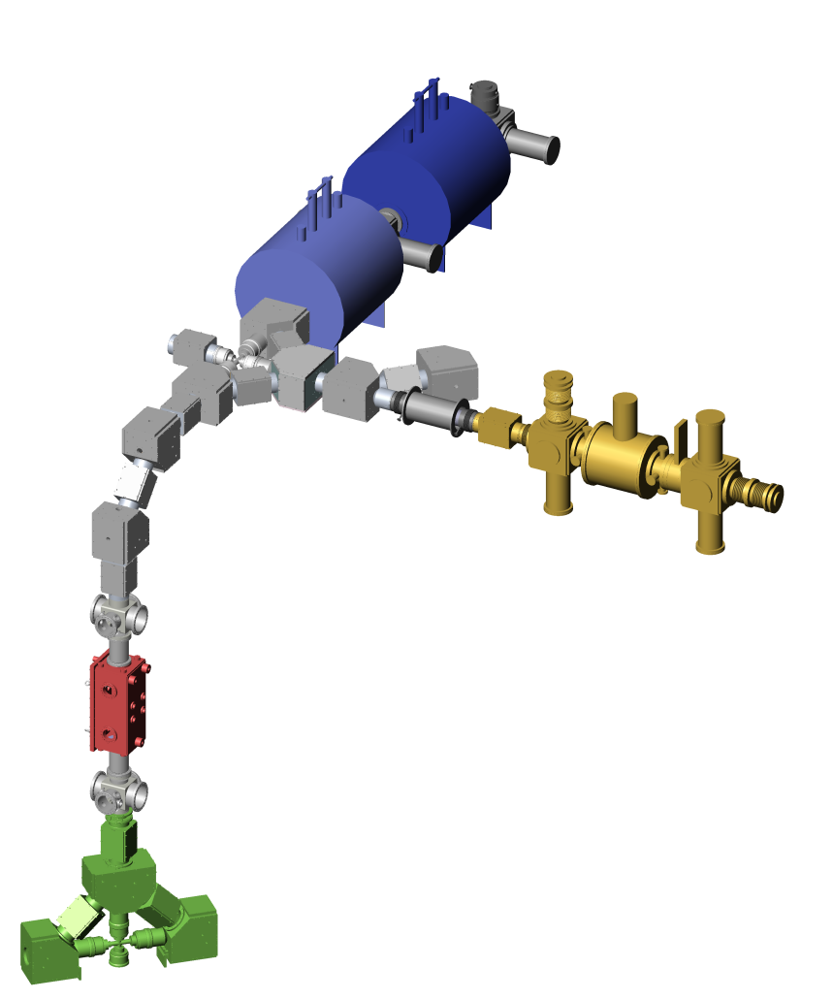
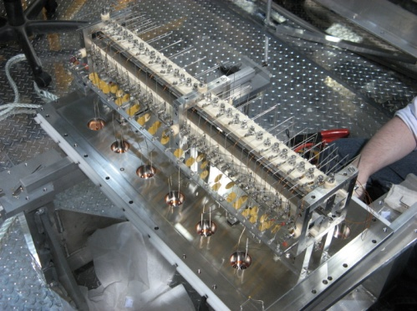
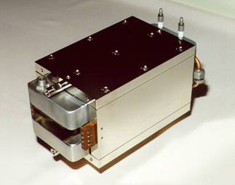
TITAN Facility
TRIUMF Ion Trap for Atomic and Nuclear science
Penning trap for high precision mass measurements
A^{q+}
Electron Beam Ion Trap (EBIT) for charge breeding
~5 kV • q
A⁺
Penning trap to cool HCI from EBIT (under design)
Radio-Frequency Quadrupole (RFQ) cools and bunches ISAC beams
Wien filter:
q/m selection
Short-lived isotopes from an Isotope
Separator and Accelerator (ISAC)
A⁺

Slide 7
TITAN Facility
Mass measurements on isotopes with short half-life T_{1/2} ≈ 10 ms and
low production yields (≈ 100 ions/s) with high precision of up to δm/m ≈ 10⁻⁹.
RFQ tested with Li, Xe and Cs and an emittance < 4 mm
mrad at 4 keV was determined.
Pulses as short as 50 ns FWHM @ up to 1 kHz.
Ideally, uniquely matched to ISOL-type production
mode.
TITAN received funding April 2003 and performed first mass measurements on ⁸He, ⁸Li, ⁹Li and ¹¹Li in 2007.
Versatile and flexible facility, can be used for other applications:
Branching ratio measurements
Laser spectroscopy on cooled and bunched beams
Charge radius measurements via x-ray spectroscopy
Accelerator Mass Spectrometry

Slide 8
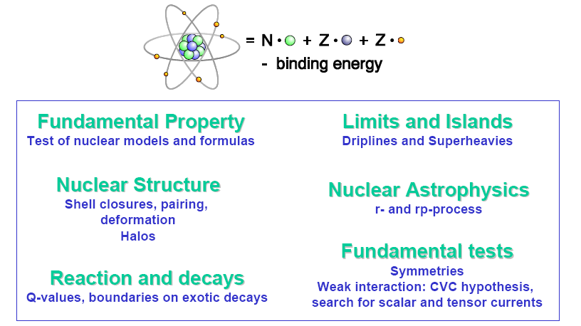
Motivation for Mass Measurements

Slide 9
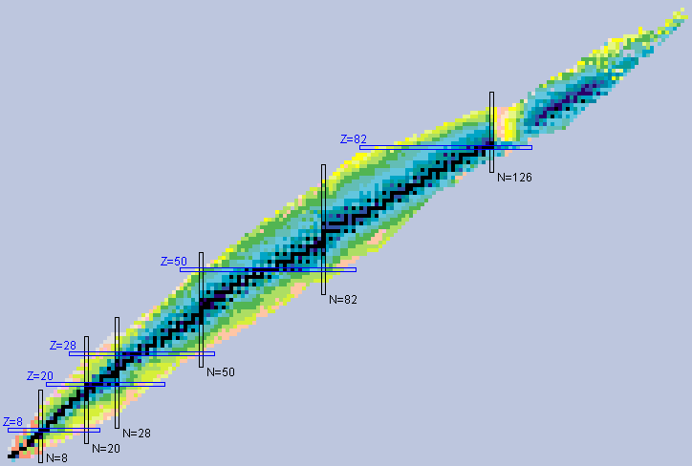
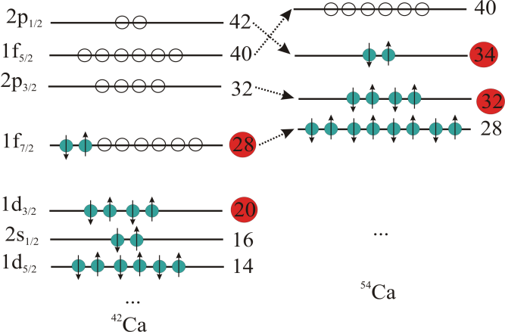
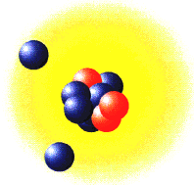
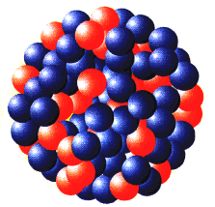
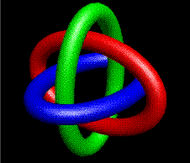
Physics motivations
Valley of stability
Testing CKM matrix
Unitarity (⁷⁴Rb)
N-rich nuclei structure
(Ca, K, Sc ~ N = 32, 34)
Proton number Z
Halo nuclei studies (¹¹Li)
¹¹Li
²⁰⁸Pb
Neutron number N

Slide 10
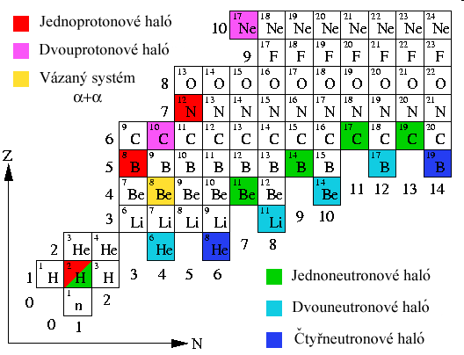
^{Halo Nuclei}
One-proton halo
HALO-nuclei: ¹¹Li
T_{1/2} ≈ 8.6 ms
Borromean three body halo nuclei.
Two-proton halo
Binary system
One-neutron halo
Two-neutron halo
Four-neutron halo
In 1985 Tanihata et al. fired light nuclei at Beryllium, Carbon and Aluminum targets
They found the radius of ¹¹Li to be much larger than its neighboring nuclei

Slide 11
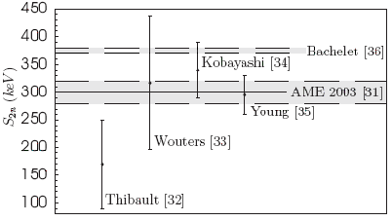
¹¹Li
R. Sanchez et al., PRL (2006)
ToPLiS collaboration @ ISAC measured isotope shifts in electronic transitions by laser spectroscopy on lithium isotopes
G. W. Drake et al. did the calculations for the mass shifts, and extracted the charge radius.
A source of error in the calculations is the mass of ¹¹Li
Five previous measurements of the mass of ¹¹Li:
Need precision of δm ≤ 1 keV/c² for charge
radius calculations
Need precision of δm ≤ 5 keV/c² to confirm
accuracy of MISTRAL 2003 experiment
A value of S_{2n} with 1% error, δm ≤ 3 keV/c²,
would provide a solid test for nuclear theory

Slide 12
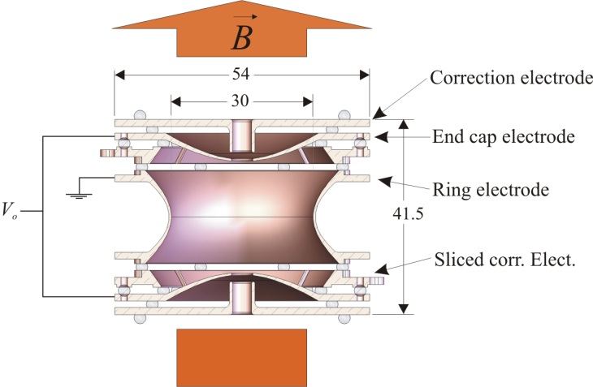
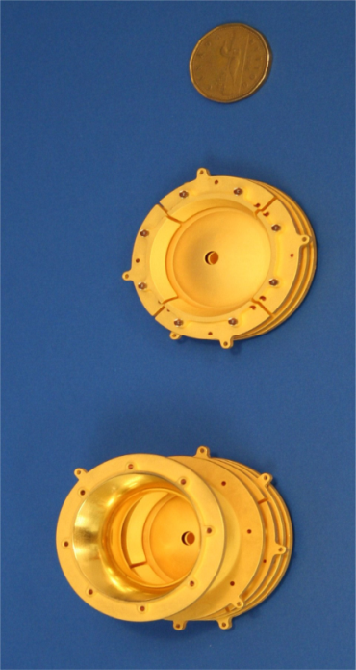
TITAN’s Mass Measurements Penning Trap
TITAN Penning Trap:
Mass determination:
Ions trapped by:
strong homogeneous magnetic field
weak electrostatic quadrupole field
B
+
q/m
Cyclotron frequency:

Slide 13
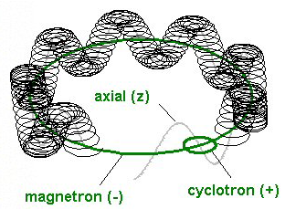
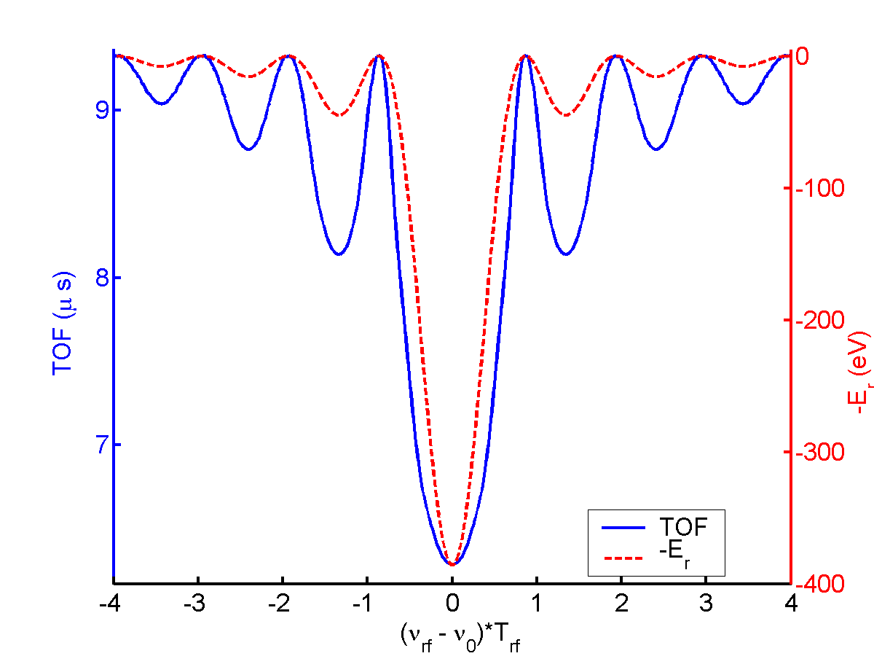
Time Of Flight (TOF) technique
submitted to an rf-excitation ω_{rf} of duration T_{rf}, to increase the cyclotron motion amplitude, then released
accelerated by the magnetic field gradient:
ion detection with a MCP where TOF is recorded
t₁=TOF
MCP
2 m
Inhomogeneous mag. field
t₀=0
Determine atom mass from frequency ratio with a well known reference

Slide 14
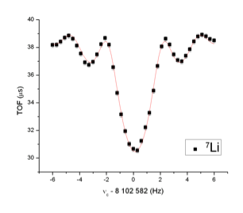
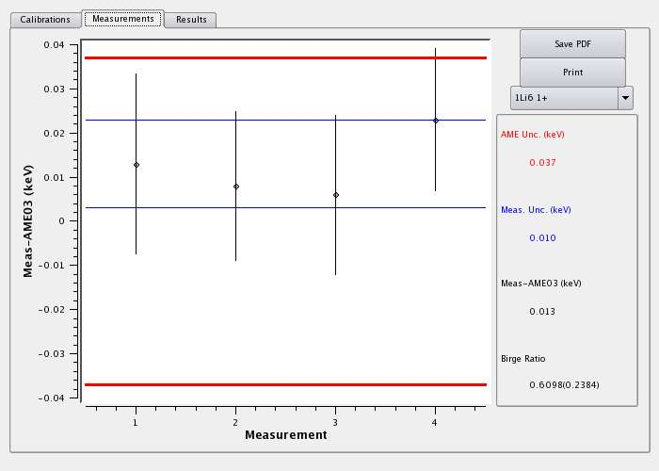
First off-line measurements
 | Mass Excess (keV) | δm/m
AME03 | 14908.14(79) | 1.1×10⁻⁸
SMILETRAP | 14907.0951(42) | 6.4×10⁻¹⁰
TITAN | 14907.053(44) | 3.2×10⁻⁹
Confirmation of recent SMILETRAP measurement and agreement with ^{6,7}Li
Systematic tests confirm system at the level of ~10⁻⁹
Systematic tests with ¹²C as reference.

Slide 15
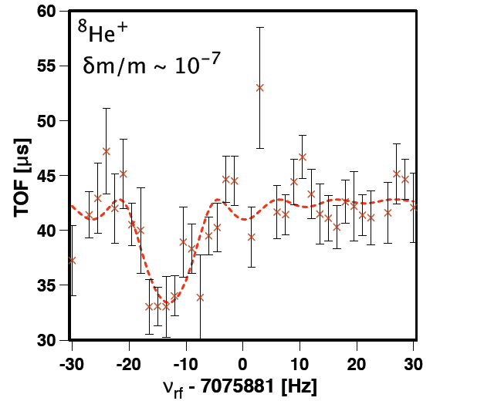
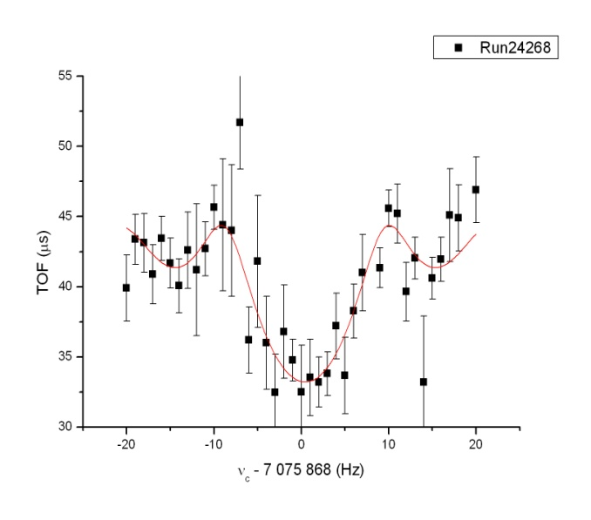
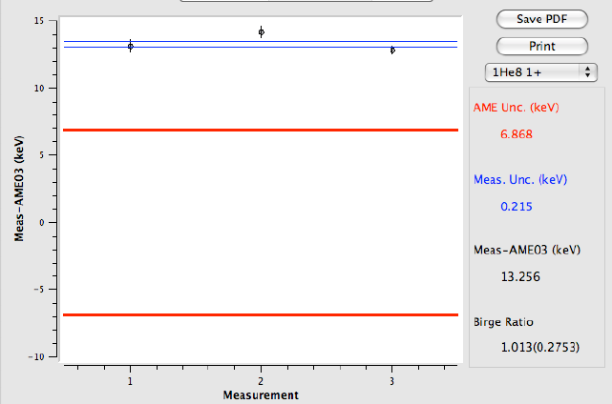
⁸He measurement (Nov. run)
Measurements of the mass of ⁸He
First direct mass measurement
Carried out with 3100/ions sec beam
Final uncertainty ~ 300eV.
Used stable Li as reference
AME 2003
Preliminary

Slide 16
On-line run ⁸He (Nov. run)
Preliminary
!

Slide 17
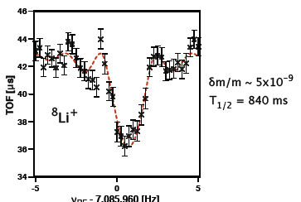
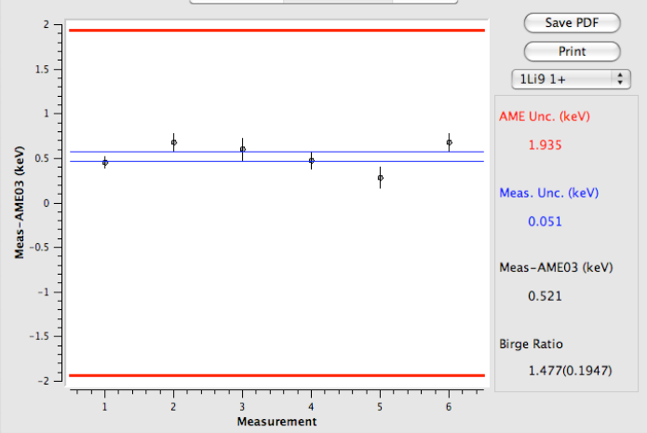
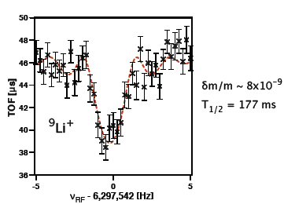
On-line ⁸Li and ⁹Li measurement
(Dec. run)
Measurements of the mass of Li isotopes
First direct Penning trap mass measurement
Carried out at three different beam times/targets+ion source
Final uncertainty ~ 100eV.
Used stable Li as reference

Slide 18
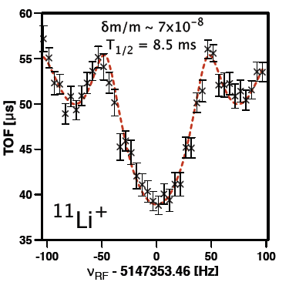
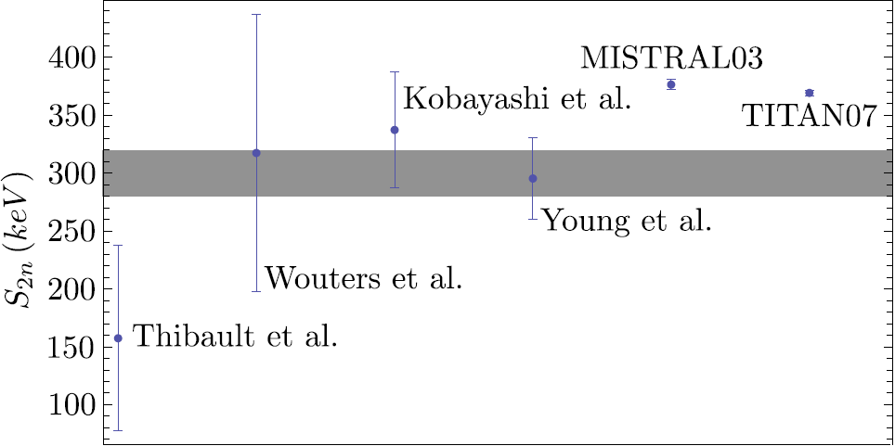
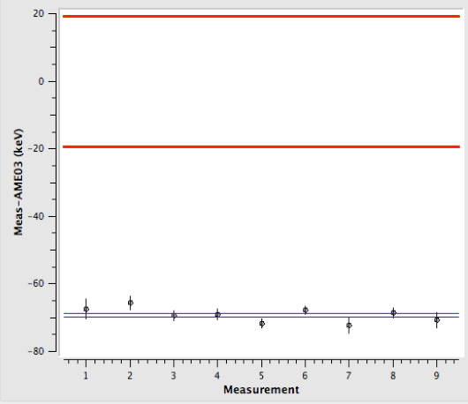
On-line ¹¹Li measurement (Dec. run)
TITAN direct mass measurement of ¹¹Li
Shortest-lived isotope ever trapped!
Run @ 50 Hz and 20ms excitation
ISAC yield of 1200 ions/s.
Preliminary analysis shows δm = 0.555 keV + systematic needed for final analysis.
Reference measurement done with ^{6,7}Li and ¹²C.
Best precision achieved.
AME2003 δm=19.295 keV
AME2003
preliminary
TITAN_{(stat)}δm=0.555 keV
preliminary

Slide 19
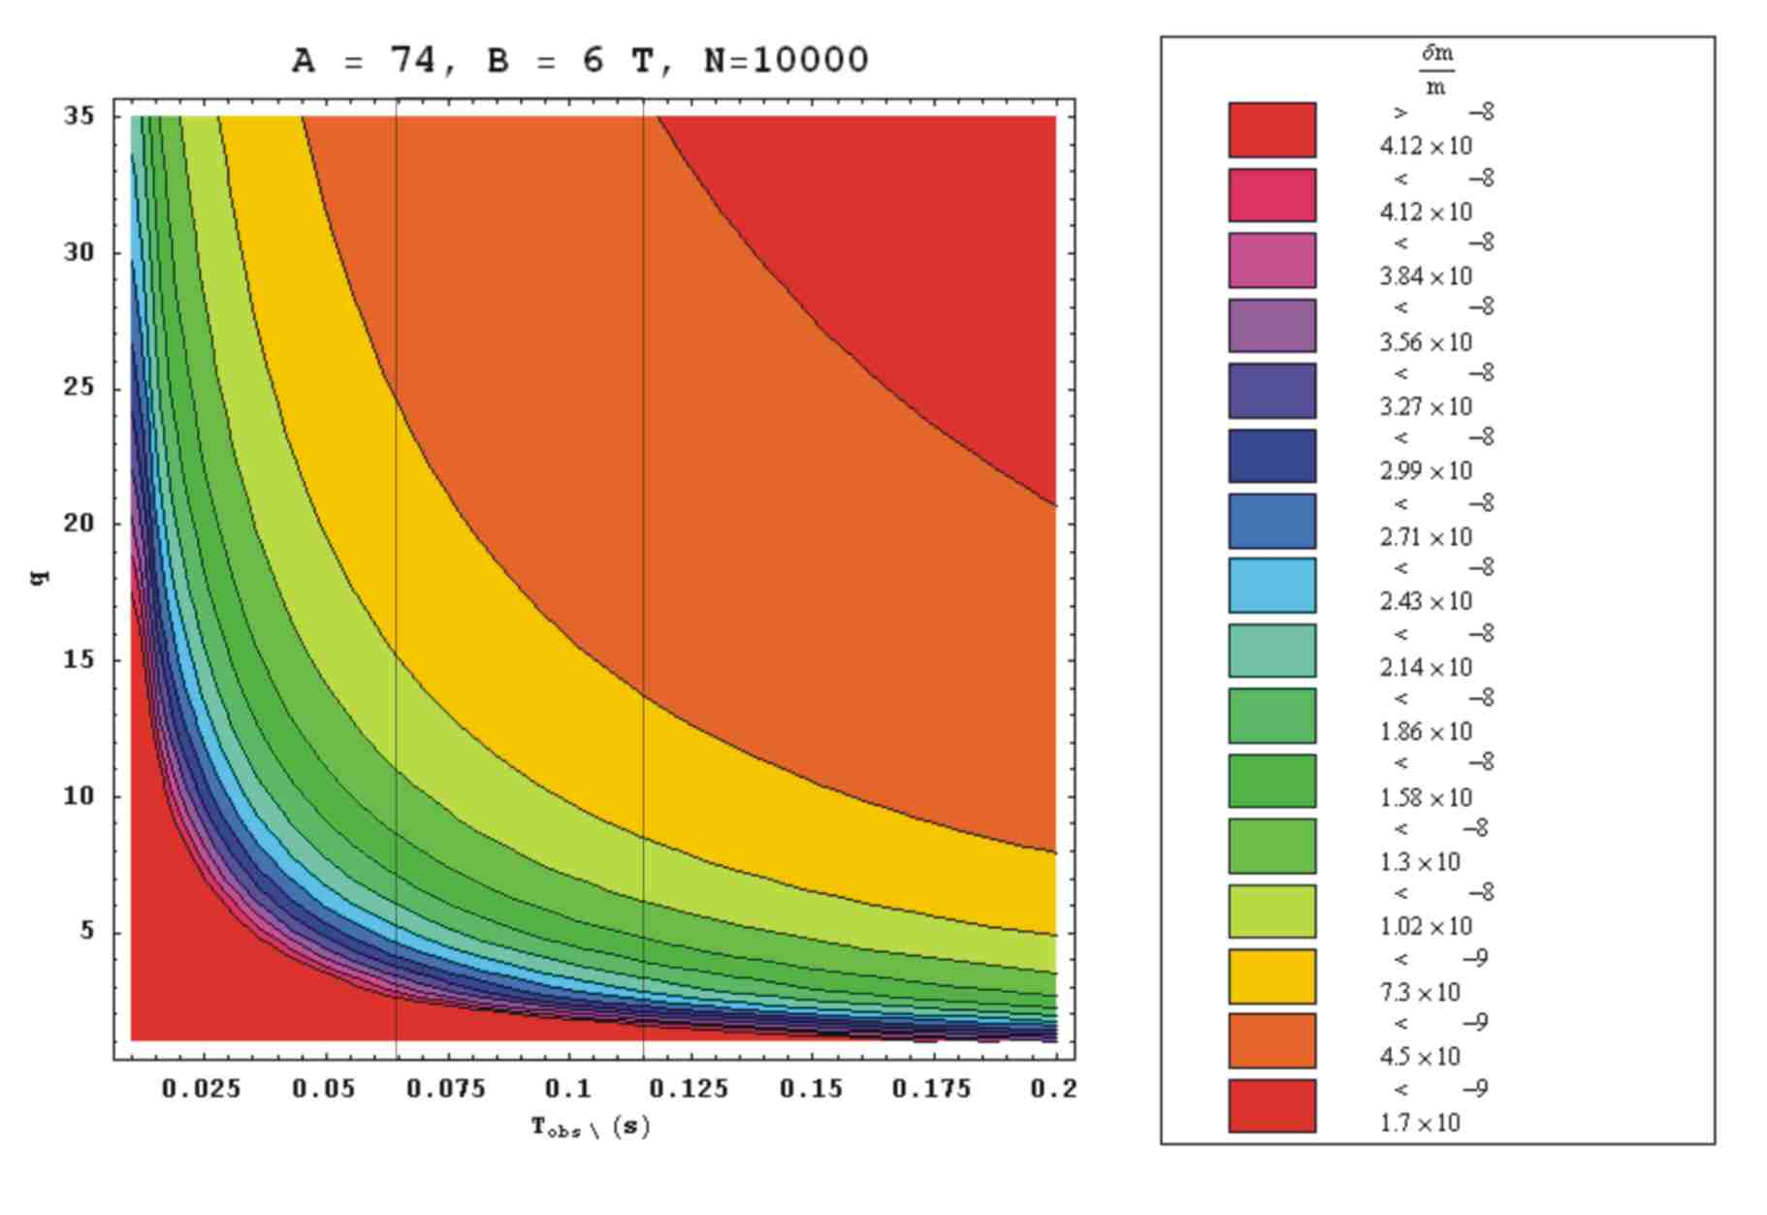
Accuracy of TOF measurements
⁷⁴Rb
Charge State q
Observation Time T_{RF} /s
Use Highly Charged Ions.

Slide 20
Charge Breeding – the EBIT
Radial:
Electron beam space charge & magnetic field
longitudinally: Electrostatic potential
B
e⁻-beam
50 μm
Electrostatic
potential
f
+5 kV
0
Axial potential
(drift tubes)
-2 to -60 kV
One can apply different potentials
to the drift tubes to create a
potential well !!!

Slide 21
The EBIT - Schematic
Cryogen-free superconducting coils
Working parameters:
Max. e-beam energy: ~70 keV
Max. e-beam current: 500 mA (up to 5 A)
Max. magnetic field strength: 6 T
Current density (center): 10⁴ - 10⁵ A/cm²
Einzel
lenses
Retractable e-gun
Magnetic-field distrib.
Electron collector
Trap
Electron gun
_
_
+
Up to ~-60 kV
0 to ~10 kV
Up to ~-60 kV
Dip
~460 mm
~235 mm

Slide 22
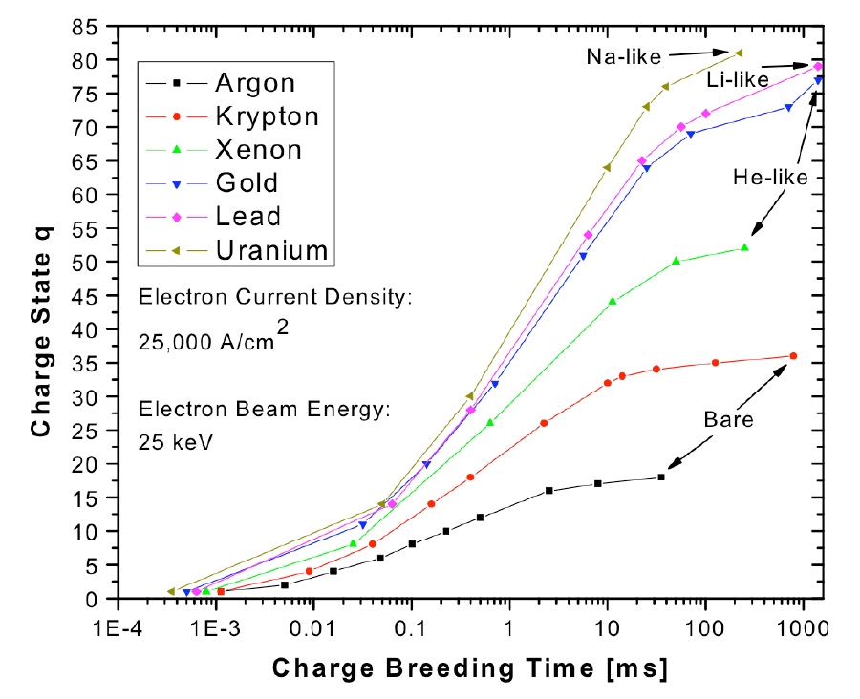
Charge breeding time
For measurements on short-lived isotopes, a rapid production of HCI is crucial!
Kr
CB time < Half Life of Nuclei
⁷⁴Rb half-life: 65 ms
He-like ⁷⁴Rb CB time:~10 ms
Bare ⁷⁴Rb CB time: ~100 ms
Ar, τ~10 ms
Mike Froese Master’s thesis
(Becker’s SUK program)

Slide 23
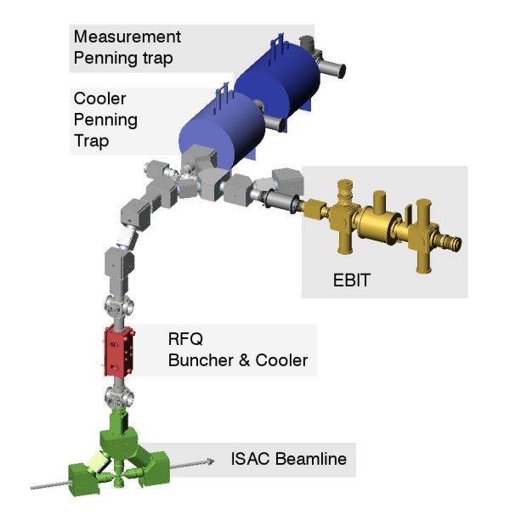
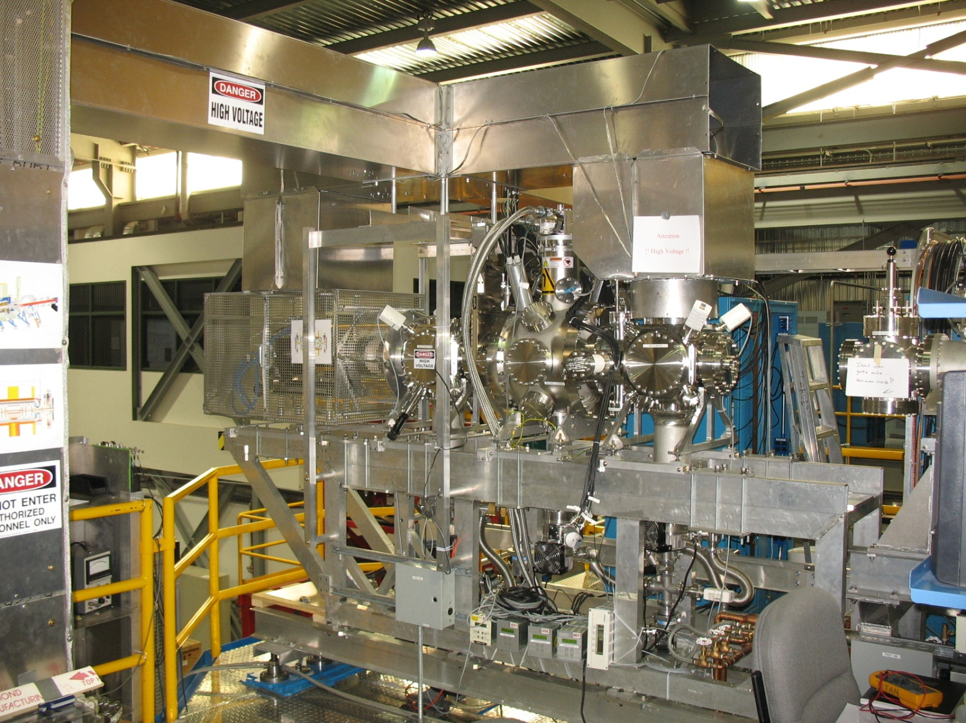
Charge Breeding – the EBIT
High-voltage platform
60 kV high-voltage duct
Beam line under construction
A^{q+}
Magnet / Trap
A⁺
Injection
Extraction
A⁺
Electron gun
(10” cube)
Electron collector
(10” cube)
3m

Slide 24
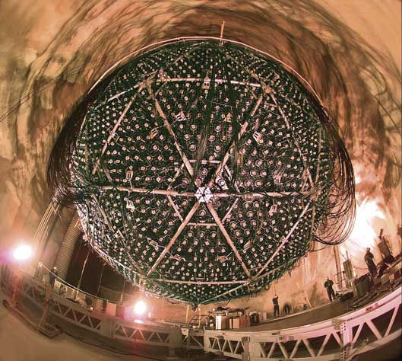
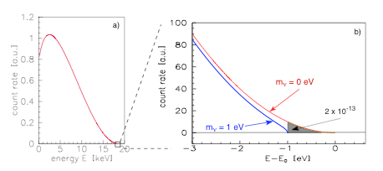
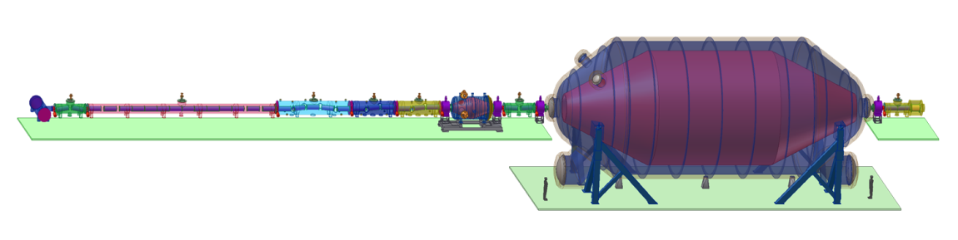
Electron Capture Branching Ratio and the Neutrino mass
Neutrino oscillation
Tritium decay
KATRIN, picture taken from http://students.washington.edu
SNO, picture taken from http://www.oit.on.ca
Relative mass scale
Absolute mass scale
Indicate a neutrino mass
Determination of mixing angle θ_{ij}
Indicate mass hierarchy
Determination of δm²
Endpoint energy of ³H decay
Effective mass for degenerated neutrinos:

Slide 25
Double β decay
Underground labs
Worldwide topic
SNO Lab
GERDA
CUORE
COBRA
EXO
NEMO3
Standard model
New physics
2ν double β - decay
0ν double β - decay
Lepton number violation
Half life> 10 ²⁴ years (⁷⁶Ge)!!!
If observed:
Half life> 10 ¹⁷ years (⁷⁶Ge)
Dirac - Neutrino
Majorana - Neutrino

Slide 26
Theoretical description
Description of double β decay nuclei with nuclear shell-model or proton-neutron Quasiparticle Random Phase Approximation (pn-QRPA)
Adjustable particle-particle parameter g_{pp} in pn-QRPA for all single and double β decay calculations (The many-particle Hamiltonian is a function of g_{pp})
Extrapolation of calculated matrix elements to 2νββ half life provides g_{pp} (g_{pp} ~ 1)
2νββ decay is sensitive to g_{pp}, 0νββ decay is insensitive to g_{pp}
Cross check of g_{pp} with single β⁻ and EC decays
1+
15.8 s
¹⁰⁰Tc
Q_{EC} = 0.168
ε ≈ 0.0018%
Q_{β} = 3.202
¹⁰⁰Mo
β⁻β⁻
¹⁰⁰Ru

Slide 27
Example ¹¹⁶Cd
Recent critical assessment of the theoretical situation
g_{pp} also enters into calculation of single β decay
2. this allows to make (in few cases) precise predictions about EC-rates
in confronting with experiment, theory fails BADLY
(if EC is known)
In case of single state dominance:
expmt
expmt
M_{EC} = 1.4 ε = 0.095% log ft = 3.77 theo
M_{EC} = 0.69 ε = 0.023% log ft = 4.39 exp-1
M_{EC} = 0.18 ε = 0.0016% log ft = 5.5 exp-2

Slide 28
Setup ECBR measurements
X-ray detector
Storage and detection
Penning trap
γ
6 T magnet
Beta detector
(PIPS)
Ion injection
10⁵ – 10⁶ ions
trapped
β⁻
Trap electrodes
TITAN Electron Capture Branching Ratio:
New approach: backing free BR measurements
soft anti-coincidence with β detector
Seven X-ray detectors around segmented trap
2.1% solid angle for X-ray detection after EC
Reduced electron background due to strong magnetic field (6T)
Long holding times in vacuum of P < 10⁻¹¹ mbar

Slide 29
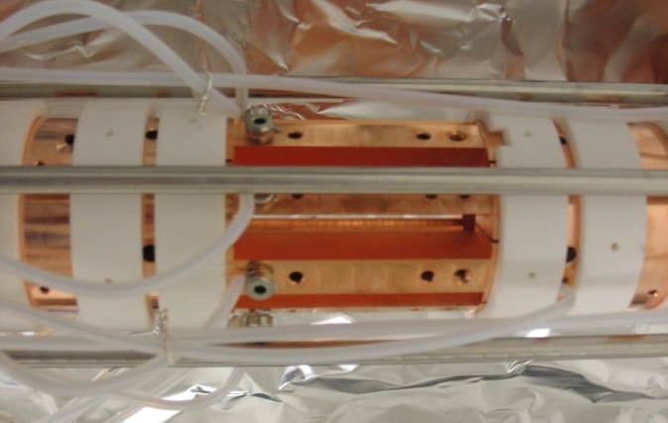
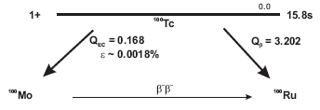
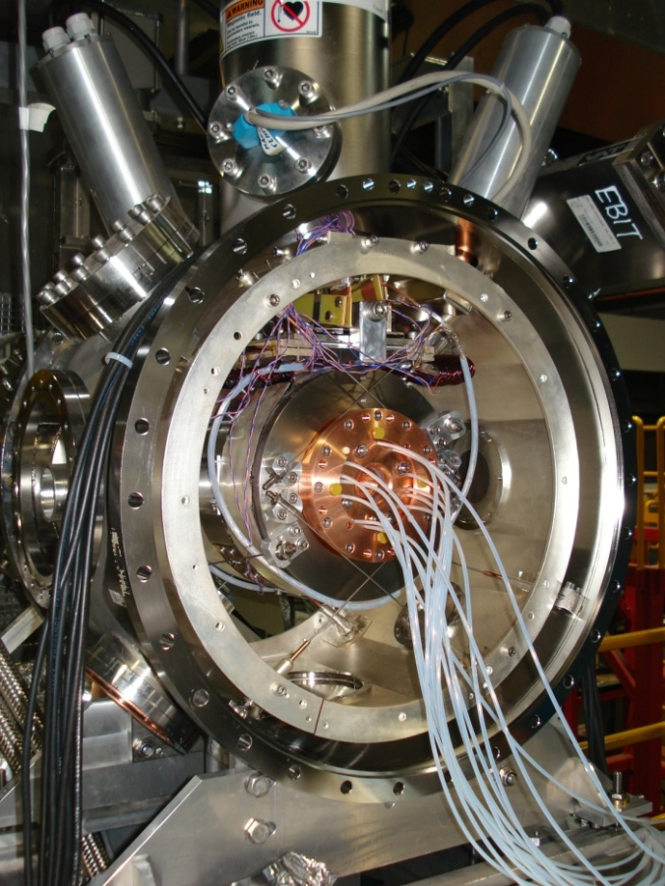
Branching Ratio Measurements
CANDIDATES FOR BRANCHING RATIO MEASUREMENTS
¹⁰⁰Mo : | ¹⁰⁰Tc (EC) | [1+→ 0+, T1/2 = 15.8 s] | K_{α} = 17.5 keV
¹¹⁰Pd : | ¹¹⁰Ag (EC) | [1+→ 0+, T1/2 = 24.6 s] | K_{α} = 21.2 keV
¹¹⁴Cd : | ¹¹⁴In (EC) | [1+→ 0+, T1/2 = 71.9 s] | K_{α} = 25.3 keV
¹¹⁶Cd : | ¹¹⁶In (EC) | [1+→ 0+, T1/2 = 14.1 s] | K_{α} = 25.3 keV
⁸²Se : | ^{82m}Br (EC) | [2-→ 0+, T1/2 = 6.1 min] | K_{α} = 11.2 keV
¹²⁸Te : | ¹²⁸I (EC) | [1+→ 0+, T1/2 = 25.0 min] | K_{α} = 27.5 keV
⁷⁶Ge : | ⁷⁶As (EC) | [2-→ 0+, T1/2 = 26.2 h] | K_{α} = 9.9 keV
10⁵ ions in trap with one half-life measurement cycle:
solid angle: 2.1%
detection efficiency: 30%
5.7 x 10⁻³ EC counts/cycle
100 EC counts → 17636 EBIT fills → 74h
88h proposed for ¹⁰⁰Tc

Slide 30
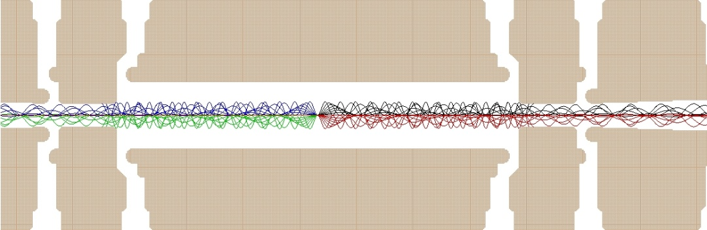
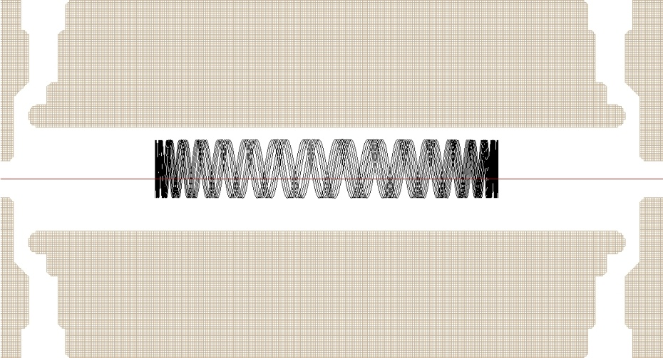
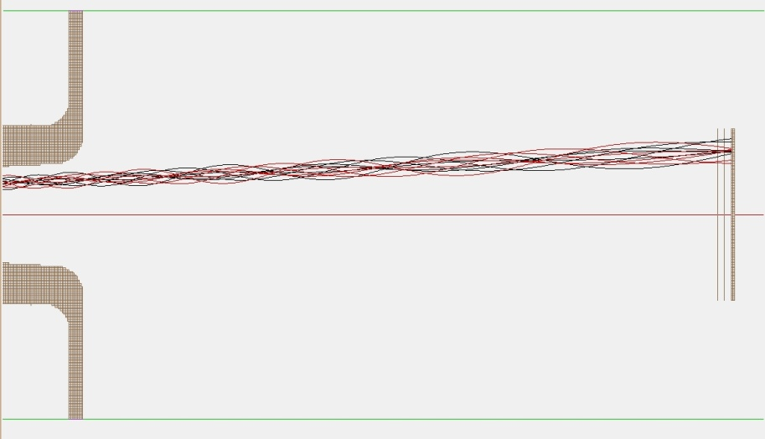
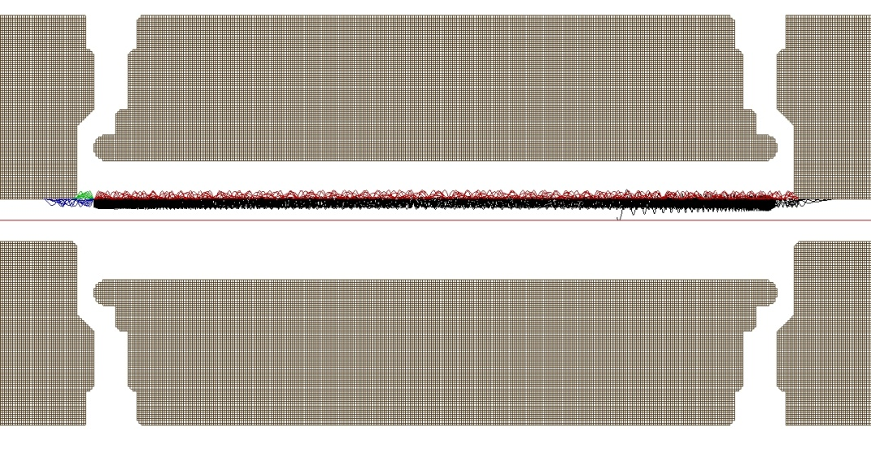
Simulations
Ø5 mm
5 kV
4.7 kV
5 kV
Loss through magnetic bottle for θ > 79deg:
3 MeV electrons
B_{max} = 6T
25 mm
284 mm to center
Loss through wall collisions
→ Rotating wall cooling or side-band cooling

Slide 31
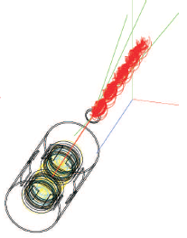
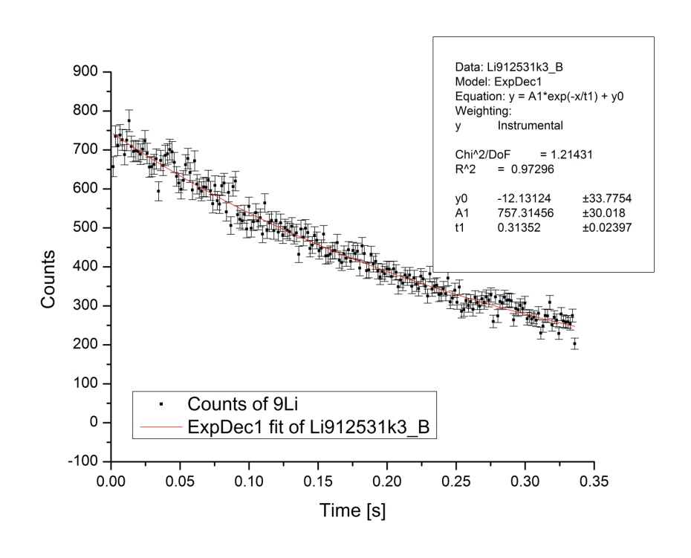
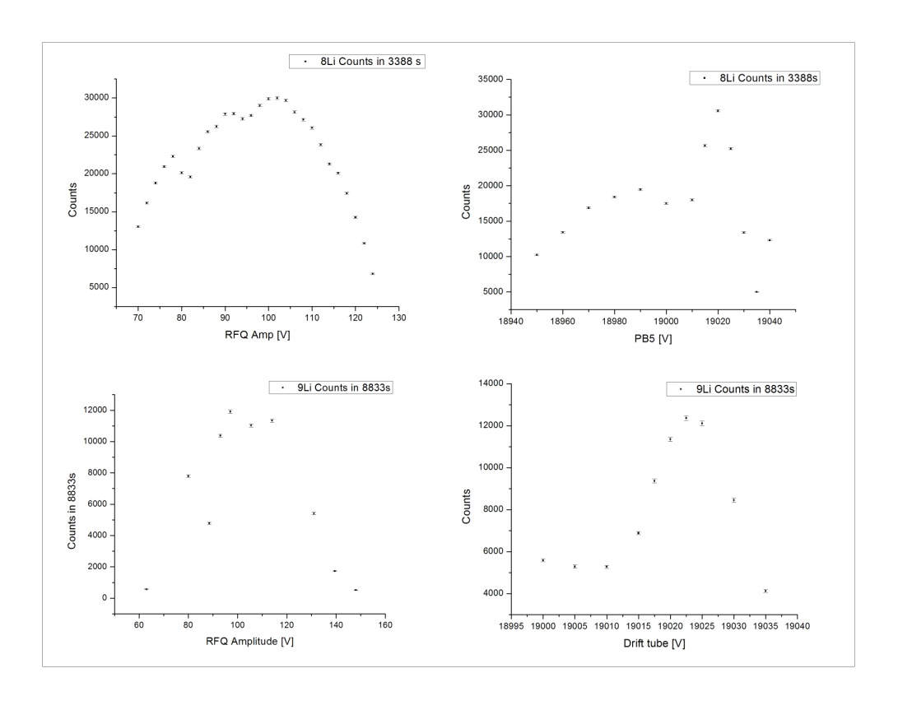
β - detector
Passivated Implanted Planar Silicon detector
⁹Li
Q = 13.6 MeV
T_{½} [lit] = 178.3ms
T_{½} [PIPS] = 217.3(16.6)ms
⁹Li
PIPS
Al- foil
3 MeV electrons hitting a 500μm Si waver
Tuning of beam parameters with counts on a PIPS

Slide 32
Summary
TITAN facility @ TRIUMF: High-precision atomic mass measurements of short lived isotopes
TITAN EBIT is used as a charge breeder to boost the precision of mass measurements
TITAN EBIT won’t be limited to charge breeding…
…for the future
TITAN facility: there are more masses of halo nuclei to be determined
TITAN EBIT will be connected to the TITAN beam line (EBIT was commissioned in August 2006).
First EC branching ratio measurements with the EBIT by the end of this year

Slide 33
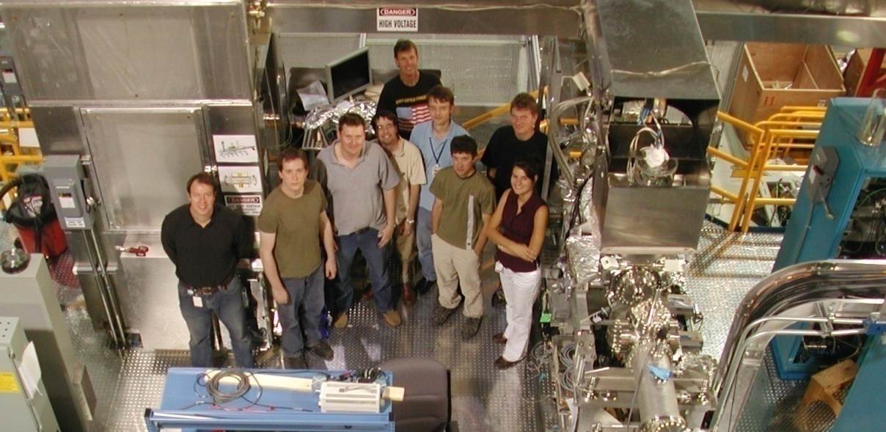









People/Collaborations
M. Brodeur, T. Brunner, C. Champagne, J. Dilling, P. Delheij, S. Ettenauer, M. Good, A. Lapierre, D. Lunney, C. Marshall, R. Ringle, V. Ryjkov, and M. Smith, for the TITAN collaboration.
U. of Manitoba
McGill U.
Muenster U.
MPI-K
GANIL
U. of Calgary
U. of Windsor
Colorado School of Mines
UBC
TU München

Slide 34






TITAN RFCT
400 Vpp applied RF at up to 3 Mhz
68% DC efficiency for ¹³³Cs⁺ in He
15% DC efficiency for ^{6,7}Li⁺ in He
60% DC efficiency for ⁶Li⁺ in H₂
Pulses as short as 50 ns FWHM @ up to 1 kHz
Reversed extraction successfully demonstrated with ¹³⁶Xe from OLIS

Slide 35
Research Plans: AMS
EBIT for AMS: Accelerator Mass Spectrometry
Isobar separation using HCI
Example with Bare ions:
Bare Ca-41: q/m=+20/41
Bare K-41: q/m=+19/41
C. Vockenhuber,
Research Associate

Slide 36

2νββ decay
accessible thru charge-
exchange reactions in
(n,p) and (p,n) direction
( e.g. (d,²He) or (³He,t) )

Slide 37

0νββ decay
mass of Majorana neutrino
nucl. matrix element
NOT accessible thru
charge-exchange reactions
Forbidden in Standard Model
lepton number violated
neutrino enters as virtual
particle, q~0.5fm⁻¹

Slide 38

Change of Neutron Rich
Nuclear Structure
Structure Changes:
Deformation
Shape coexistence
Variation of spin-orbit strength
Structure change are seen through two-neutron separation energy:
S_{2n} = M(A-2, Z) – M(A,Z) + 2M_{n}
(allows to avoid pairing effects)
Appearance of new magic
number N = 16.
Disappearance of magic
number N = 20 & 28.
H. Savajols et al., Eur. Phys. J A 25, s01, 23 (2005)

Slide 39

Two Neutron separation
S_{n} (keV)

Slide 40

TITAN Facility
Mass measurements on isotopes
with short half-life T_{1/2} ≈ 10 ms and
low production yields (≈ 100 ions/s)
with high precision of up to δm/m ≈ 10⁻⁹.
Ideally, uniquely matched to ISOL-type production mode.
TITAN received funding April 2003 and performed first mass measurements on ⁸He, ⁸Li, ⁹Li and ¹¹Li in 2007.
Versatile and flexible facility, can be used for other applications:
Branching ratio measurements
Laser spectroscopy on cooled and bunched beams
Charge radius measurements via x-ray spectroscopy
Accelerator Mass Spectrometry
low yield & short half-lives
Interest: CKM, nucleosynthesis
Interest: nucleosynthesis, nuclear
structure, halo nuclei

Slide 41
TITAN Facility
Mass measurements on isotopes with short half-life T_{1/2} ≈ 10 ms and
low production yields (≈ 100 ions/s) with high precision of up to δm/m ≈ 10⁻⁹.
RFQ tested with Li, Xe and Cs and an emittance < 4 mm mrad at 4 keV was determined.
Pulses as short as 50 ns FWHM @ up to 1 kHz.
Reversed extraction successfully demonstrated with ¹³⁶Xe from OLIS.
Ideally, uniquely matched to ISOL-type production mode.
TITAN received funding April 2003 and performed first mass measurements on ⁸He, ⁸Li, ⁹Li and ¹¹Li in 2007.
Versatile and flexible facility, can be used for other applications:
Branching ratio measurements
Laser spectroscopy on cooled and bunched beams
Charge radius measurements via x-ray spectroscopy
Accelerator Mass Spectrometry

